Slide 1
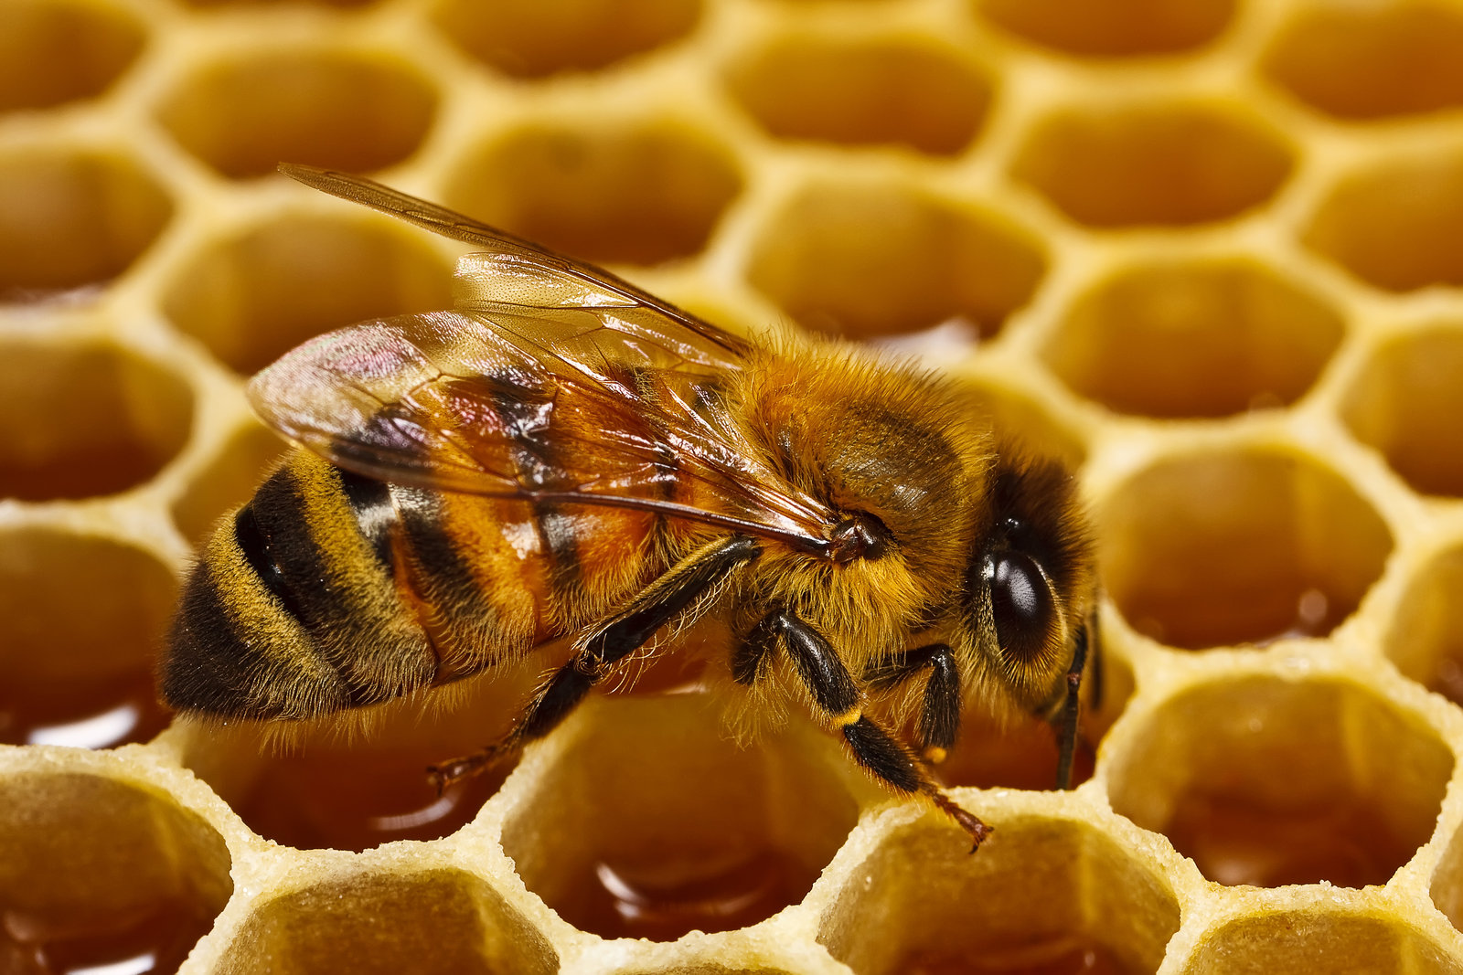
Getting Your First Bees
Christopher Heathcote
MCBA November, 2019
Short Course

Slide 2
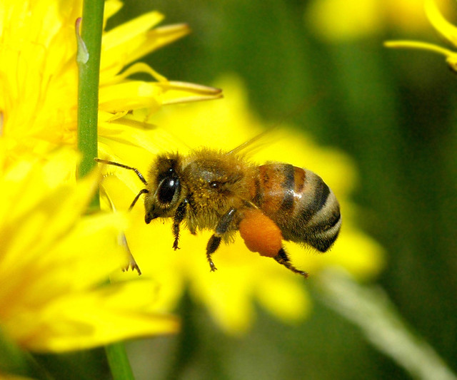
Where Will You Get Your Bees?
Sources of Honey Bees
Packages
Nucleus Hives (Nucs)
Wild/Feral Bees
Swarms

Slide 3
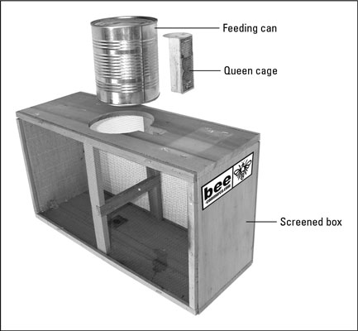
Packaged Bees
What is a Package?
A screened box containing several
pounds of bees, food, and a queen.
Usually shipped from southern
states, Hawaii, or California.

Slide 4
Packaged Bees, cont.
PROS of a Package

Slide 5
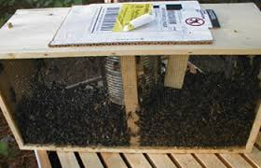
Packaged Bees, cont.
Pros of a Package
Will get bees earlier in the spring.
(Bees should be ordered in Dec or Jan)
Easier for Beginners to work: fewer bees.
More adult bees than in a nucleus colony.
Certified as apparently healthy (mite free).

Slide 6
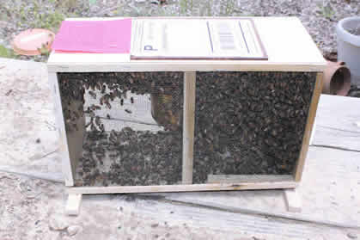
Packaged Bees, cont.
Pros of a Package
No Brood Disease.
Easy to obtain a replacement queen.
Less Expensive than a NUC.

Slide 7
Packaged Bees, cont.
CONS of a Package

Slide 8
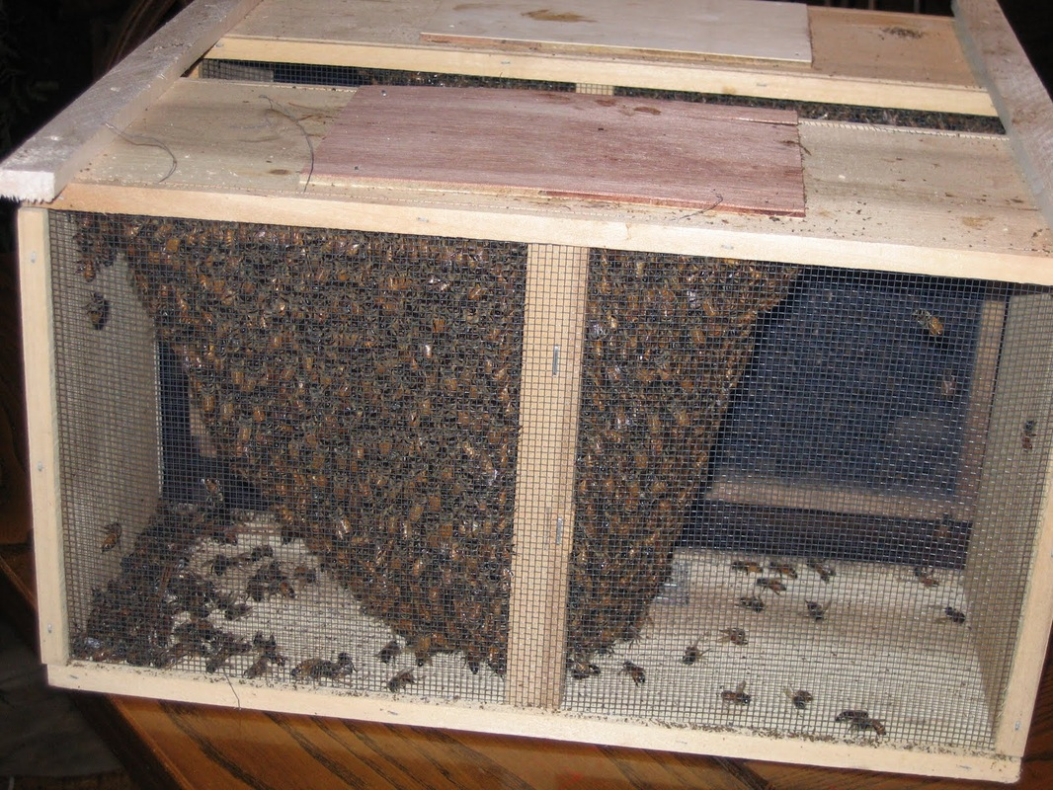
Packaged Bees, cont.
Cons of a Package
Queen could become injured or lost
due to stress of shipment.
Bees have a foreign queen
(from a queen bank).
There is no drawn comb.
Drifting is common.

Slide 9
Packaged Bees, cont.
Cons of a Package, cont.
There are no eggs, larvae, or capped brood
until queen starts to lay (needs drawn comb).
No new bees until new adult bees emerge
in 21 days.
Success depends on the weather:
Too cold- bees will not feed and could starve.
Bees may not forage if too cold.

Slide 10
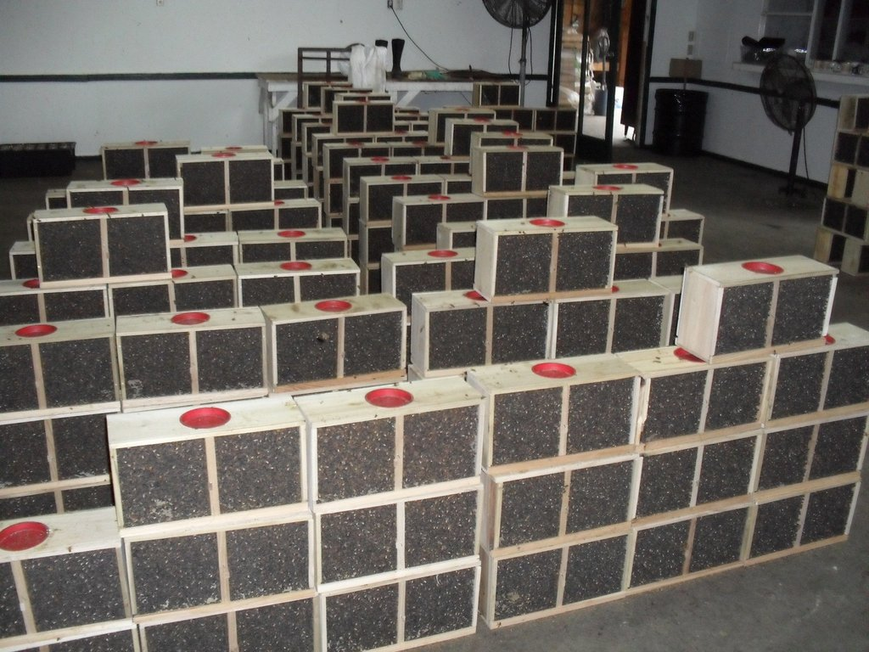
Packaged Bees, cont.
Cons of a Package, cont.
Bees MUST be fed heavily 1:1 syrup to stimulate
wax production in order to draw out comb.
Bees must be fed protein supplement until
flowers bloom.
Bees could be infested with mites or hive beetles.
Disease, such as virus, may be present.
https://www.apishive.com/resources/how-to-install-a-3-lb-package-of-honey-bees

Slide 11
Packaged Bees, cont.
Installing a Package

Slide 12
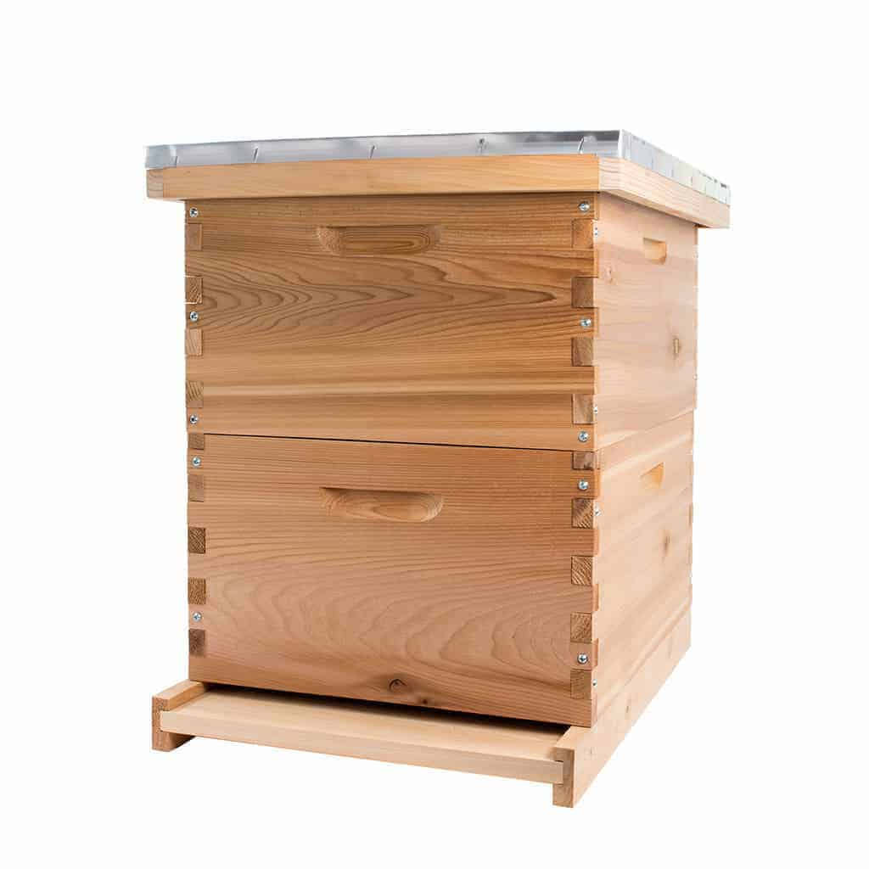
Installing Packaged Bees
BEFORE the Package Arrives
Equipment should be readied and placed WELL BEFORE the package arrives.
Hive Stand
Bottom Board (IPM)
2-3 hive bodies with frames of foundation
or drawn comb.
Inner Cover
Feeder (and feeder box) for 1:1 sugar syrup
Telescoping Cover
Entrance should be closed until bees are installed
Before the package arrives: make 1:1 sugar syrup.
Before the package arrives: have pollen patty on hand.

Slide 13
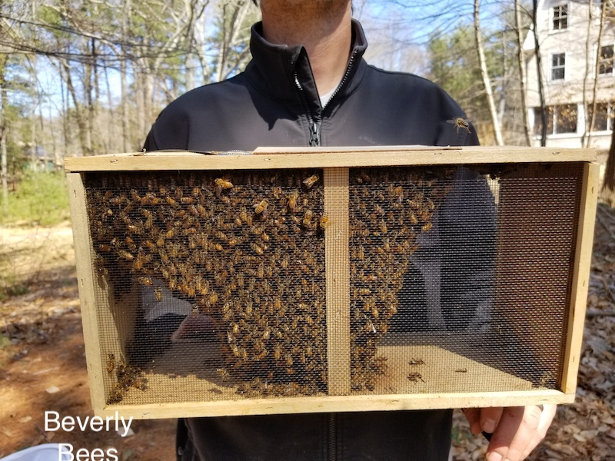
Installing Packaged Bees
WHEN the Package Arrives
Check for the Certificate of Inspection.
Keep the package in a cool (not cold), draft-free,
quiet, and darkened area: NOT IN YOUR HOUSE!
Package should be installed as soon as possible
Feed the bees by spraying the screen liberally
with sugar syrup.

Slide 14
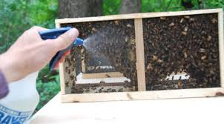
Installing Packaged Bees
Installing the BEES
Place the small opening of the entrance reducer
into hive bottom board.
Feed by spraying the screen continuously
½ hour prior to installing.
Firmly bump or jar the package downward
so the bees fall to the bottom of the box.

Slide 15
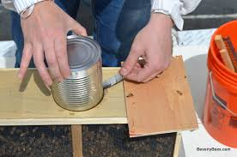
Installing Packaged Bees
Remove the plywood lid to expose feeder can and queen cage tether.
Remove the feeder can and the queen cage:
Take great care to ensure the queen cage
does not fall to the bottom of the box.
Replace the plywood lid to keep the
bees from escaping.
Inspect queen in the cage, if alive:
Place Queen cage in pocket or a shady place

Slide 16
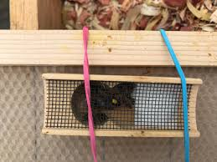
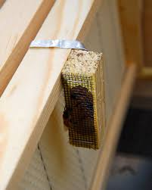
Installing Packaged Bees
Remove the cork plug from the candy side of the cage.
Place the queen cage against the central frame.
Use a rubber bands or staple tether to top bar.

Slide 17
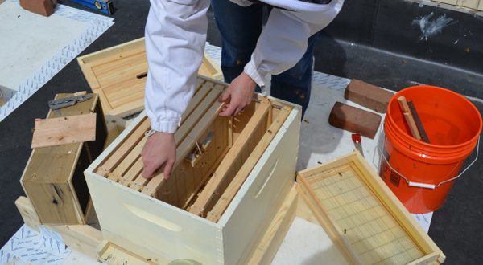
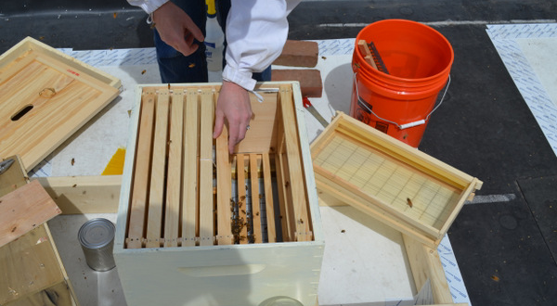
Installing Packaged Bees
Place frame with queen in the middle of the hive.
Then place another frame against queen cage to protect the queen when installing the bees.

Slide 18
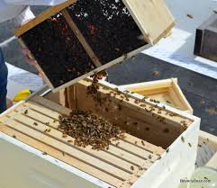
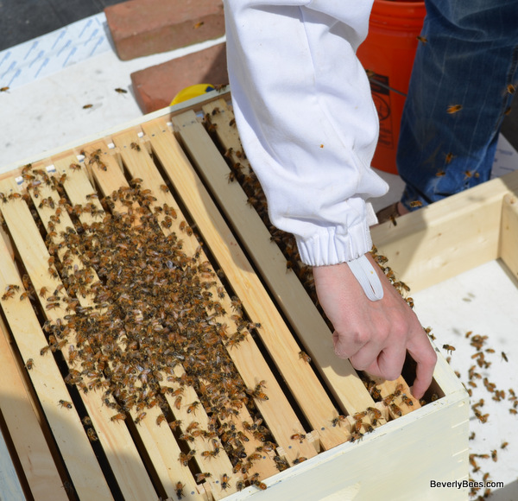
Installing Packaged Bees
Shake the bees into the hive body, then gently place the remaining frames into the box. Don’t work about getting all the bees into the box. The stragglers with find their way.

Slide 19
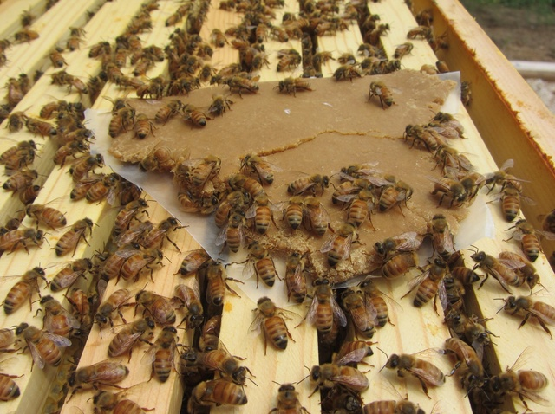
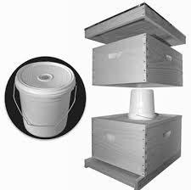
Installing Packaged Bees
Place pollen Patty on top bars.
Place inner cover, feeder, and feeder box
on hive body and place telescoping cover
on top.
Bees MUST be fed heavily 1:1 syrup to
stimulate wax production in order to
draw out comb.
Bees MUST be fed protein supplement
until flowers bloom (pollen patty).

Slide 20
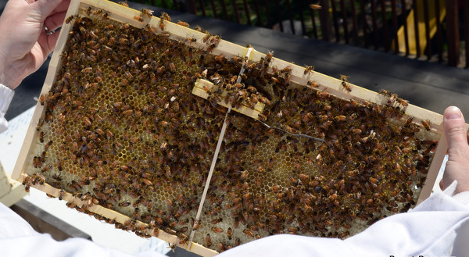
Installing Packaged Bees
Leave Hive Alone for 3-5 days, then open and check to make sure queen was released.
Remove empty queen cage and close
the hive up.
Leave hive alone for the next 14 days
except to add syrup to feeder.
FEED THE BEES!!!
https://www.youtube.com/watch?v=MZknUirqbQk

Slide 21
NUCLEUS HIVE
Nucleus Hive
aka: A NUC

Slide 22
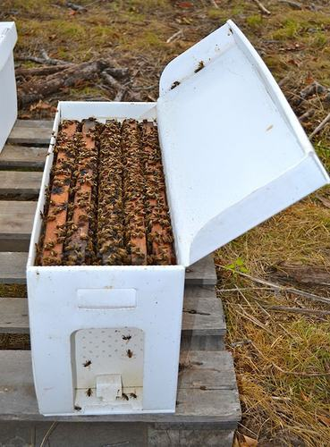
Nucleus Hive (aka: NUC)
What is a Nucleus Hive?
Consists of 5 frames of drawn comb that contain:
Adult bees
Eggs
Larvae 2 frames
Capped brood
Laying Queen
Honey Stores……1 frame
Pollen Stores…...1 frame
Foundation………1 frame

Slide 23
NUCLEUS HIVE (aka: NUC)
PROS of a NUC

Slide 24
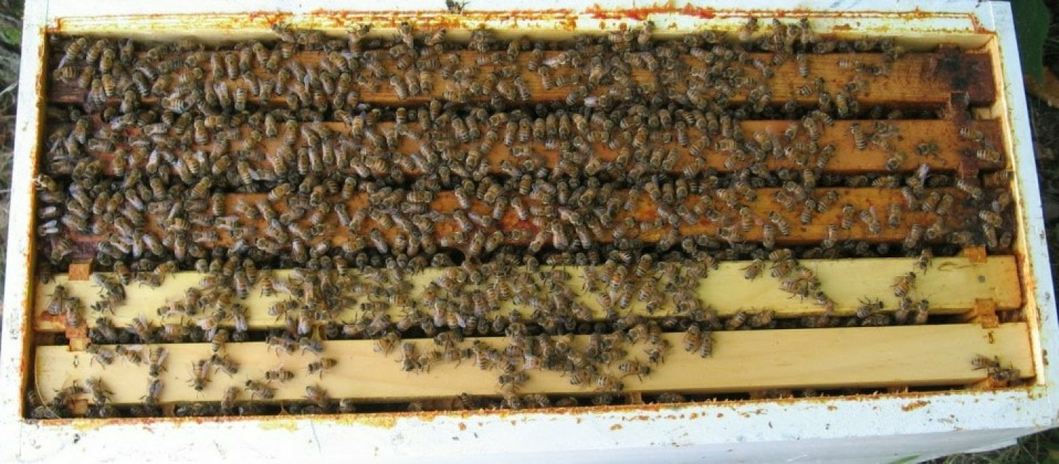
NUCLEUS HIVE (aka: NUC)
Pros of a Nuc
It is a fully functional hive:
Laying Queen
Worker Bees
Eggs, Larvae, Capped Brood
Drawn Comb
Honey Stores
Pollen Stores
Produces surplus honey

Slide 25
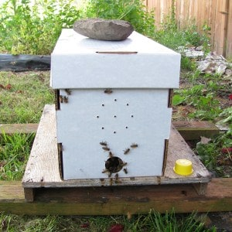
NUCLEUS HIVE (aka: NUC)
Pros of a Nuc, cont.
Easy way to get a hive going.
Usually cared for by an expert
Are available locally (assistance)
Easy to transfer into hive body.
Included all ages of bees
Quicker turn around than a package:
New bees emerge immediately
Easy to transport

Slide 26
NUCLEUS HIVE (aka: NUC)
CONS of a NUC

Slide 27
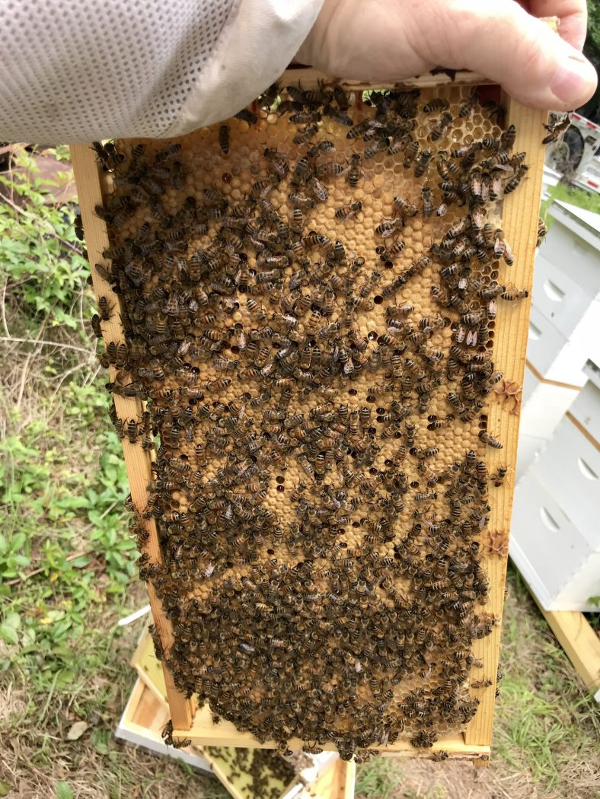
NUCLEUS HIVE (aka: NUC)
Cons of a Nuc
Nuc box and frames (if not new) may contain
disease or pesticide residue.
Queen could be old of poor quality.
Bees may require additional feeding and/or medication.
Nuc may be infested with mites or small hive beetles.
Additional equipment is need if Nuc grows fast.
More expensive than a Package.

Slide 28
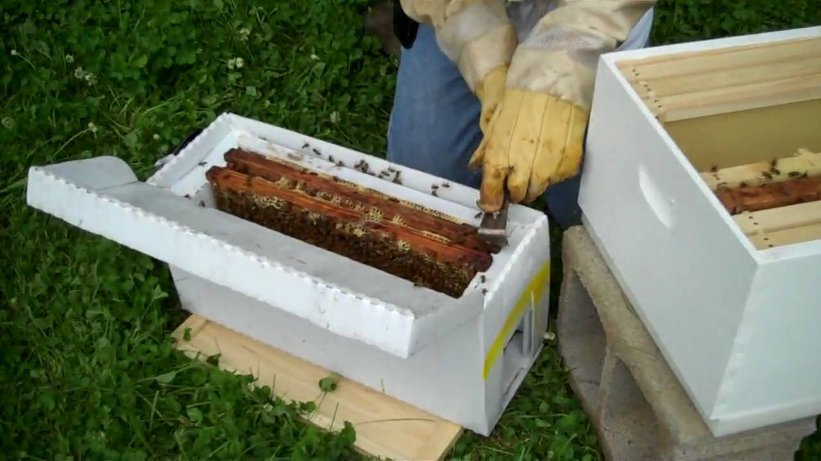
INSTALLING A NUC
BEFORE the NUC Arrives
All equipment should be readied and placed WELL BEFORE the nuc arrives.
Place entrance reducer with small opening into bottom board.
Open the full-size hive box and remove
all frames of foundation from the hive body.
Slowly open the nuc box.
Slowly transfer each frame (in the same order)
from the nuc box into the center of the hive body.
Fill out the edges of the hive body
with frames of foundation.

Slide 29
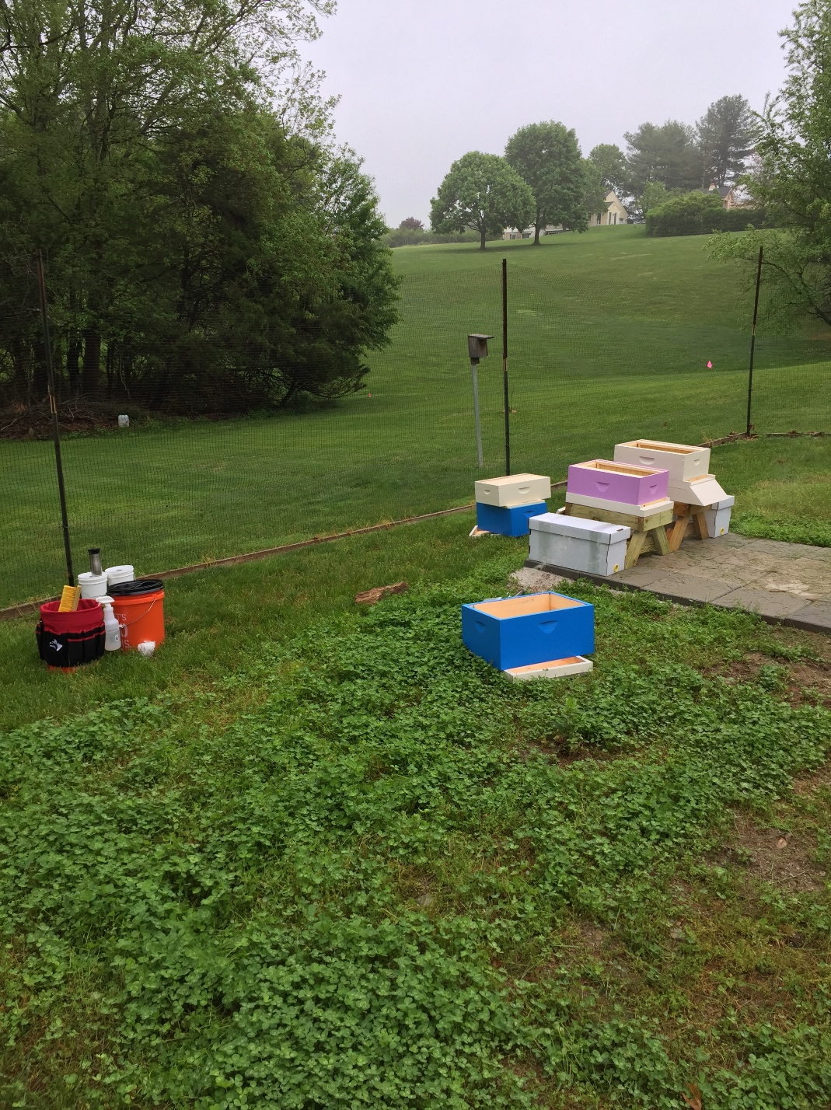
INSTALLING A NUC
Here was my setup when I installed my Nucs.

Slide 30
NUCLEUS HIVE (aka: NUC)
Place pollen patty on top bars.
Place the inner cover on hive body.
Place feeder on inner cover.
Place box around feeder.
Place telescoping cover on top of
YOUR NEW BEEHIVE!!!!!
FEED THE BEES!!!

Slide 31
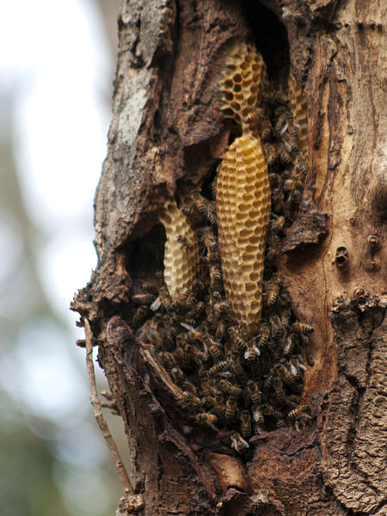
Feral Bees (FREE!)
Bees naturally live in a tree trunk.
Known as feral bees or a feral colony.
Feral colonies are unmanaged.
Pose a significant risk of mites and disease.
AND…
Generally have to cut the tree down and
open trunk to remove the bees and queen.

Slide 32
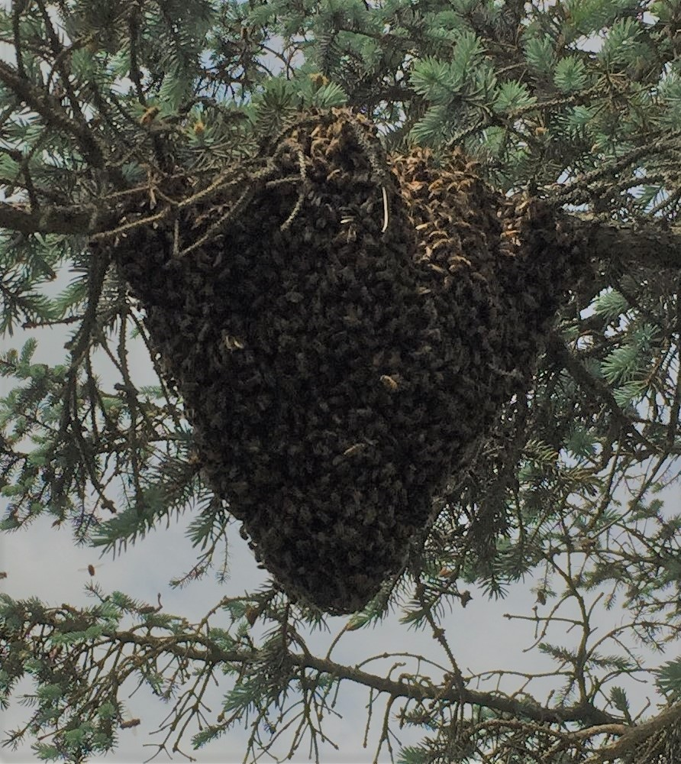
Swarms (FREE!)
Swarms are the way bees naturally propagate.
Swarms come from established colonies.
(either feral or managed)
The queen and ~1/2 the bees leave the hive.
and land somewhere nearby.

Slide 33
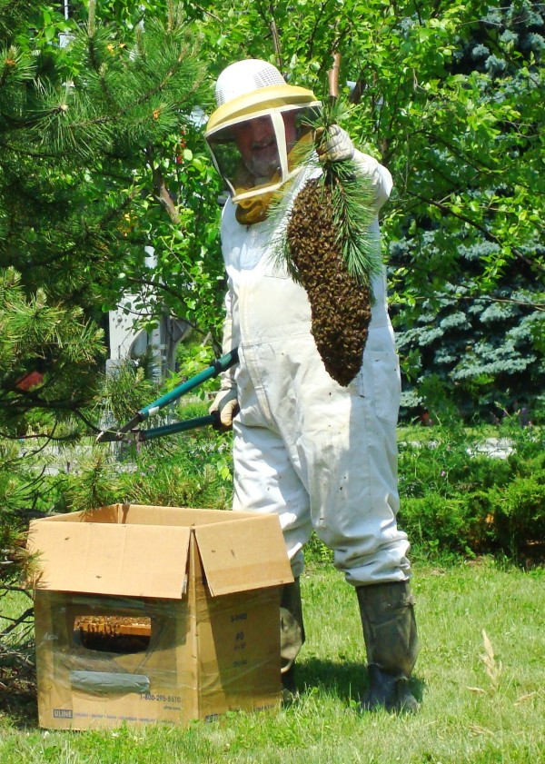
Swarms (FREE BEES!)
If your lucky enough you can catch the
actual swarm itself!

Slide 34
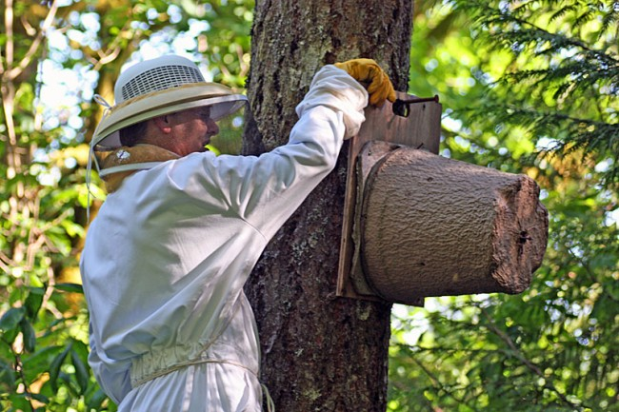
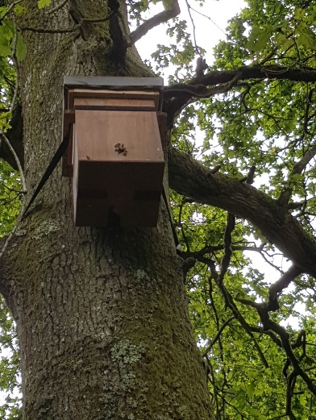
Swarms and Feral Bees (FREE!)
You can catch swarms in a swarm trap.

Slide 35
Welcome to the Fascinating World of Honey Bees!
QUESTIONS?????

