Slide 1
Summer Management
July through September

Slide 2
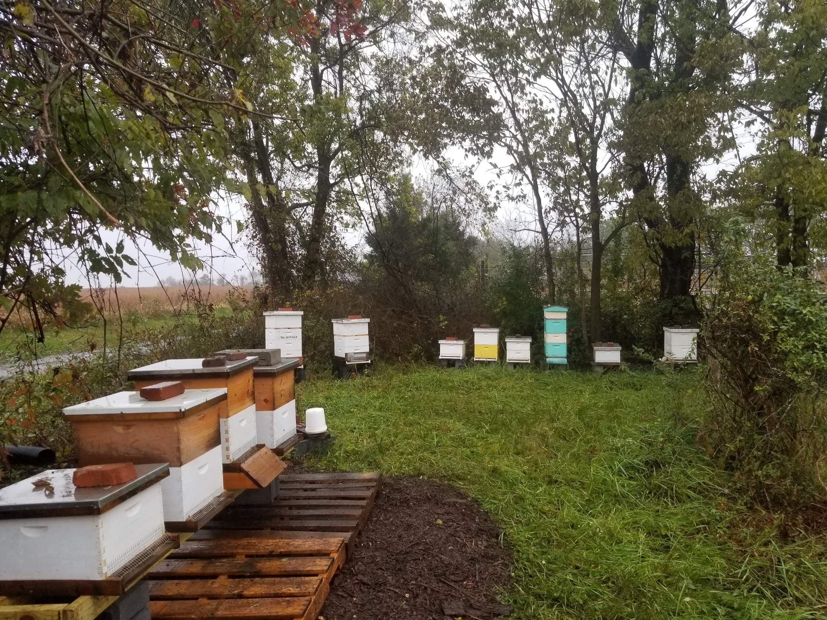

Slide 3
Topics to be covered
Harvesting supers
honey
pollen
propolis
wax
Inspections
Treating for mites
Feeding

Slide 4
Honey Harvest time

Slide 5
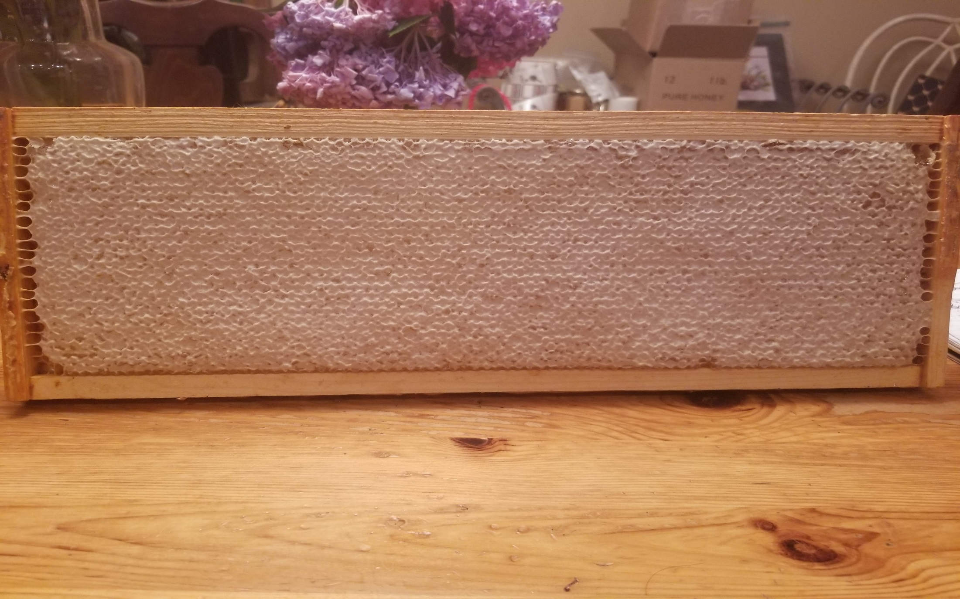

Slide 6
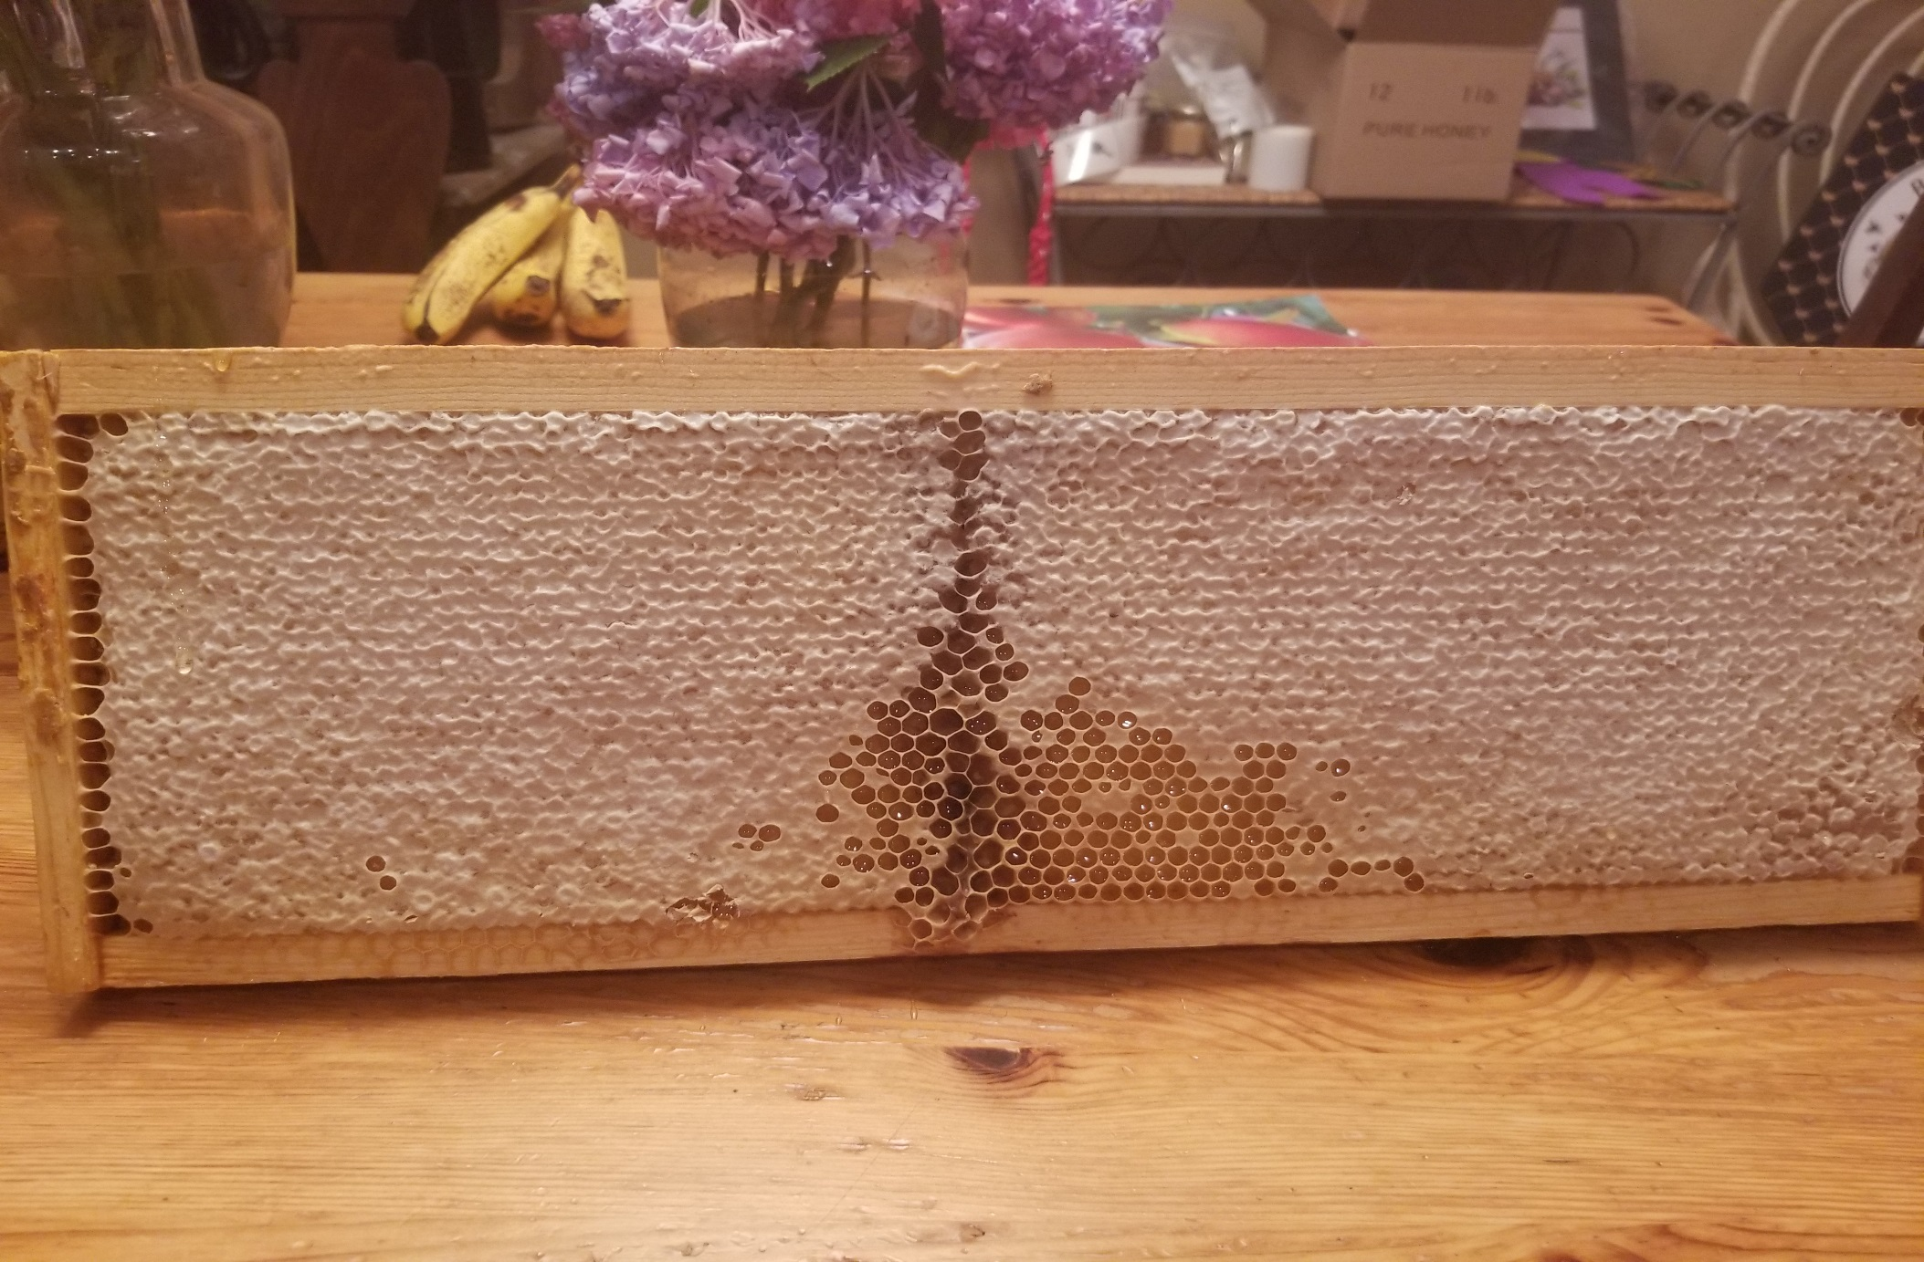

Slide 7
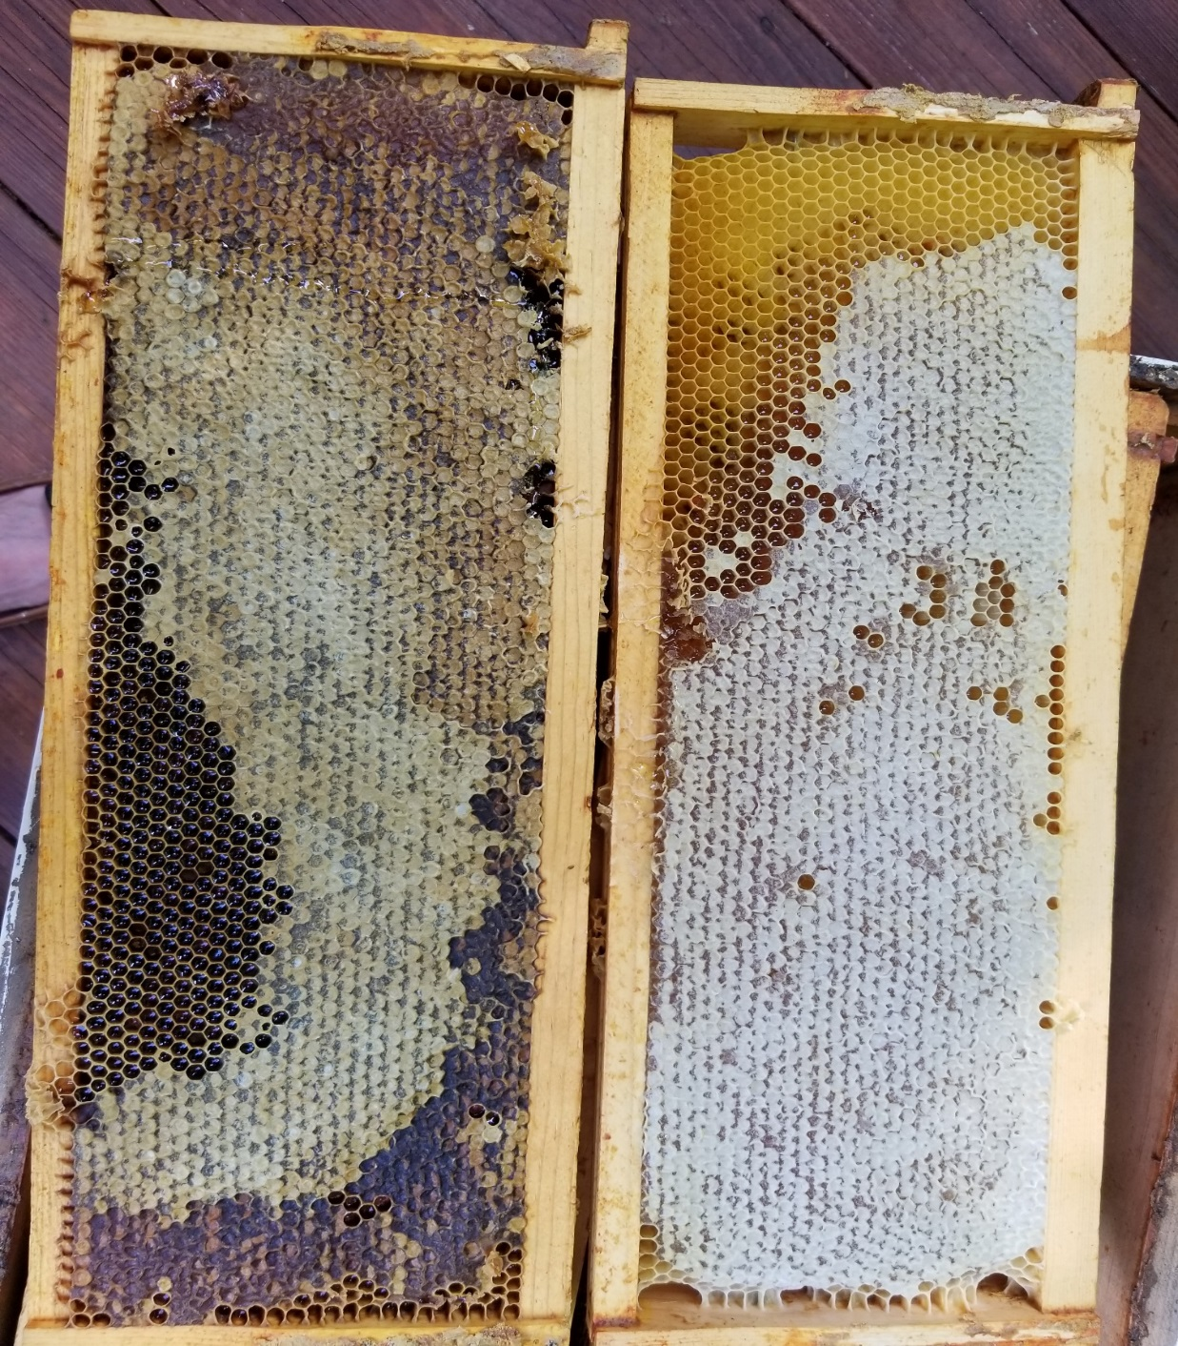

Slide 8
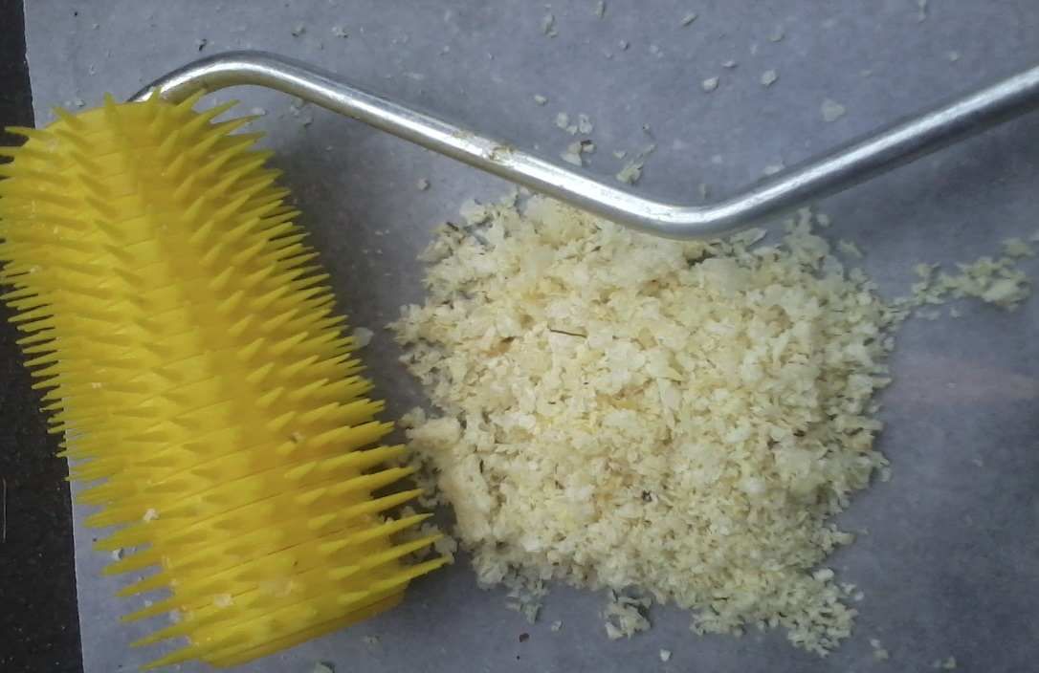
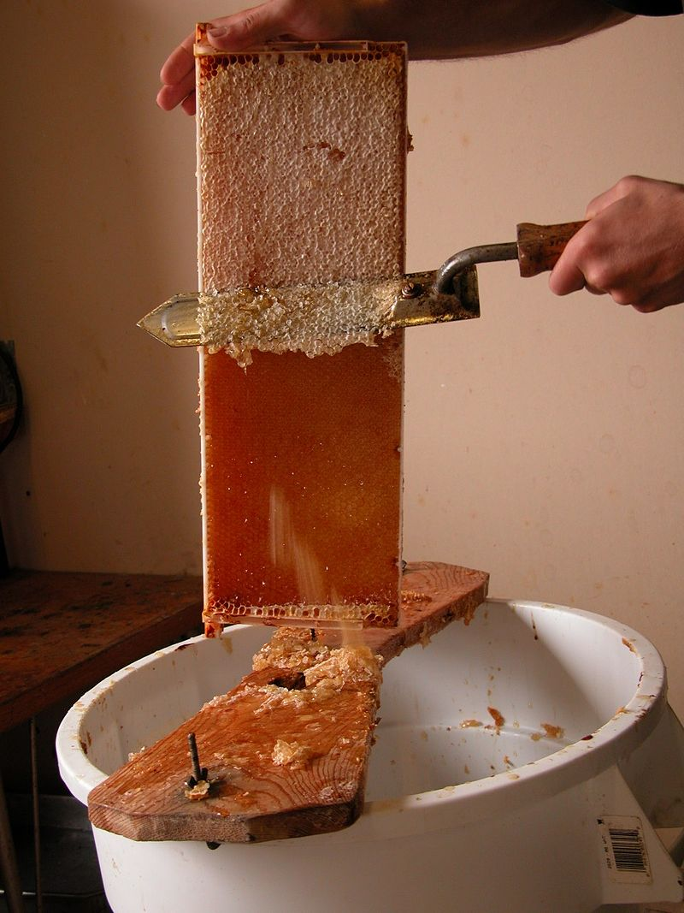

Slide 9
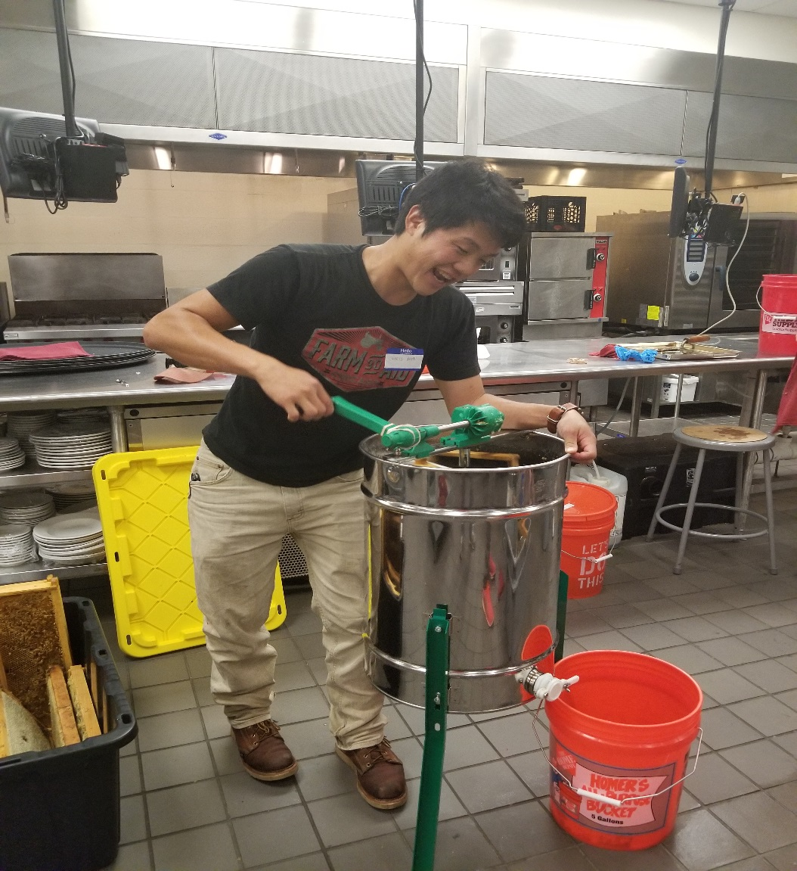
Harvesting Honey
Take honey when frames are ready. Why wait?

Slide 10
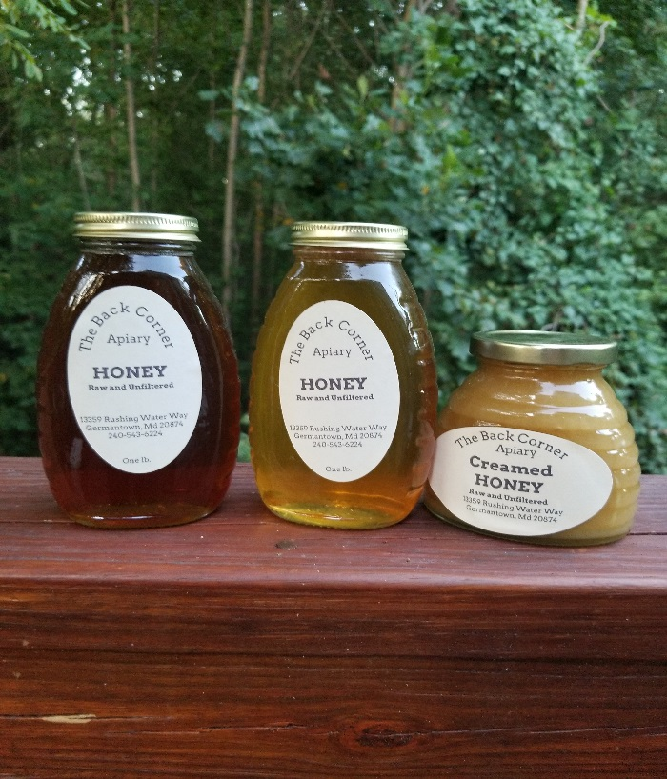
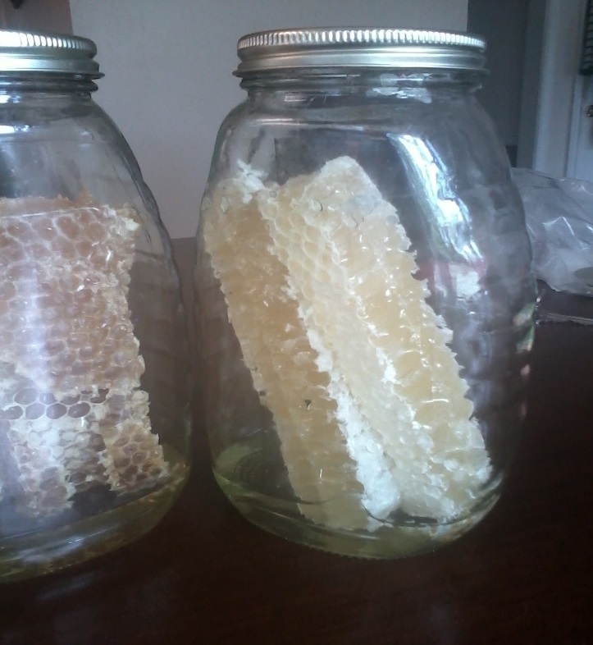
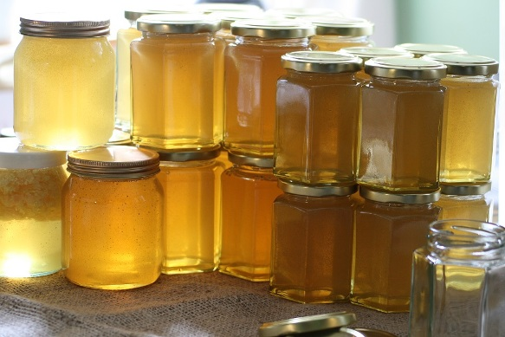

Slide 11
Collecting Pollen

Slide 12
Uses of pollen

Slide 13
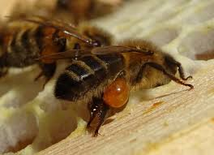
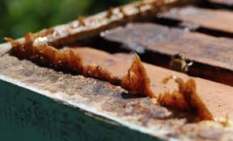
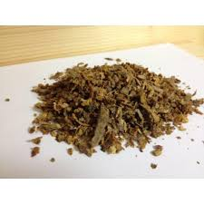
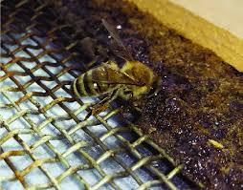
Propolis Tree sap and plant resins

Slide 14
Uses of Propolis
Tinctures for medicinal purposes
Throat spray
Cough drops
Capsule form
Varnishes for furniture

Slide 15
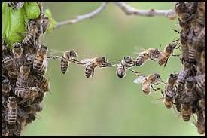
WAX

Slide 16
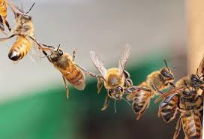
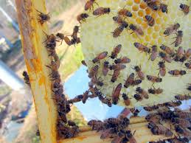

Slide 17
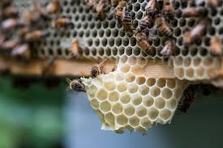
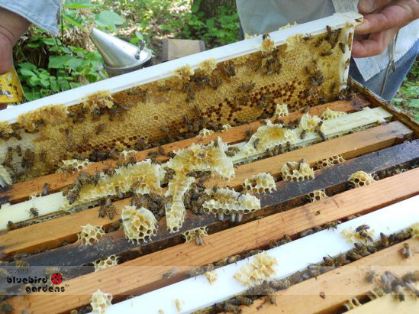

Slide 18
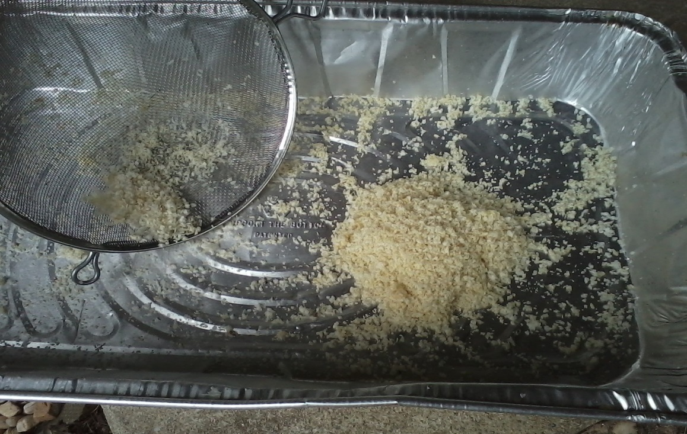
Wax cappings

Slide 19
Uses for wax
Candles
Cosmetics – lotions, salves, lip balms
Furniture wax
Ornaments
In bulk blocks for sale, or show
Honeycomb for consumption

Slide 20
Inspections
What should you look for?
How often?

Slide 21
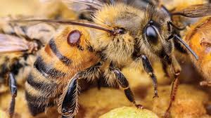
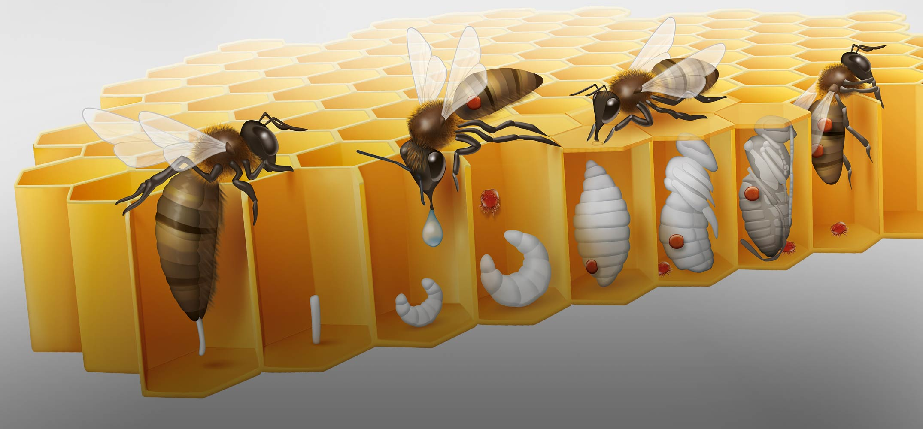
Treating for mites
Test
Treat
Repeat

Slide 22
Feeding
Depends on how much honey was taken
the stage of development of the hive
weather and timing of the dearth
making summer splits

Slide 23
Robbing
What are the signs?
Methods to discourage
Do’s and don’ts

