Slide 1
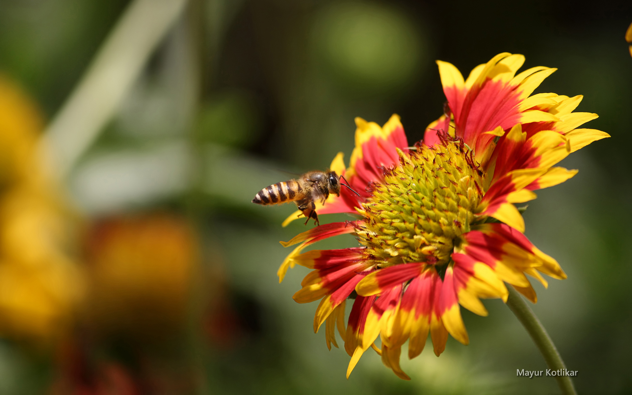
MCBA SHORTCOURSE

Slide 2
Welcome to MCBA
Montgomery County Beekeepers Association

Slide 3
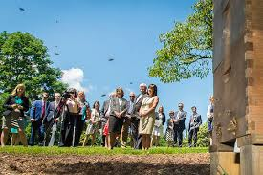
MCBA
500 Members and counting

Slide 4
MCBA
You are now a member with your sign up for this short course
Our website sign in is available for your use
Listserv is available for dialog among other beekeepers

Slide 5
MCBA
Activities Include
Short Course
Monthly Meetings
Social events
Educational Outreach
Montgomery County Fair

Slide 6
MCBA
We have a fantastic web-site, Please create a login
You can borrow extractors from our Extractor Czars

Slide 7
MCBA
The Short Course is an introduction to
Langstroth Hives
Top Bar Hive

Slide 8
MCBA
Setting up you hives
Ordering and Installing the Bees for the Hives
Hive Management

Slide 9
MCBA
Bee Diseases
Feeding
Special Hive Placement
Size of Your Hive (10 frame or 8 frame)

Slide 10
MCBA
At each session we will have members available to answer questions and to guide you in decisions

Slide 11
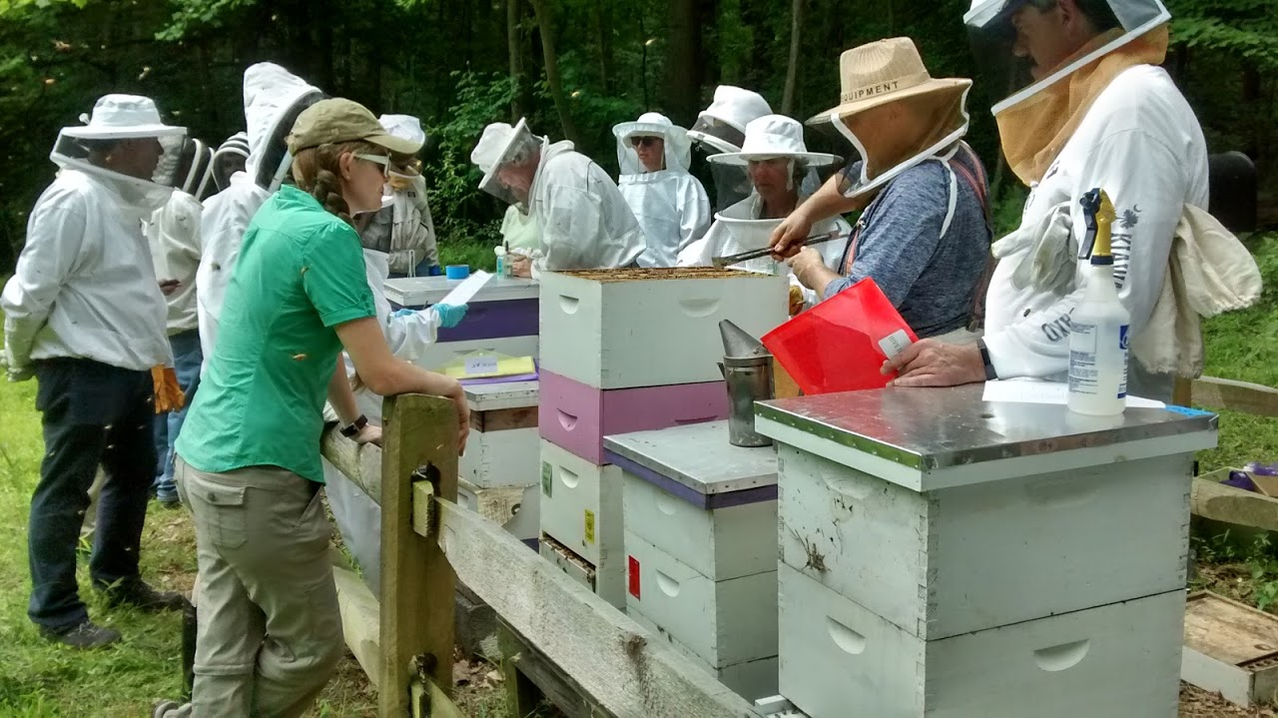
MCBA
Mentoring

Slide 12
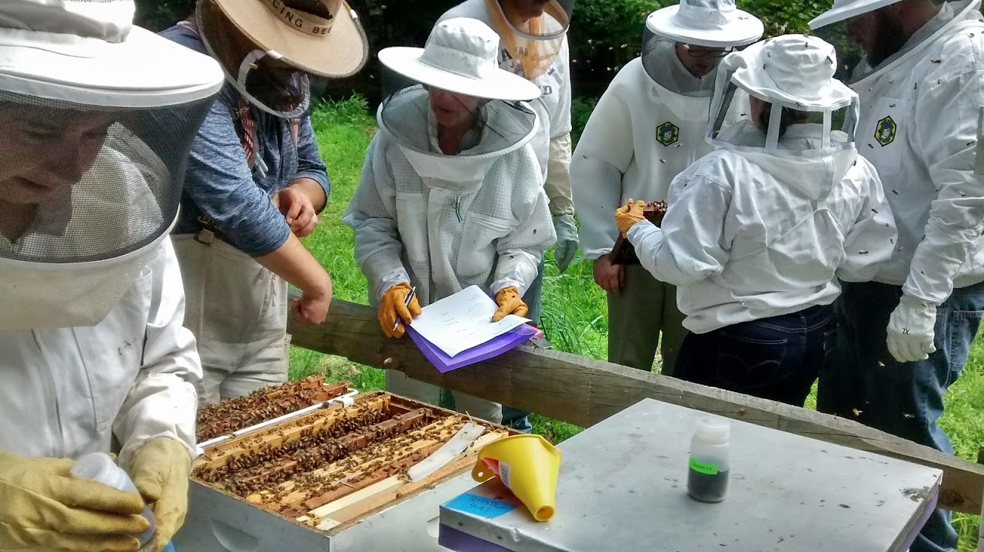
MCBA

Slide 13
MCBA
In beekeeping, you will be presented with many thoughts on how to do and what not to do. You will ultimately decide what fits you best in beekeeping.

Slide 14
MCBA
Bee Culture
Bee Culture Your First 3 Years
American Bee Journal
Vendor Supply Magazines
Obtaining Bees (Nucs or Packages)

Slide 15
MCBA
Sit back , learn and enjoy your new hobby

