Slide 1
Spring Management
MCBA Short Course November 2019
Noam B. Katz

Slide 2
The Beekeeping Year
For over-wintered colonies, the year 2020 began months ago.
Keep that in mind as you get started this spring and fall.

Slide 3
Key Themes of Springtime Beekeeping
Bee population down in winter to conserve stores
Stores now mostly depleted
Bees and colonies in a weakened or precarious state
But colonies have to repopulate ahead of main nectar flow to have the labor force to exploit it
To successfully reproduce (naturally), a colony needs to swarm when there is still enough nectar flow and summer
All these issues need to be managed

Slide 4
Inspecting Your Colonies
For overwintered colonies, weekly is plenty
Experienced beekeepers with many hives might inspect each hive less frequently
Inspect when the weather is right:
light winds, no rain, air temperature 60° F or higher
Early inspections should focus on:
colony health, status of queen and adequacy of stores
Later spring inspections will also look for:
signs of swarming and signs that honeyflow has begun

Slide 5
Spring Health Issues
Nosema and Dysentery
Cleansing flights are normal; excessive bee poop is not
Sacbrood; Chalkbrood
Move colony to sunnier, drier location
Tracheal Mites
Spring is the main season for this
Varroa Mites
Testing; certain treatments only before or after honey flow
Foulbrood diseases
Be wary of when recolonizing dead-out hives
Queen Problems

Slide 6
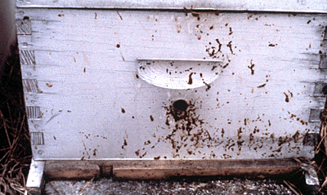
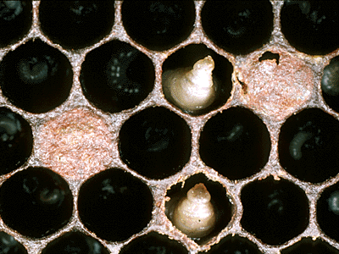
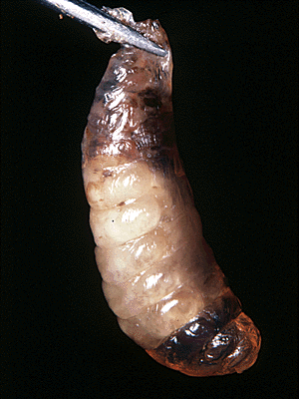
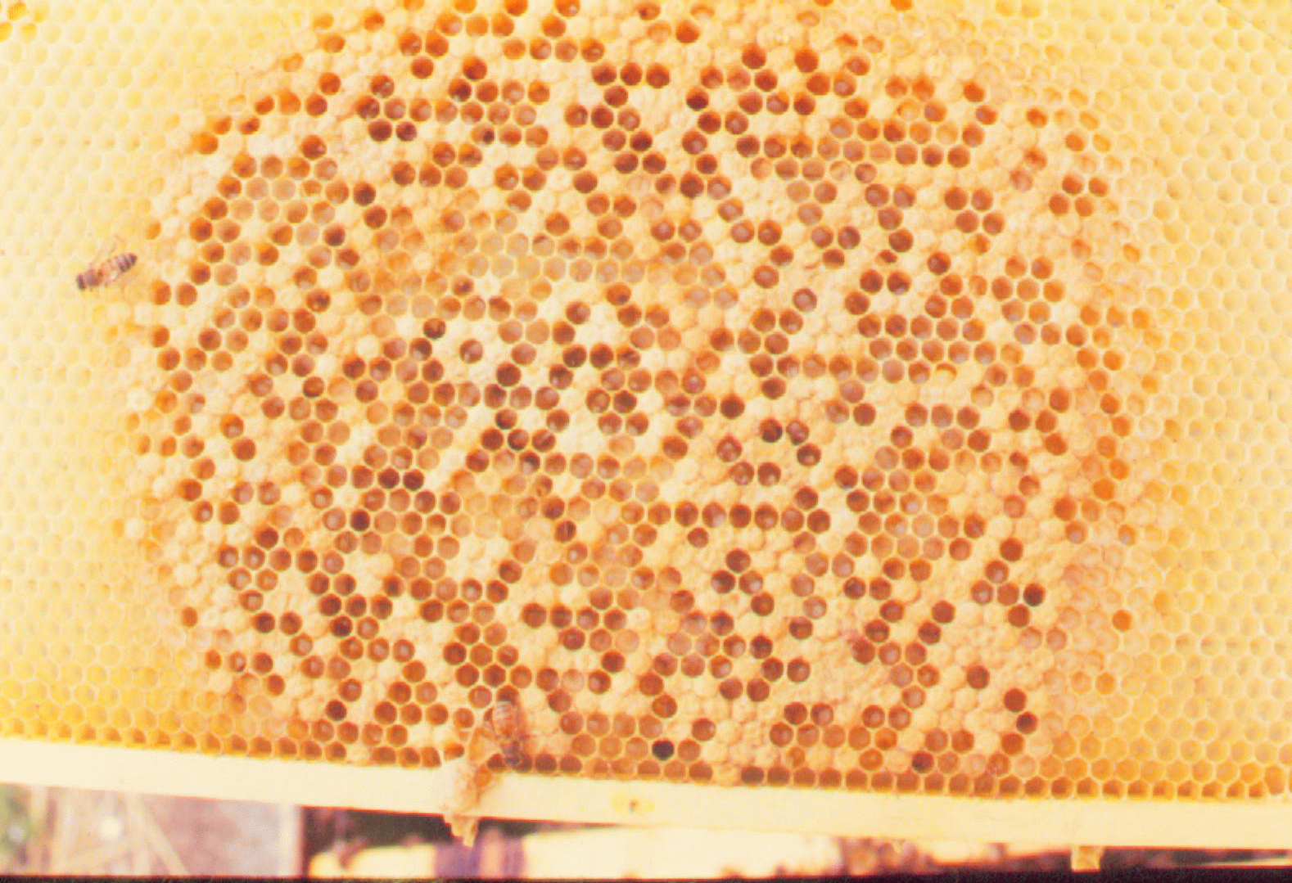
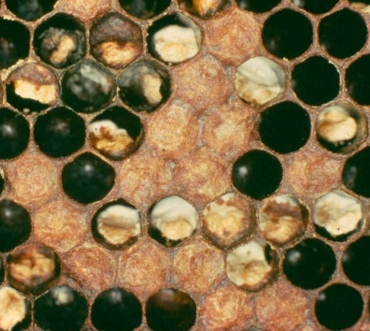
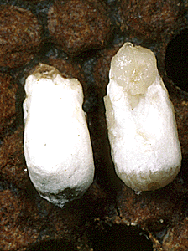
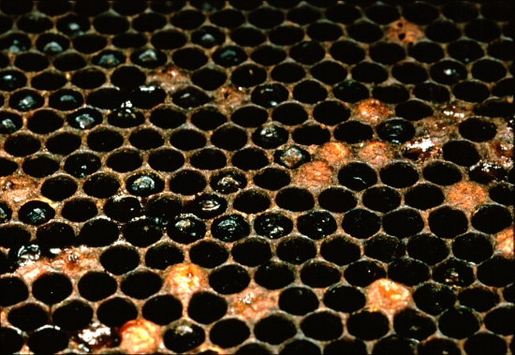
Spring Health Issues Illustrated
Nosema / Dysentery (protozoan)
Sacbrood (virus)
American ↓, European →
Chalkbrood (fungus)
Foulbroods (bacterial)

Slide 7
Spring Feeding: How and When
Early spring feeding:
1:1 sugar syrup + protein supplement (if pollen stores low)
Stop feeding when honey flow begins
Keep tabs on bloom times; bees will naturally prefer real nectar, so worst case timing should be self-evident
Don’t stop feeding newly established colonies
Feed syrup all year straight into fall
Building new wax and comb requires lots of resources

Slide 8
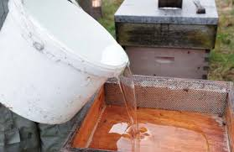
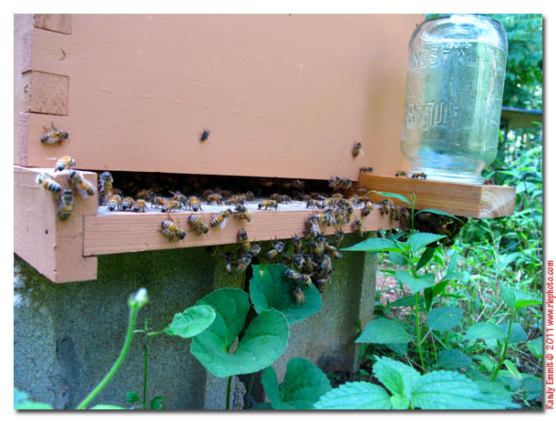
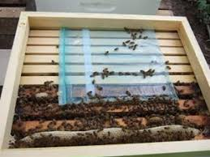
Feeding Bees

Slide 9
Feeding Bees
Pollen Substitutes
Pollen

Slide 10
Anticipating the Nectar Flow
Maximizing the field force of foragers is key.
Keep in mind the brood cycle:
21 days from egg to adult worker bee
21 days from hatched bee to effective forager
Therefore, for a mid-May nectar flow, eggs must be laid before mid-March.
Eggs laid, in an over-wintered colony, after mid-May are largely superfluous with respect to honey production.

Slide 11
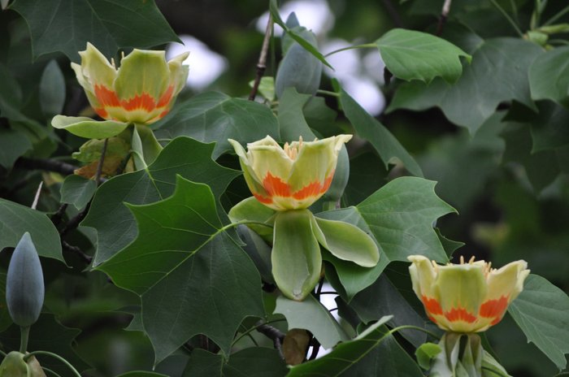
Nectar Flow in Maryland
Black Locust
Robinia pseudoacacia
Tulip Poplar
Liriodendron tulipifera

Slide 12
Supering the Colony
Top- or over-supering
Bottom- or under-supering
Empty super >
Super with honey
Brood chamber
Brood chamber
Super with honey
Empty super >
(Queen excluder)
Brood chamber
Brood chamber

Slide 13
One way to keep supers straight
- Only medium boxes for all hive components
- Need to be able to differentiate between them
- Nothing from a green (brood) super can go into a blue (honey) super

Slide 14
Swarming
Swarming: the natural way new colonies are formed
Stimulated by spring conditions and crowding in the hive
But swarming robs the beekeeper of resources and workforce just when they are needed most
Bee swarms also alarm the neighbors
Needlessly, as it turns out, because bee swarms are extremely gentle and not inclined to sting

Slide 15
One Alarming Swarm
Times Square street shut down after bees swarm hot dog stand (NY Post, August 28, 2018)
“A swarm of thousands of bees made their home atop the umbrella of a Sabrett hot dog stand in the heart of Times Square, prompting a police response and the closure of a city street Tuesday afternoon.”

Slide 16
Swarm Early Warning Signs
Population very high
Comb crowded with brood and stores
Construction of swarm cells
Swarm Behavior
Old queen stops laying, loses weight and regains ability to fly
10,000+ worker bee gorge on honey and take flight with queen
After circling in a cloud, the swarm lands on a nearby tree branch as scouts look for a suitable new home

Slide 17
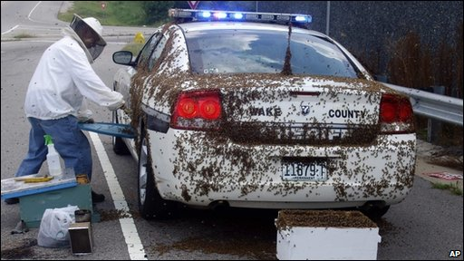
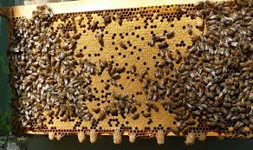
Swarming in Pictures
Swarm (Queen) Cells
Swarm Clustered in Transit

Slide 18
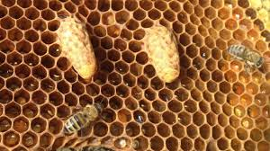
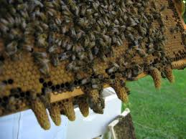
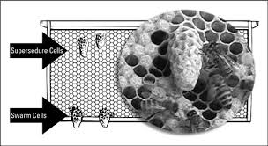
Swarm Cells vs. Supersedure Cells
Own Goal: Don’t make your colony queenless
Supersedure Cells
Swarm Cells
- Mid-comb vs. bottom of frame
- Few vs. Many

Slide 19
Preventing Swarming
Staying ahead of the game is key; once the point of no return is passed, a colony may swarm no matter what you do.
Add supers and brood chambers
Inspect for swarm cells
Unused queen cups are an early sign; filled (“charged”) swarm cells are a late sign
In the event of charged swarm cells, consider making a split or a nuc.
You can also destroy swarm cells, but that risks an “own goal”

Slide 20
Post-Swarm Management
Signs your colony swarmed:
Sudden drop in a healthy population
Empty, used swarm cell(s)
Brood break
After a swarm, your existing colony is taken over by a new queen from one of the swarm cells:
Possibly not even hatched when the swarm departs
Then has to take mating flights and start laying
Then those eggs have to mature and hatch new workers
Afterswarms

Slide 21
One Method of Manipulation for Swarm Prevention

Slide 22
Remember
Enjoy your bees and your beekeeping.
Relish the fruits of your labors.
There are many ways to obtain desired results.
Ask for help and advise when you need it.
Bees will forgive almost all of your mistakes (perhaps providing you a reminder of errors).

