Slide 1
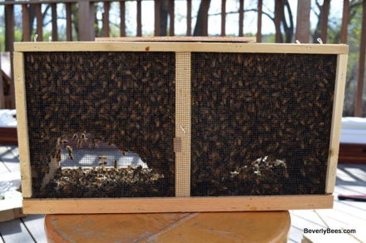
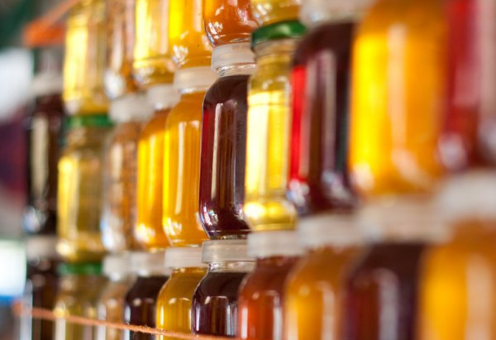
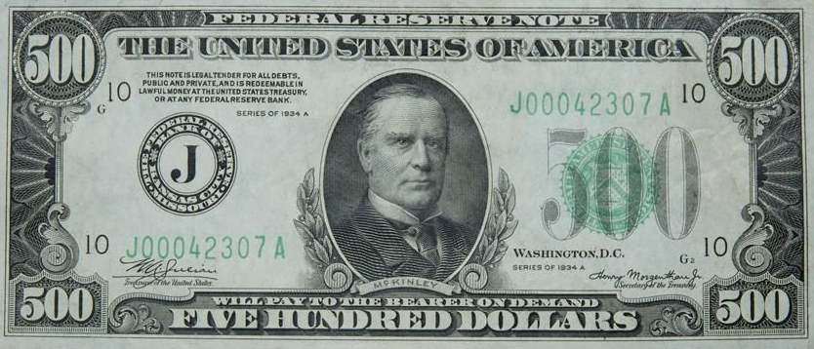
Swarm Cost
Package’s worth of bees & Queen =
- $200
- $300
30 pounds of honey @ $10/lb =
Total Cost of 1 Swarm =
- $500

Slide 2
Splitting hives reduces urge to swarm
Methods to split hives include:
Walk-away splits
Snelgrove double screen board
On the Spot Queen Rearing (OTS)
Today’s Talk!

Slide 3
On The Spot Queen Rearing
Maryland Style
Based on Mel Disselkoen’s work
His book is excellent Only available through his website www.mdasplitter.com
This talk has been adjusted to Maryland’s honey flow timing

Slide 4
Dave Clark version of OTS, a variation on Mel Disselkoen’s technique
David Clark March, 2021

Slide 5
Timing
You must have emerged drones, and drone cells
No drones = no mated queens
50°F or above

Slide 6
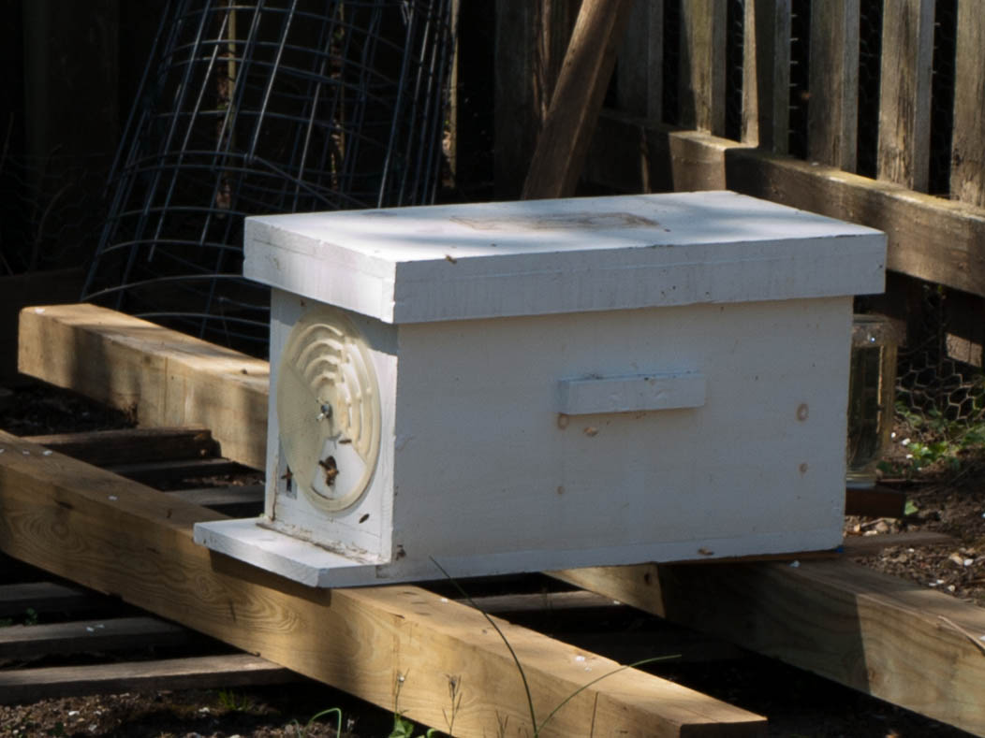
Have Ready
Nuc box
Five frames of foundation

Slide 7
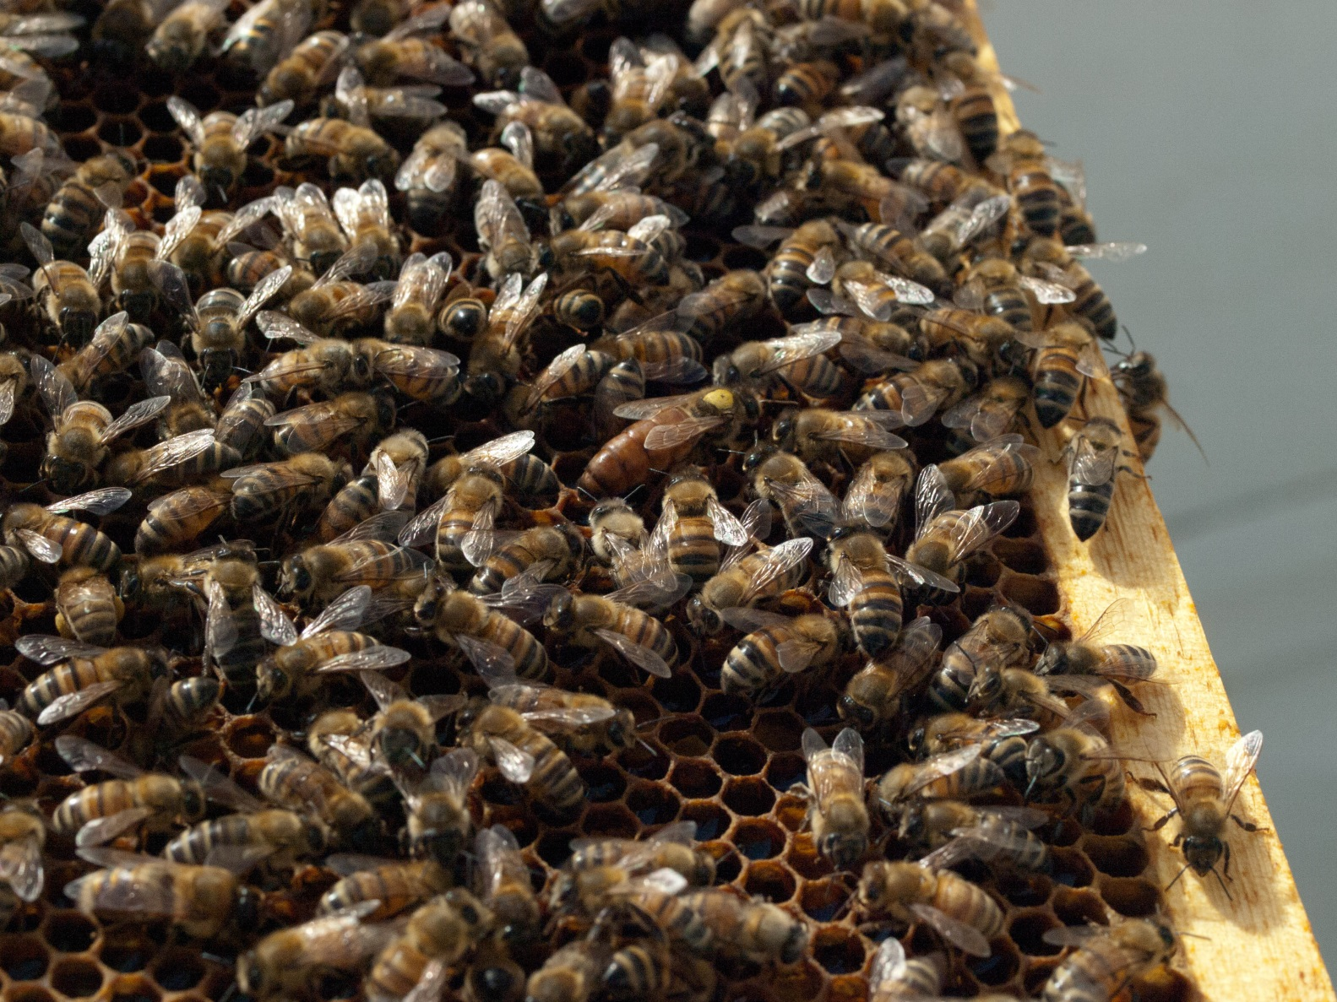
Cage mother queen to keep her safe while you work the hive.

Slide 8
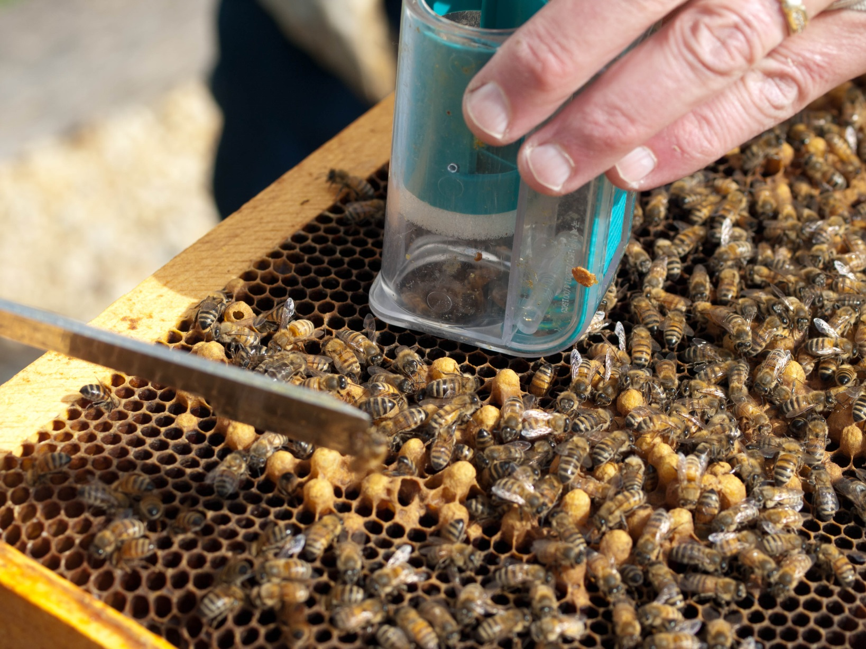
I use one handed TEAL queen catcher ($25)

Slide 9
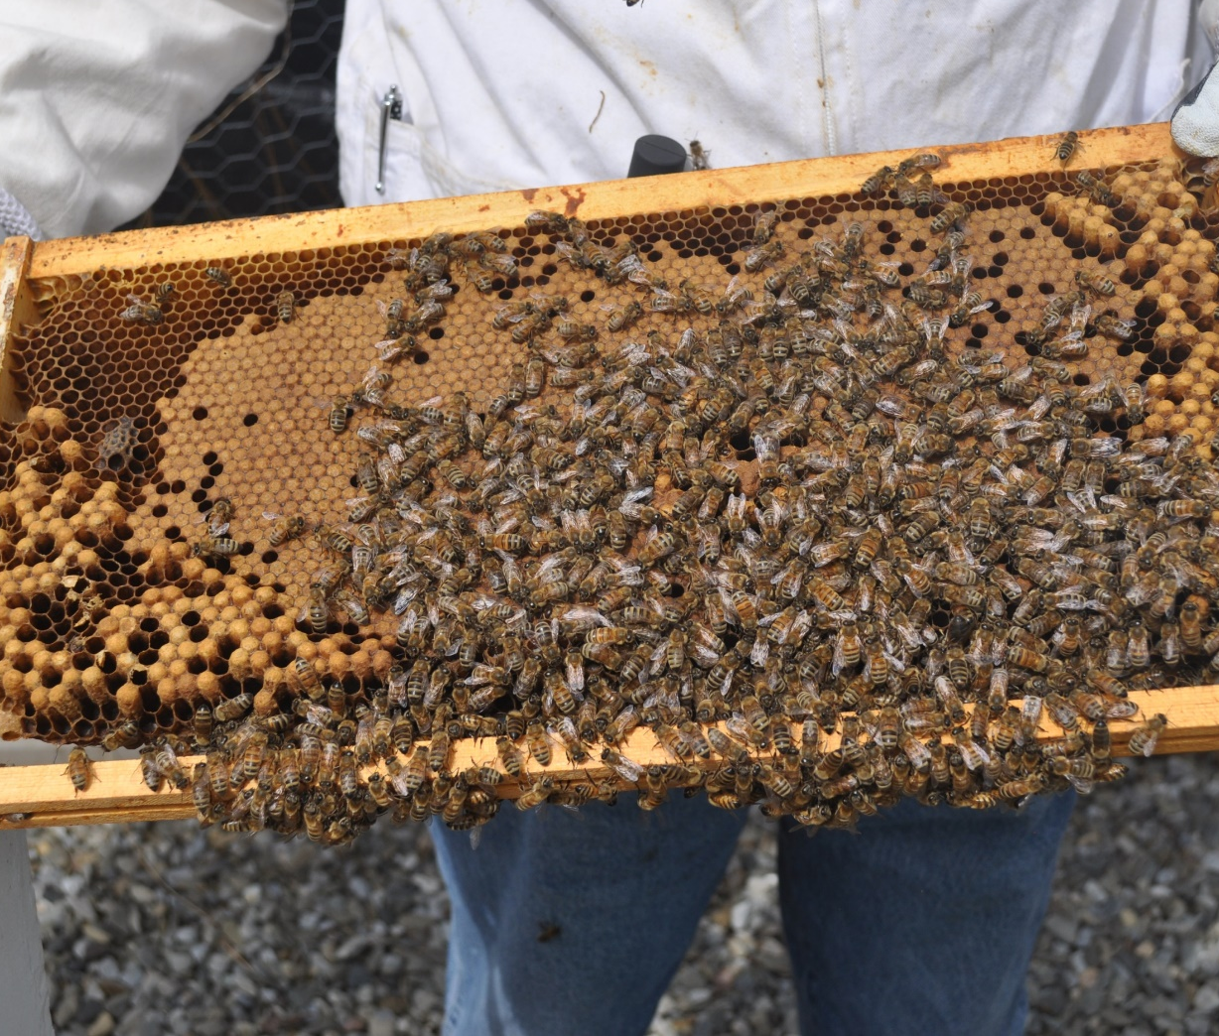
Building Nuc Starts with
2 Frames Honey & Pollen
2 Frames Capped Brood

Slide 10
Put Frames of
Honey & Pollen
First and Last
Food
Food

Slide 11
Put
Capped Brood
next to food
Brood
Brood
Food
Food

Slide 12
Keep
center slot
empty
Brood
Brood
Food
Food

Slide 13
Collect Nurse Bees from Main Hive

Slide 14
Pour Nurse Bees into Nuc

Slide 15
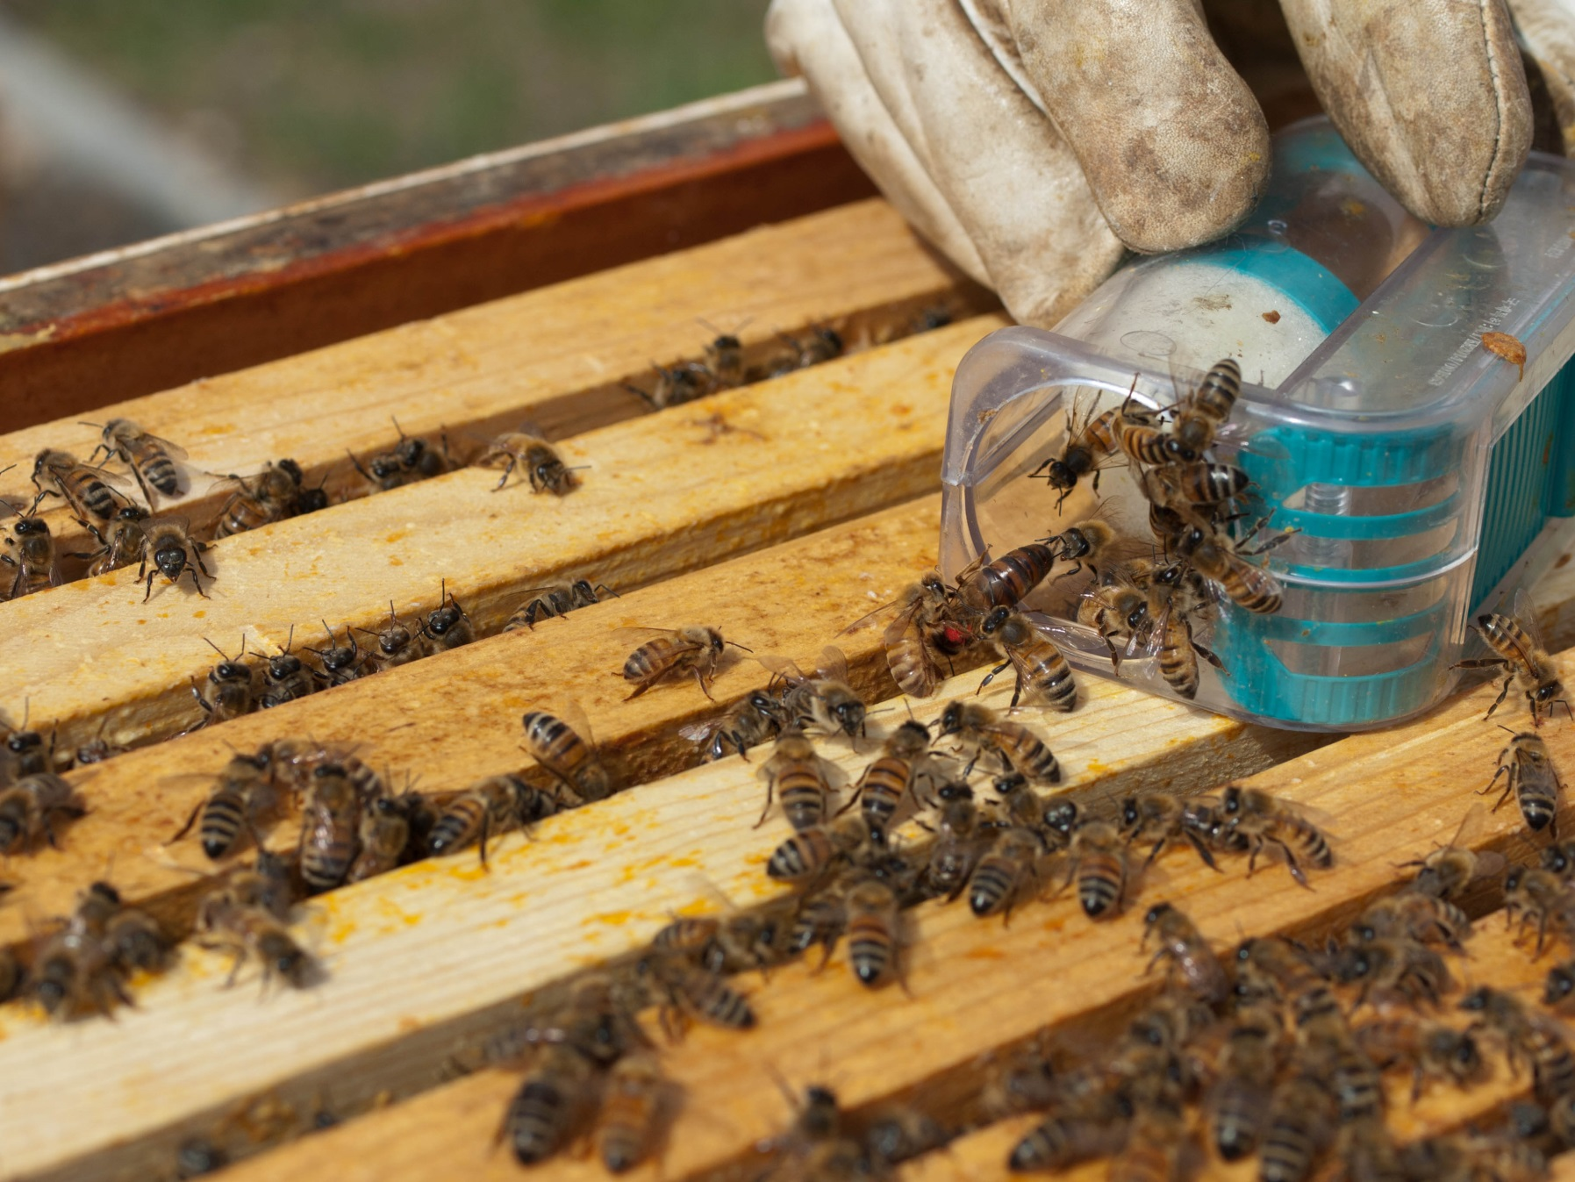
Release mother queen
back into the full size hive

Slide 16
Close Hives

Slide 17
Wait

Slide 18
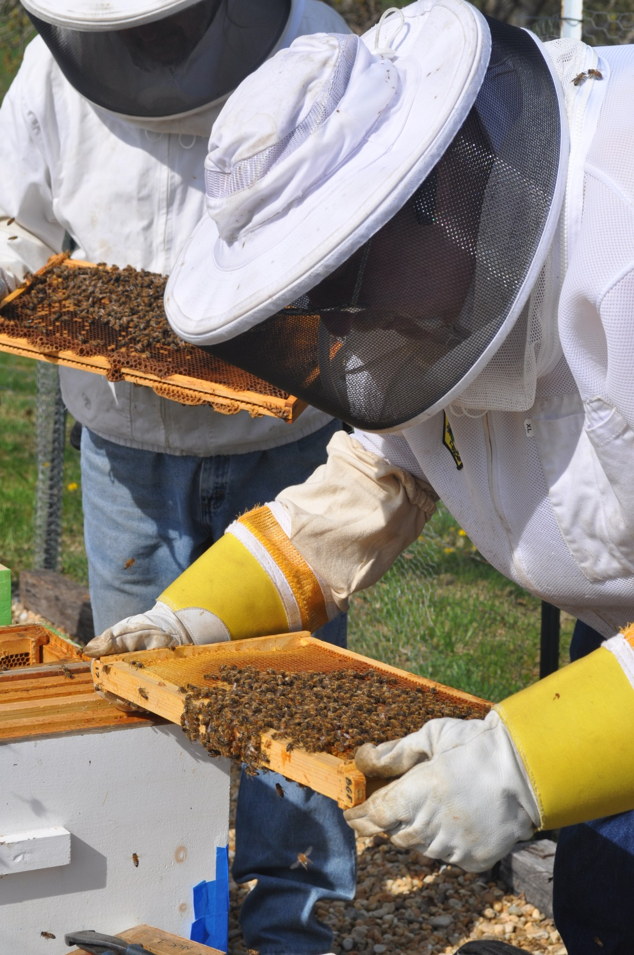
That Magic Moment
The next morning
Take a frame of larvae from the large hive

Slide 19
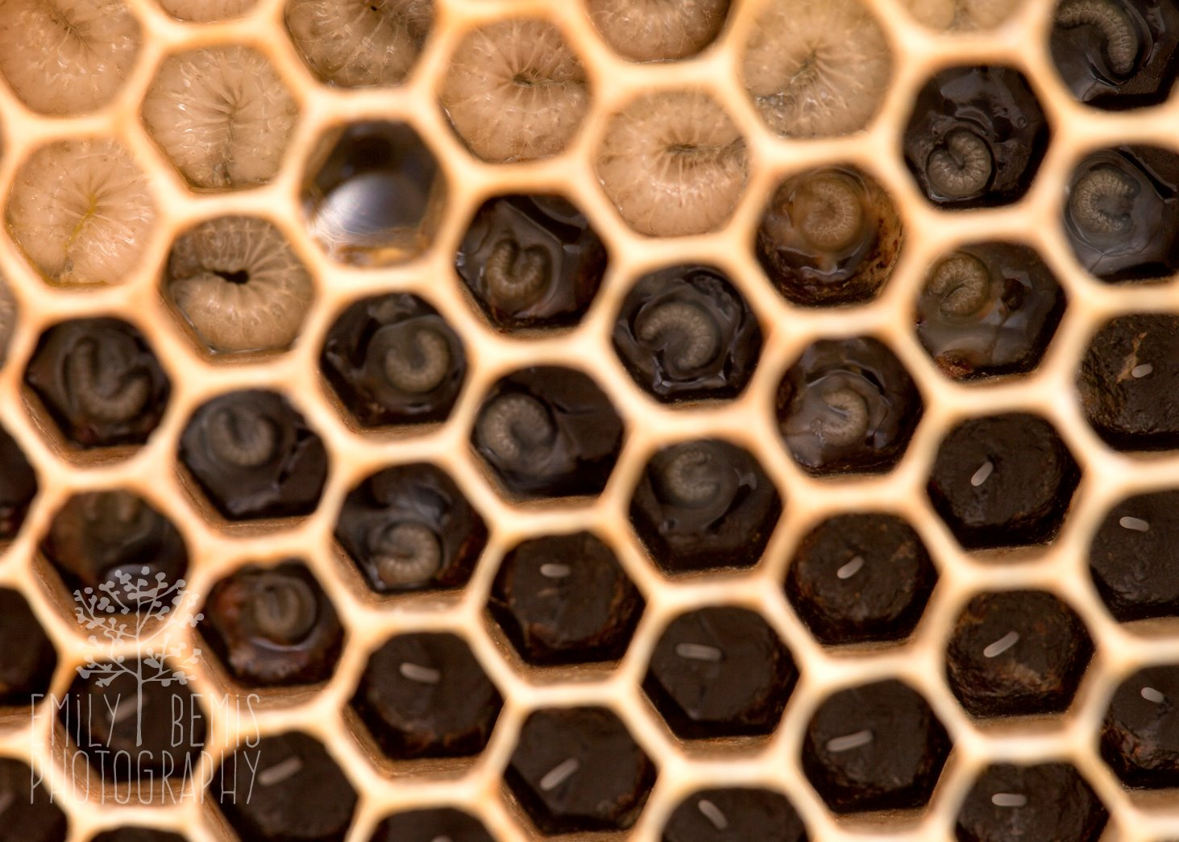
. Larvae must be fewer than 3 days old.







Slide 21
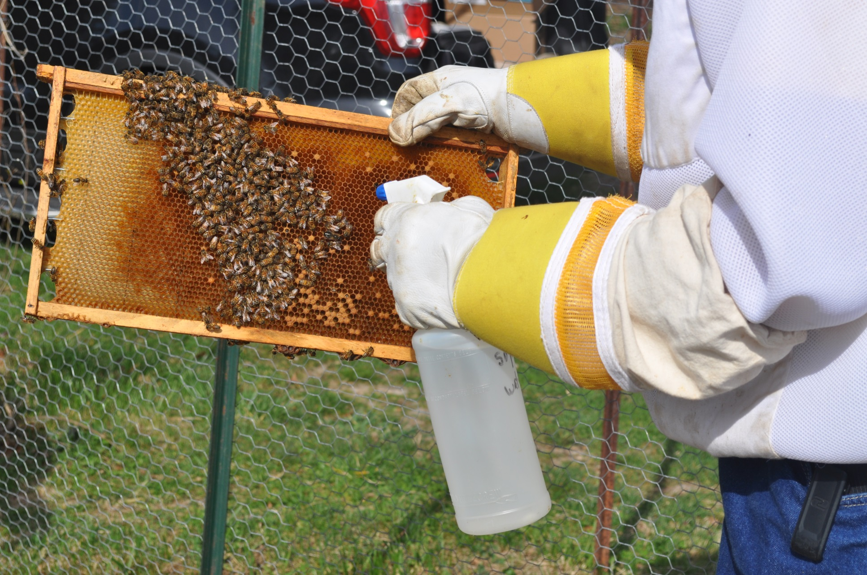
Clear Working Area
Spray bees with sugar water
Remove bees with bee brush

Slide 22
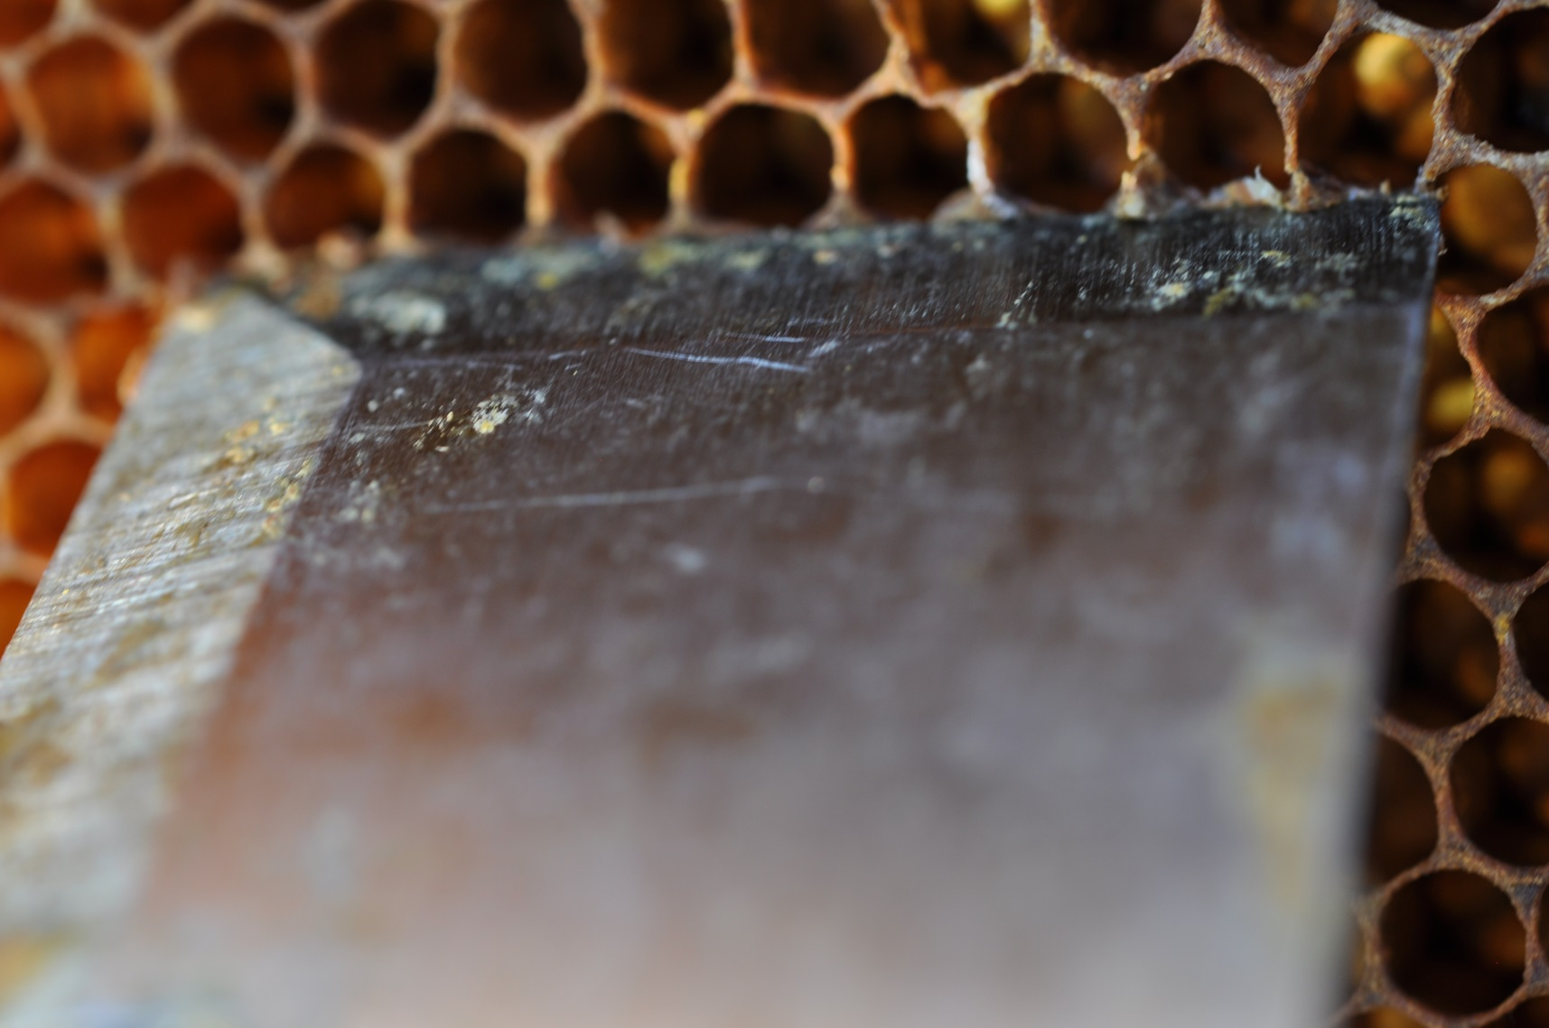
Use hive tool to notch bottom walls of the larvae’s cells down to the foundation.

Slide 23
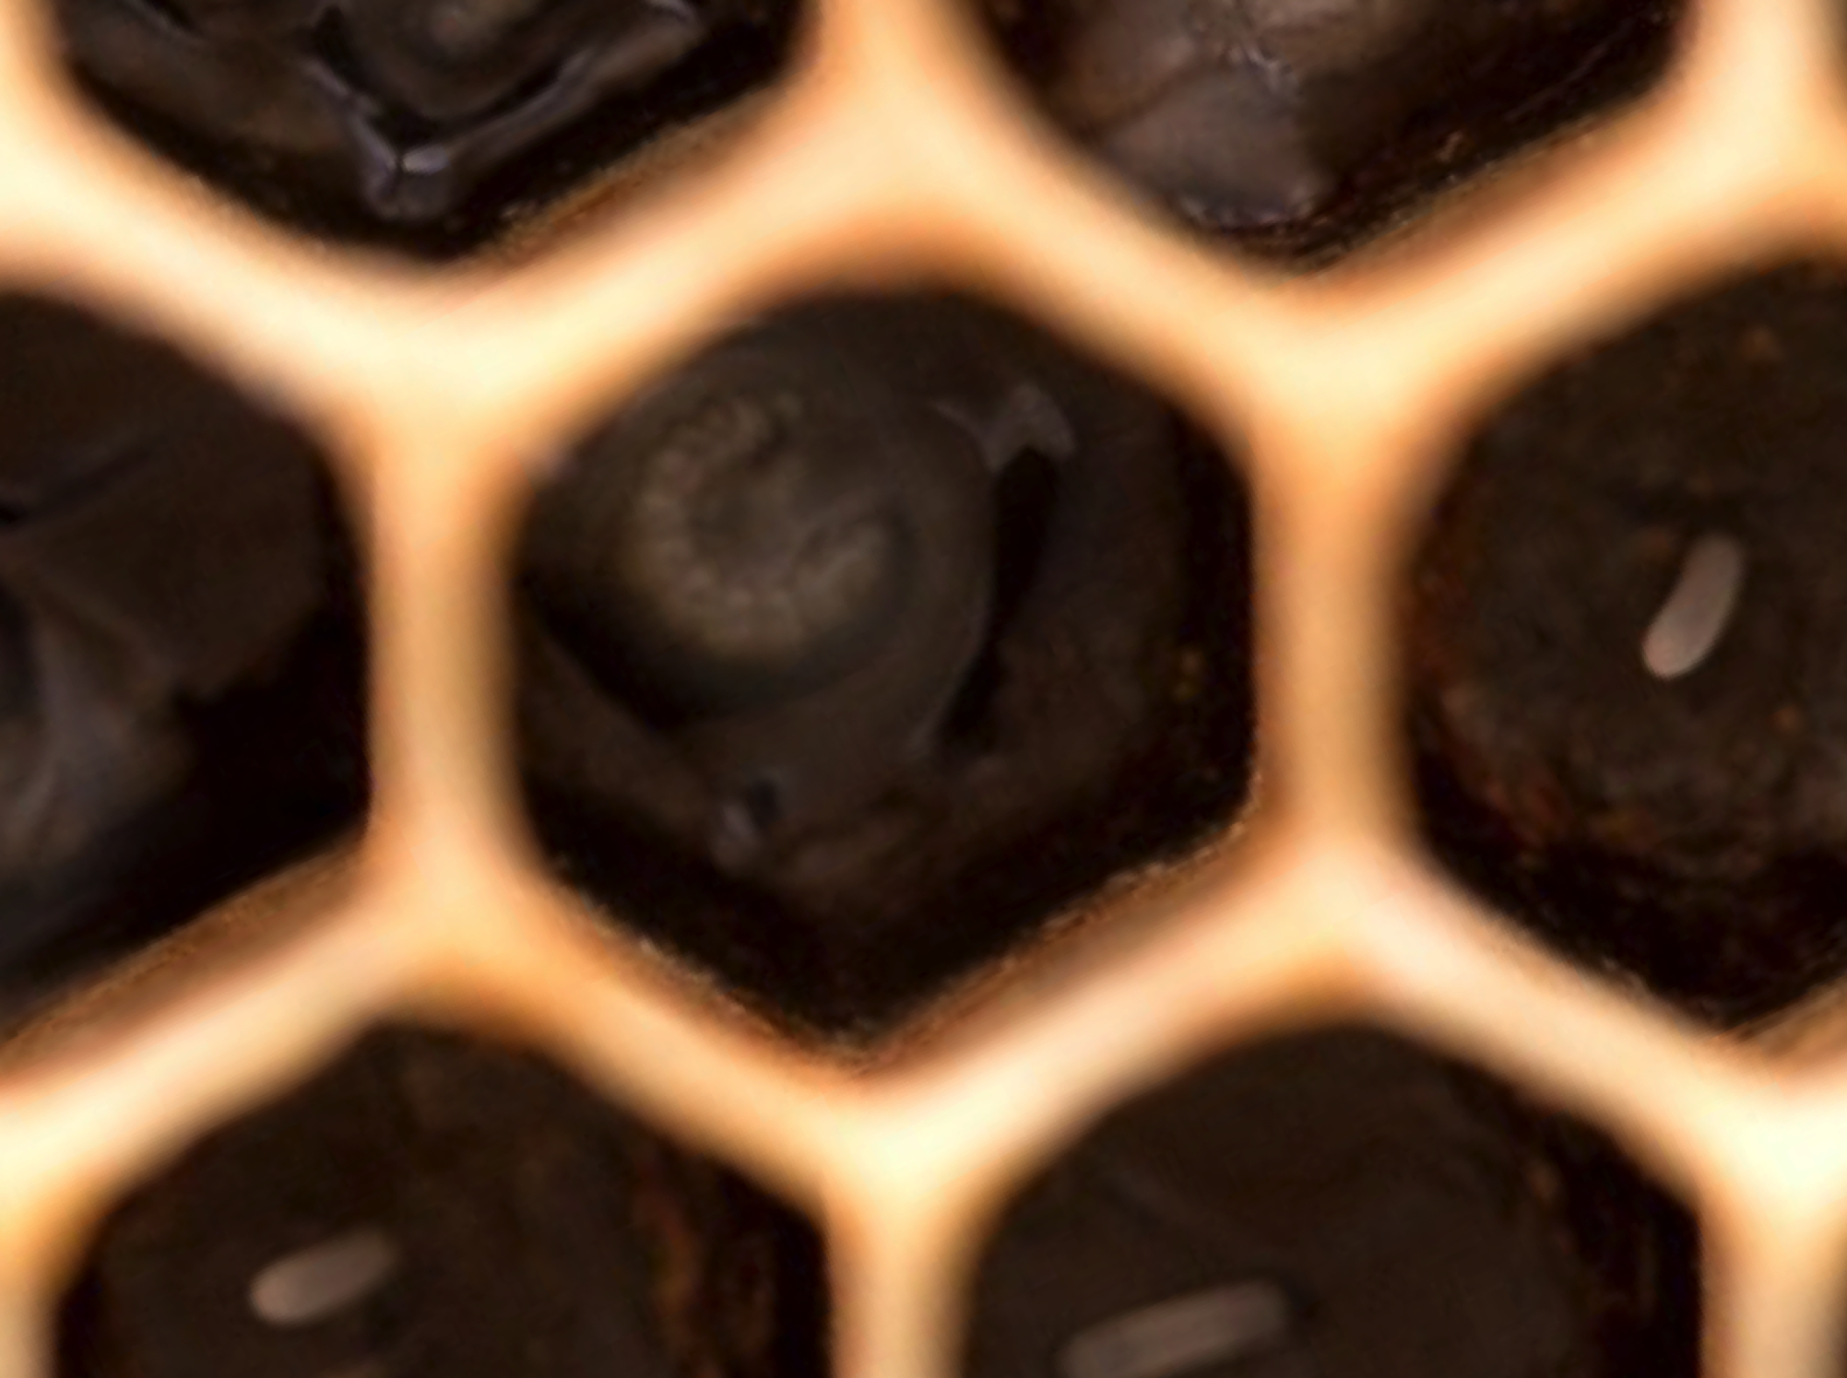
Cut Line

Slide 24
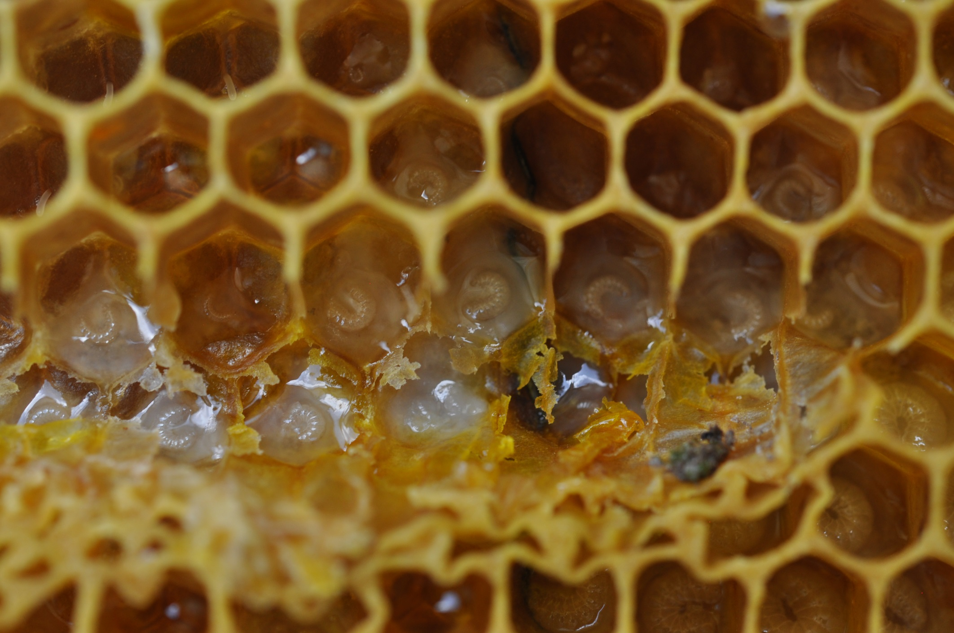
⬅⬅ Hive Tool Blade ➔➔
Perfect sized larvae

Slide 25
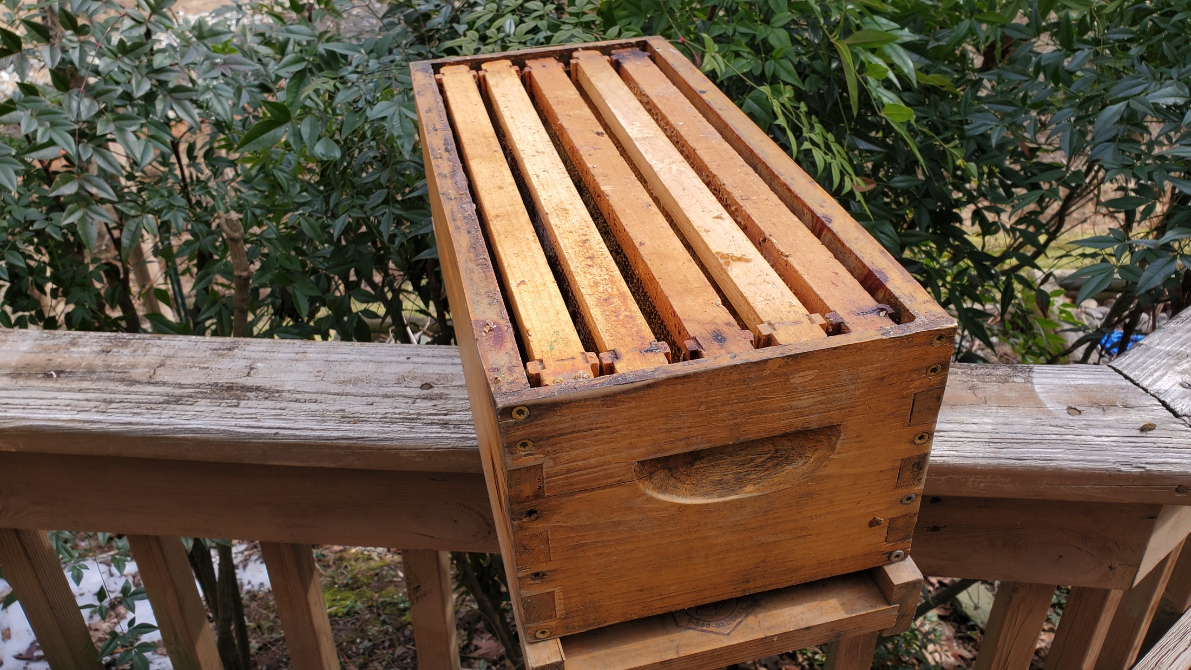
Insert
Larvae
Frame in
center slot

Slide 26
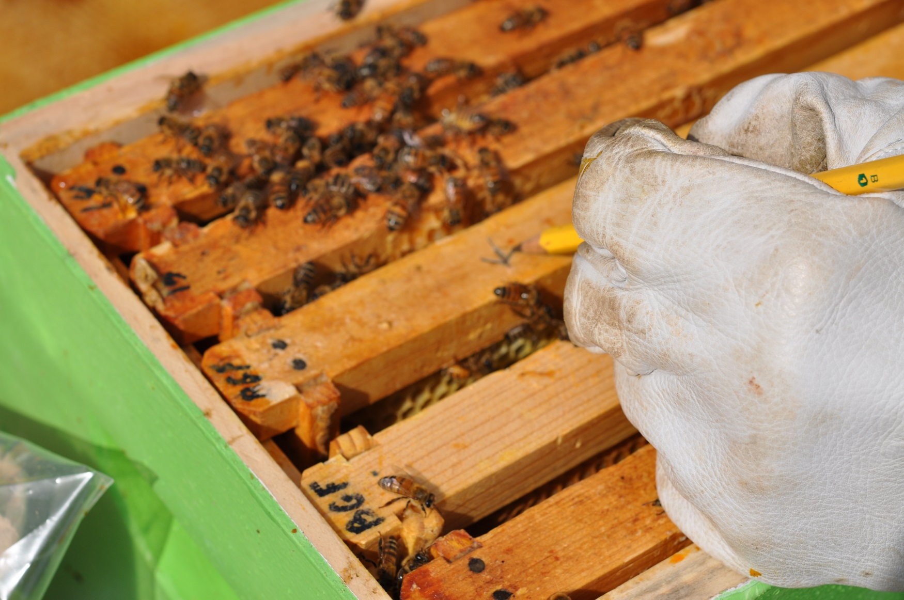
Place notched frame in center of nuc box.
Mark where notch is located.

Slide 27
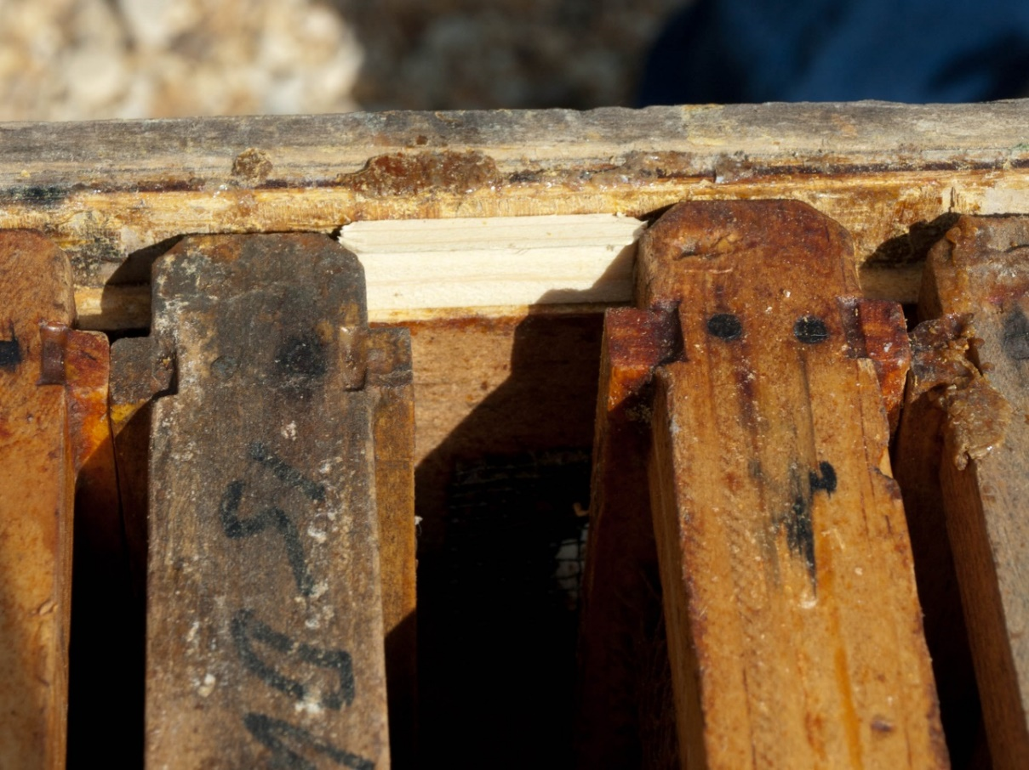
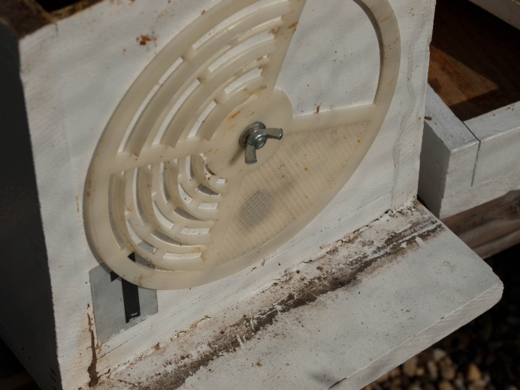
IF you need to relocate nuc… use a popsicle stick portion to keep frames from moving

Slide 28
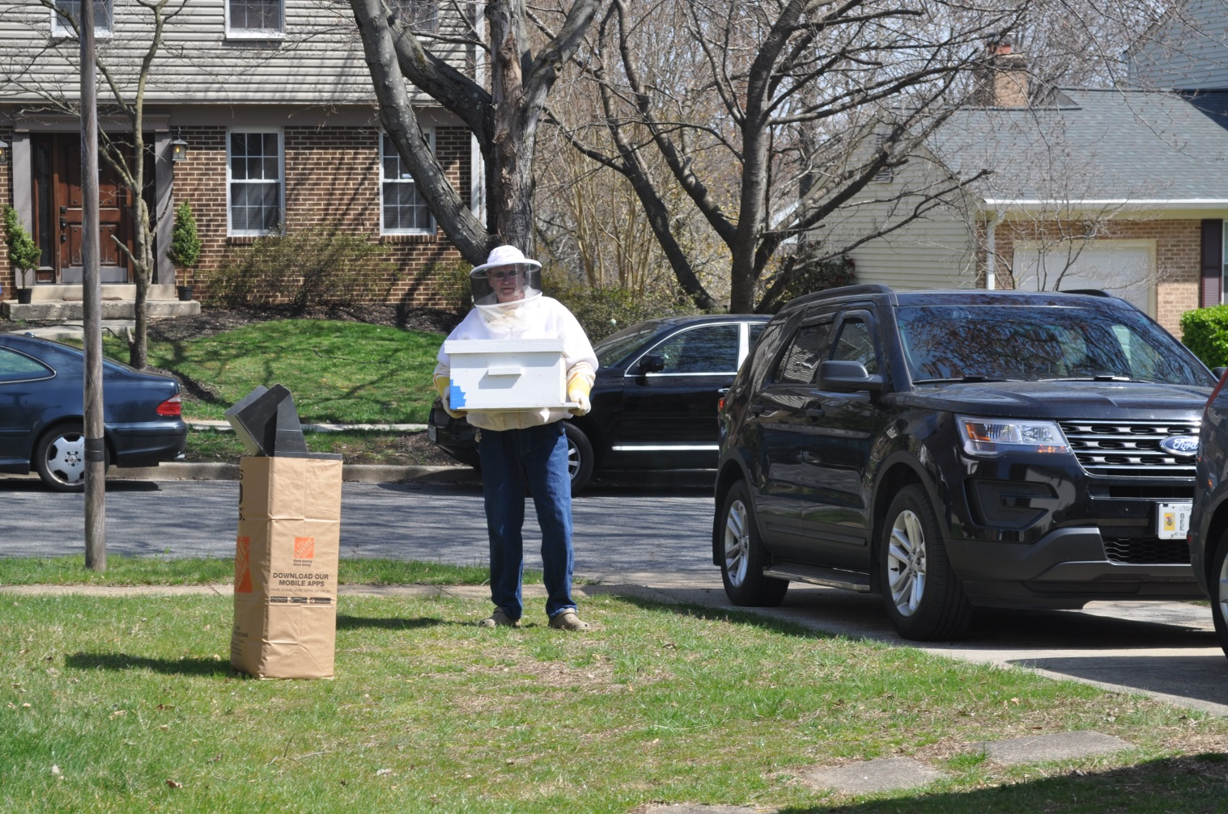
Take Nuc Box to your mating location

Slide 29
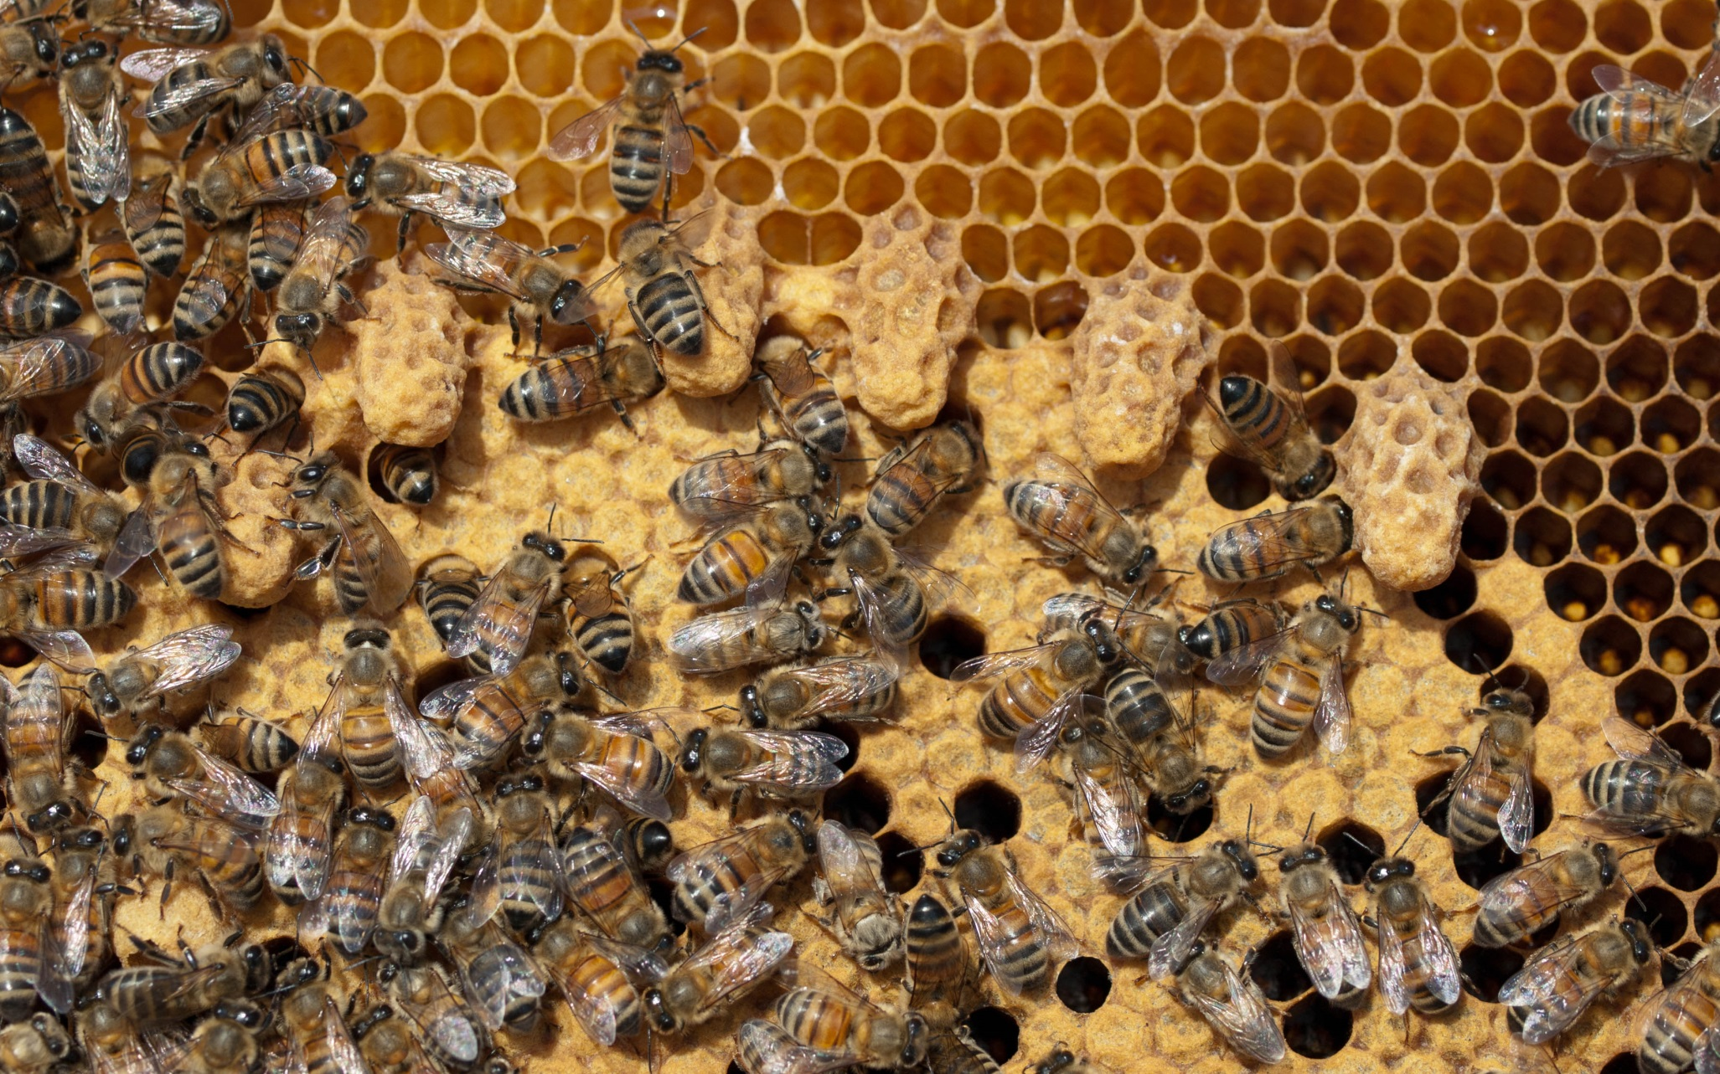
After 7-10 days check your queen cells. Handle frame carefully, do not jostle or turn upside down

Slide 30
25 days after making split Capture mated queen

Slide 31
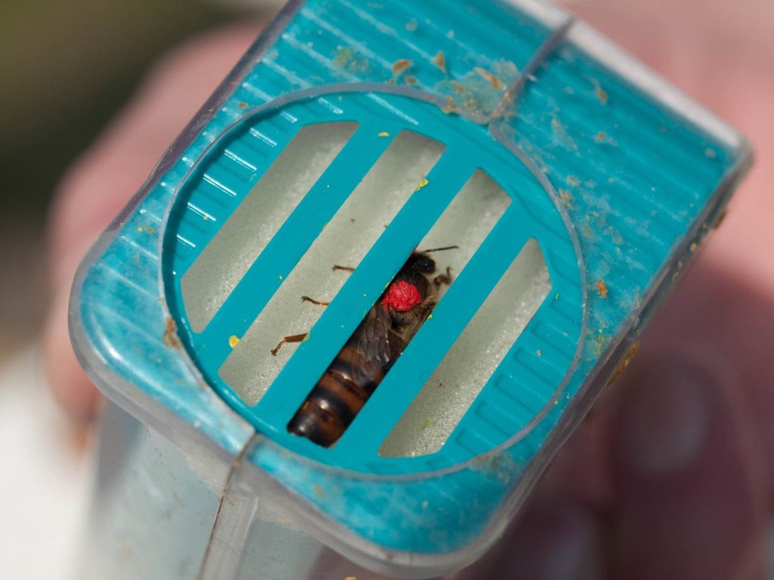
Mark your new queen
Let her paint dry in the cage 4 minutes!
Not 3, not 5, but 4

Slide 32
Let her gently walk out

Slide 33
Compare queens
Assess new queen in nuc vs mother queen in hive.
If both are laying well, you now have three choices:
Make a new hive with this starter nuc
Sell the nuc to another beekeeper ($$!)
Switch queen positions: Put older queen into the nuc, new queen into the large hive
If old queen is under performing:
Make one hive – Dispatch old queen, newspaper combine the new queen and her nuc with large hive.
That new queen should last two years.

Slide 34
Common Mistakes Things that can go wrong
Not waiting the full 25 days before looking for the new queen. A disrupted new queen will fly off and not return
Queens may not return from mating flights
(birds/dragonflies like to eat big queens)
If this happens you can immediately do another OTS without the hive producing laying workers. But this means you need to wait another 25 days. Patience Grasshopper
Newly mated queen does not lay well, give her two weeks to settle down. Otherwise kill her off, and do OTS again from donor mother stock

Slide 35
Benefits
You made your own queen. Be proud.
You have slowed down swarming by managing your booming hives
You can increase your apiary size without purchasing packages or nucs Use the money to buy wood and start making wooden ware.
You have increased your future honey production, by using your best honey makers as mother stock.
You have a nuc to use as a backup for
Winter loss
Queen failure in another hive
This is the first step to becoming a self-sustaining apiary
CONGRATULATIONS!

