Slide 1


BEES
What’s The Buzz?
Notes:
My name is ______________ and a member of Montgomery County Beekeepers Association.
The Montgomery County Beekeepers Association (MCBA) of Maryland has one purpose that is to promote better beekeeping.
We have over 600 members, some of whom are Master Beekeepers.
We welcome new members and conduct beekeeping classes for beginners every spring.
We have monthly meetings which you are invited to attend if you wish to learn more about bees.
I have been a member of MCBA for ____ years, and currently have _____ (number of ) hives.
I hope this presentation will help you appreciate this incredibly complex and wonderful insect the honey bee.
Bees, What’s the Buzz? (Click on audio for bee hive sound)

Slide 2
Talk Outline
Honey Bees
History of Man and Bees
Why Do We Need the Bees?
What Makes Up A Colony?
Life Cycle Of A Bee
Swarms
Stings
How Do Bees Make Honey?
Extraction
What is happening to our bees?
What can you do to help our bees?
Notes:
Here is the outline of my talk. I will be talking specifically about honey bees. The talk will cover the relationship between man and bees, what do bees do for us, what makes up a colony, their life cycle, swarms and stings, how bees make honey and how we extract it, and lastly what is happening to our bees and what we can do to help them.
Montgomery County Beekeepers, Inc.2

Slide 3
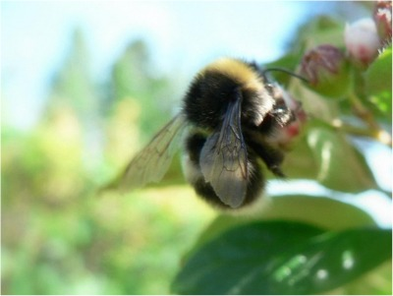
Bumble Bee
Notes:
There are many different bees.
You are probably familiar with this one, a bumble bee.

Slide 4
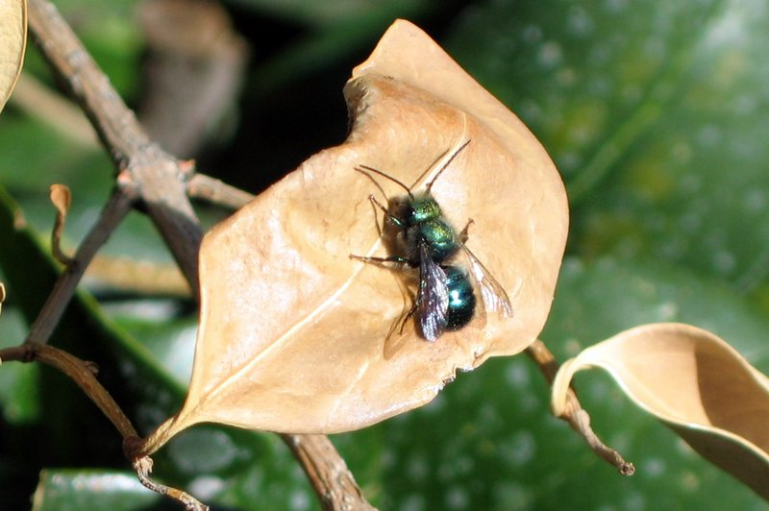
Blue Orchard Bee
Notes:
This is a blue orchard bee.
There are over 20,000 different species of bees.

Slide 5
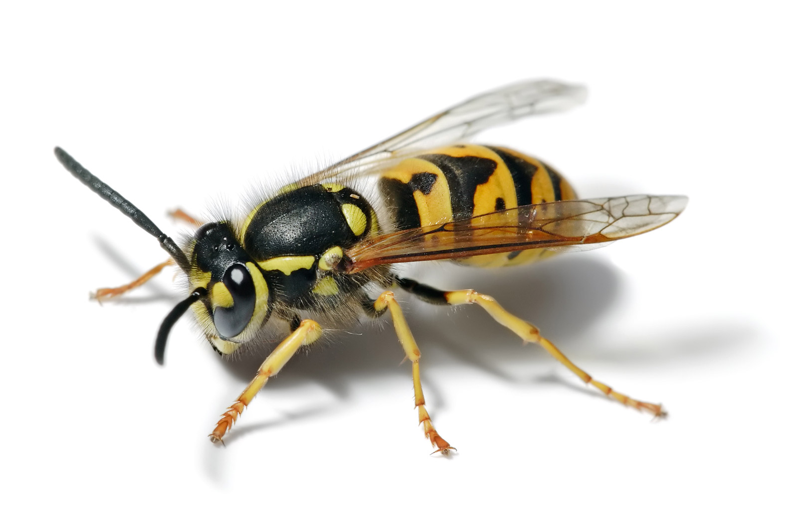
Yellow Jacket
Fir0002/flagstaffotos
Notes:
This is not a bee but a wasp or yellow jacket.
Wasps are often mistaken for honey bees. Wasps are aggressive, they can sting multiple times without dying.
In contrast honeybees are defensive not aggressive. They sting once and die.
Wasp give honeybees a bad reputation. We need to change the narrative. If you get stung by an insect it is probably a wasp. So please say I got stung by a wasp., not a bee, if you are ever stung!

Slide 6
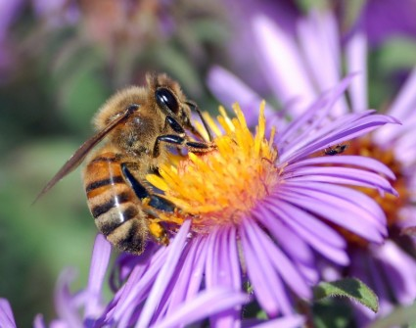
Apis Mellifera
Notes:
Today we are going to talk about Apis Mellifera which means honey bearing bee.

Slide 7

History of Man and Bees
Notes:
Honey bees have a long history. They have been around for over 100 million years.
This is a drawing found in prehistoric caves near Valencia Spain showing a person collecting honey.

Slide 8
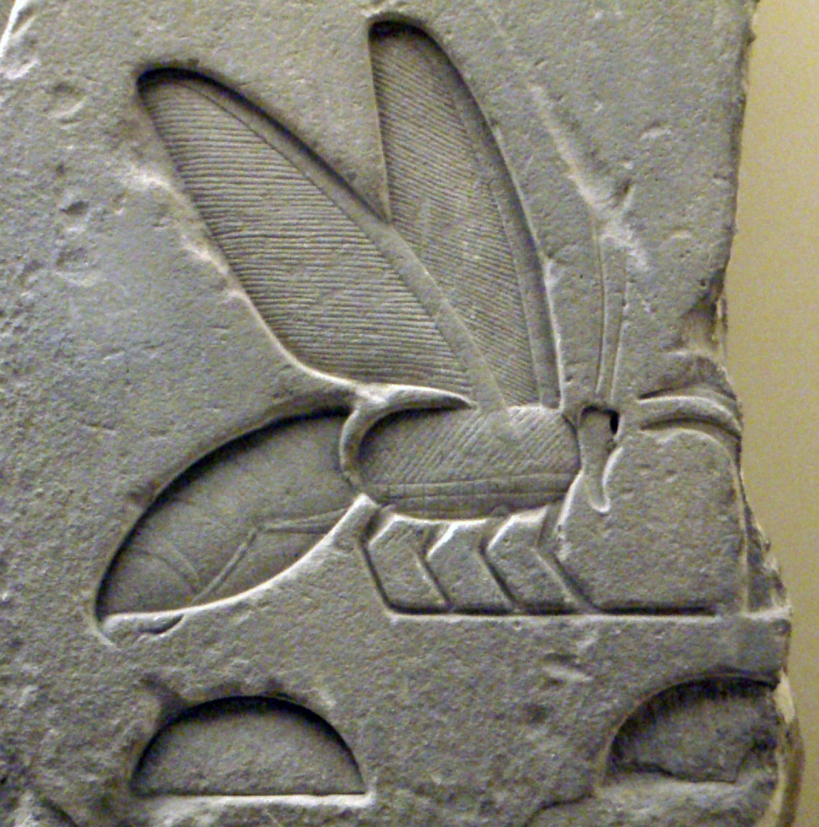
Egyptian Hieroglyph
Notes:
This is a picture of an Ancient Egyptian bee Hieroglyph
Egyptian art shows humans working with bees.
Man did not always get everything right about bees. The Pharaohs thought the queen was actually a king.
But they did get one thing right. They understood that honey stored in air tight containers never spoils.
Sealed honey vats found in King Tut's tomb still contained edible honey, despite thousands of years beneath the sands.

Slide 9
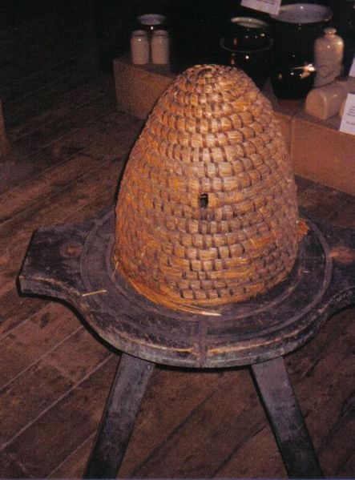
Skep
Notes:
Honey bees first came to the US around 1622 when the colonists brought them to Virginia from England.
There were no honey bees the continent of North America before 1622.
Native Americans called them the “white man’s fly”.
Colonists brought them from Europe to pollinate their crops and plants, to harvest the honey for sweetener, and to produce beeswax for candles.
By 1850 bees were found all the way across the continent to California
Colonists created the hives called skeps out of clay pots or baskets as seen in this picture.

Slide 10
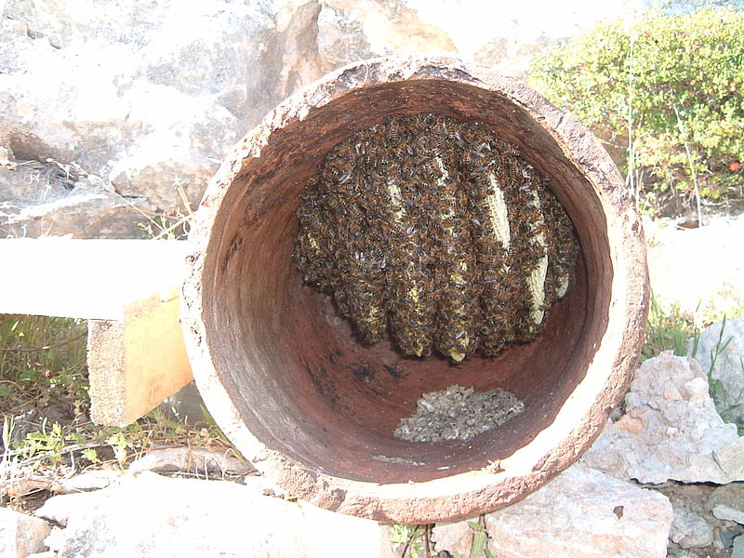
Inside of Skep
Notes:
The bees form wax comb on the inside of the skep. Note the spaces between the comb where bees can maneuver to maintain their colony. Latter we will talk about this bee spacing.
The major problem with this type of hive is that when the time came to harvest the honey and wax the whole hive was sacrificed.
The bees had to start the whole process of building comb again.

Slide 11
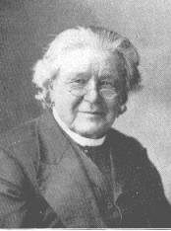
Rev. Lorenzo Lorraine Langstroth
Father of American Beekeeping
Notes:
An apiarist is another word for a beekeeper.
Lorenzo Langstroth was a preacher a teacher and an apiarist.
He is credited with making a key discovery to keeping bees.
His key discovery was bee space: What do we mean by bee space?
If a small space was left (less than 1/4 inch or 6.4 mm) the bees filled it with propolis, or bee glue; on the other hand, when a larger space was left (more than 3/8 inch or 9.5 mm) the bees filled it with wax comb.
He used this information to design moveable frames, so honey and wax could be extracted without destroying the whole hive.

Slide 12
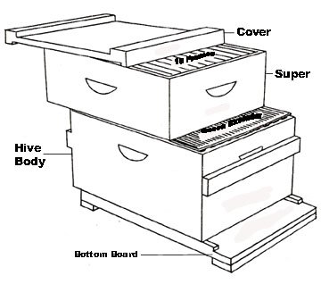
Hive Diagram
Notes:
Langstroth was also an inventor. He used the discovery of bee space to make a hive with moveable frames. He patented this hive in 1852.
Similar configurations of this hive are used today and are still referred to as the Langstroth hive. It is made up of wooden boxes and frames that can be taken apart without destroying the hive.

Slide 13
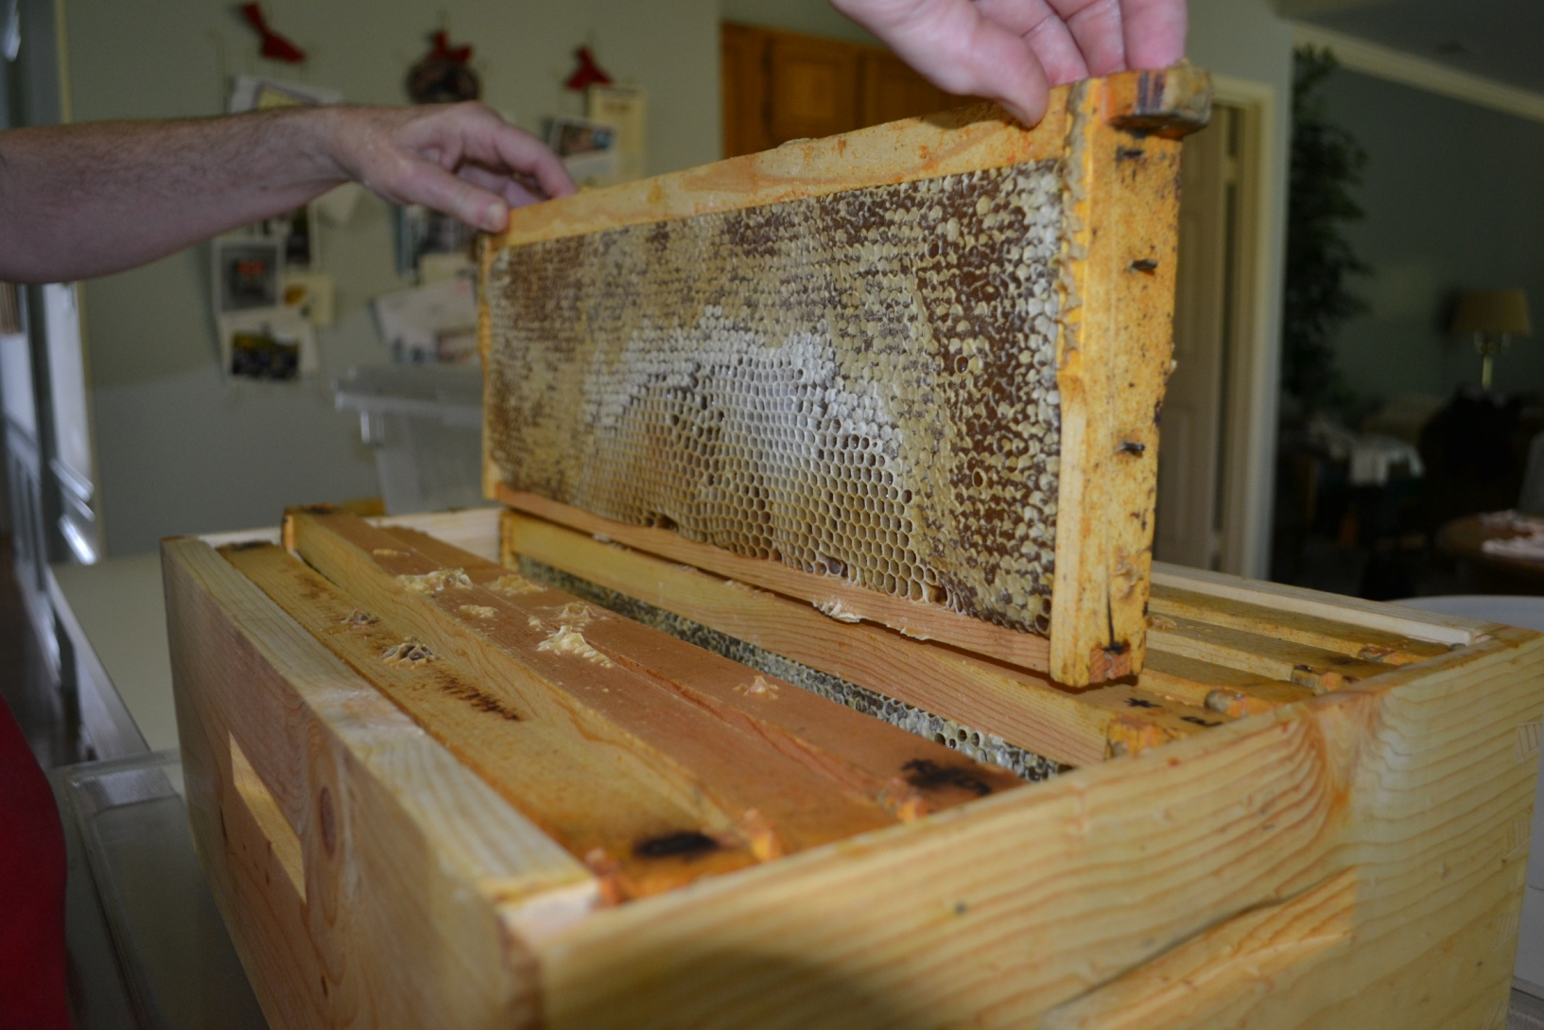
Hive Frames
McQueen
Notes:
Inside those boxes are moveable frames, separated by bee space.
Each box has 8 to 10 frames that can individually be manipulated to extract wax and honey.

Slide 14
US Beekeepers
Notes:
According to the American Honey Board it is estimated that there are between 140,000 and 210,000 beekeepers in the United States today.
The vast majority are hobbyist beekeepers managing fewer than 25 bee hives
4% are part time beekeepers who manage 25 to 299 hives
An estimated 1,600 beekeepers are commercial beekeepers that mange more than 300 hives.
About half of these 1,600 commercial beekeepers are migratory beekeepers. They rent their bees to farmers following the pollination season to various crops.

Slide 15
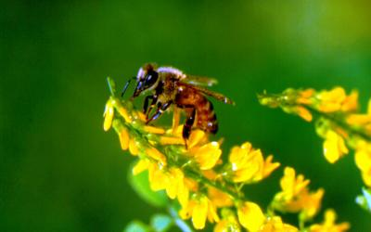
Why Do We Need The Bees?
Notes:
Honey is the only food humans eat that is made by an insect that people gladly eat.
It is the only sweetener that has nutritional value

Slide 16
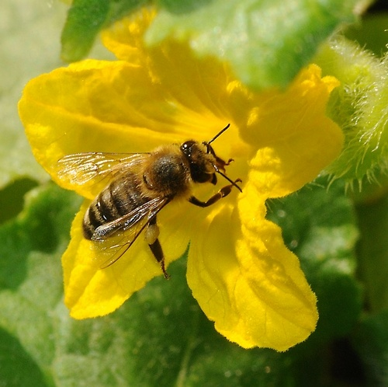
Pollination
Kathy Keatley Garvey
Notes:
Besides making honey, bees pollinate many fruits and vegetables that we eat. This is a picture of a bee pollinating cucumbers.
Pollination happens when the pollen from the anther (male part) is transferred to the stigma(female part) of the same or another flower.
In the case of the honey bee, her fuzzy body attracts lots of pollen.
When she goes from flower to flower she drinks the nectar and collects pollen and transfers the pollen in the process.
(Note the pollen in the pollen sacs )

Slide 17
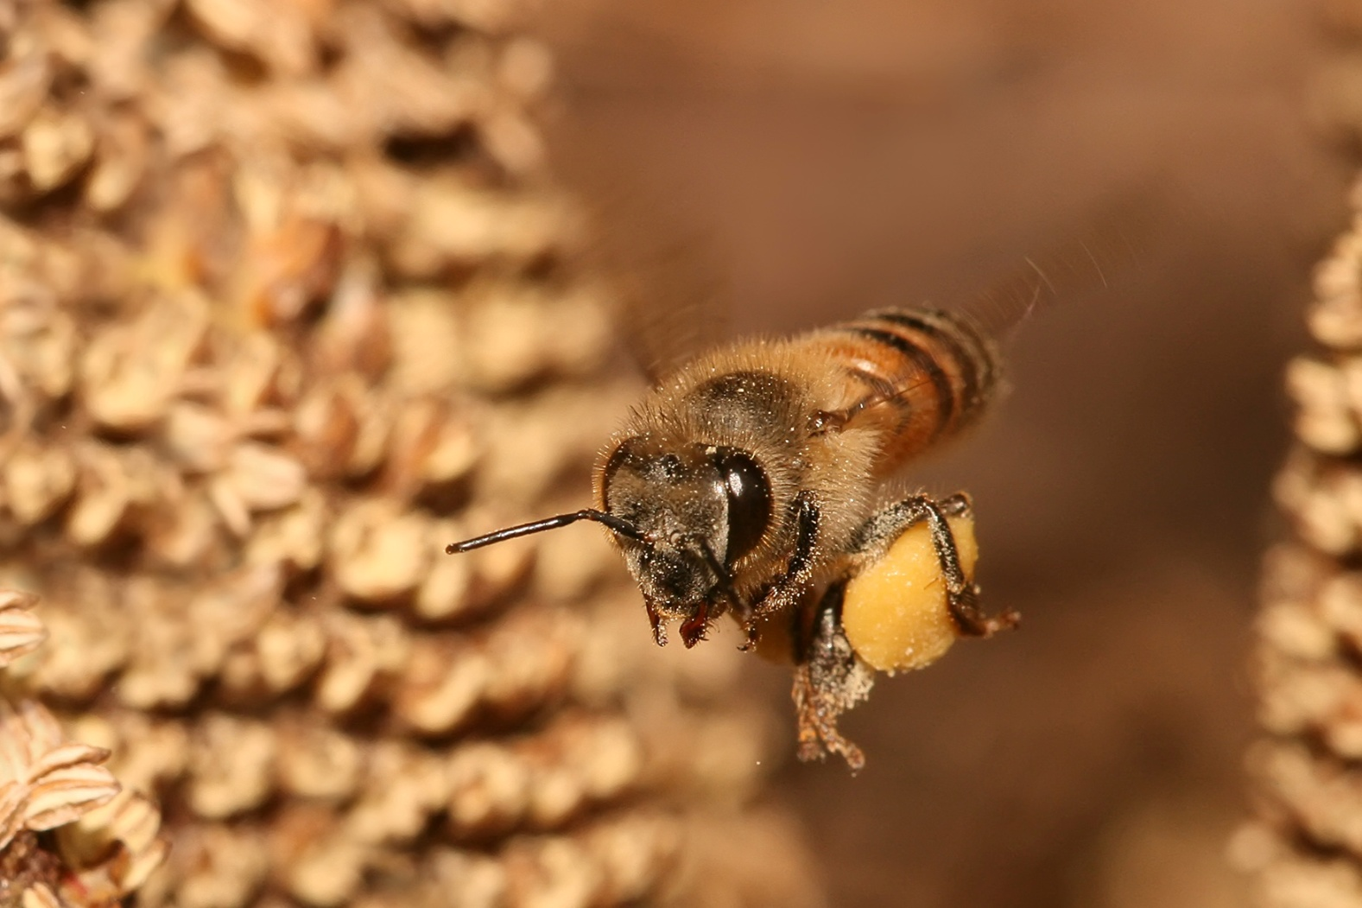
Benefits of Pollination
Muhammad Mahdi Karim
Notes:
Here is a bee returning to the hive with a load of pollen carried in her pollen sacs. Pollen sacs are sometimes called pollen baskets, they are stiff hairs on the back of their legs where they collect and carry pollen.
One third of foods eaten by humans is benefited by insect pollination.
Bees pollinate many foods, examples of nuts they pollinate are almonds and cashews; examples of fruits and vegetables are apples, blueberries, watermelons, zucchinis, pumpkins, and they even add spice to our life by pollinating nutmeg and allspice.

Slide 18
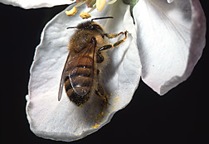
Pollination In Maryland
Jack Dykinga
Notes:
According to the United States Department of Agriculture over $26 million dollars of agricultural produce are attributed to the honey bee pollination in Maryland.
The most valuable crops for Maryland are apples, peaches, soybeans, cantaloupes, cucumbers and watermelon.
This is a bee on an apple blossom

Slide 19
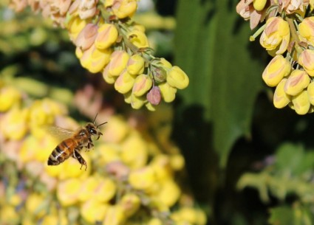
Flowers As A Food Source
Notes:
Flowers and bees have been evolving so that each depends on each other for survival.
The nectar of the bee is the bee’s carbohydrate or energy drink.
The pollen is the bee’s protein or hamburger.

Slide 20
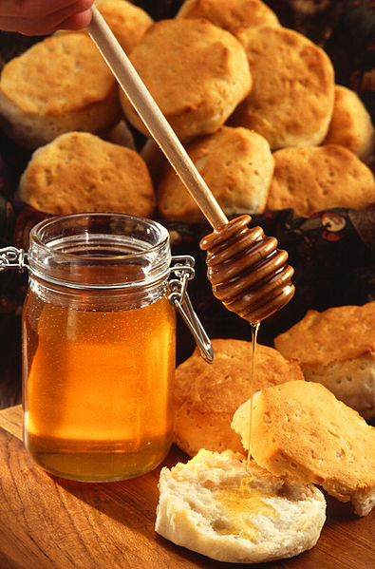
Honey
Notes:
Honey production is another reason we should care about our bees.
Honey has been used as a medicine for thousands of years.
It helps people with allergies and recently found to be as effective as cough syrup for children.
It is also used in makeup, medicines and soaps.
Most importantly it just tastes real good. Some people call it liquid gold.
More than 100,000 pounds of honey are produced by Maryland beekeepers annually. Honey is produced both in the country and the city.

Slide 21
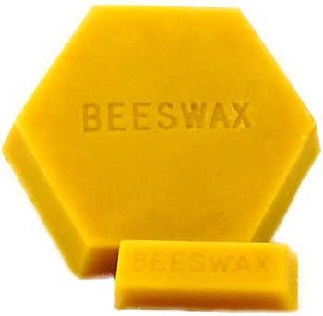
Beeswax
Notes:
Bees wax may be more important than the honey.
It is the best wax for candles, burning more slowly and creating less smoke.
It is used in medicines, makeup, soaps, crayons, floor and furniture polish.

Slide 22
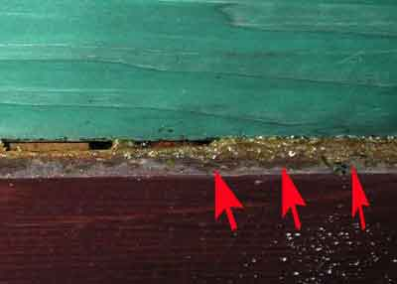
Propolis
akarlovic
Notes:
Propolis is another product made in the hive, it is often called bee glue.
The bees make propolis from tree resins that they collect from leaf buds and tree sap. The bees mix the resin with honey and wax. Chewing on it they add enzymes from their stomachs to turn it into this useful product propolis.
It has been found to have antibacterial properties. It bolsters the colony health acting as a natural disinfectant.
Scientists are studying propolis to see what health benefits for humans it might have.

Slide 23
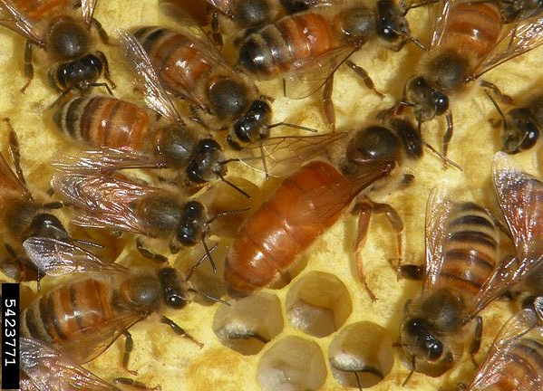
What Makes Up A colony?
Jessica Lawrence, Eurofins Agroscience Services, Bugwood.org
Notes:
In this picture you can see worker bees and the queen bee laying eggs in the open cells.
There are 3 different bees in the honey bee colony, the queen the drone and the worker bees.
The Queen’s job is to lay eggs. She is the mother of the entire hive which can consist of 30 to 60 thousand bees.
She is the largest of the bees having a longer abdomen and a shiny thorax.
The Queen does not have pollen baskets on her legs.
She has a stinger which she uses to fight off other queens. She can sting multiple times without dying.

Slide 24
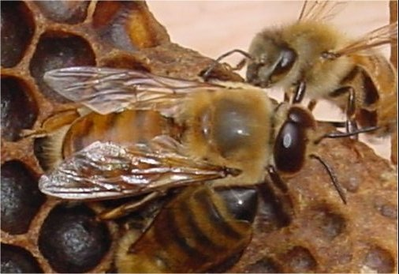
Drone
Notes:
Drones are the male bees. Drones are characterized by eyes that are twice the size of those of worker bees and queens
They are bigger than worker bees but smaller than the queen bee.
They do not have a long proboscis, another word for a tongue, to collect nectar to produce honey.
Drones do not have the capacity to sting.
Their purpose is to mate with other queens from other hives.

Slide 25
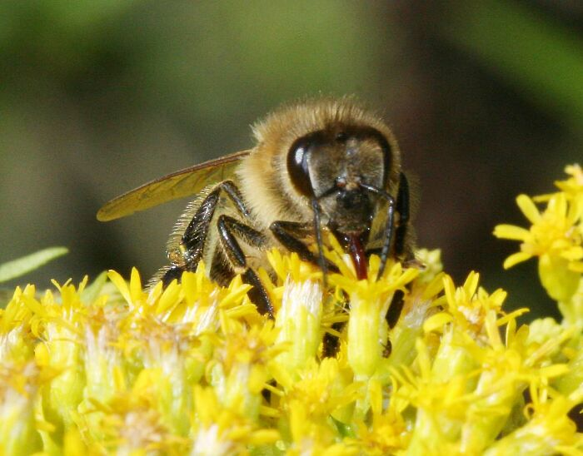
Worker bee
Frank Mikley
Notes:
The workers are the smallest of the honey bees.
They have a long proboscis or tongue used to suck up nectar from flowers.
Worker bees hind legs are fringed with stiff hairs that form pollen baskets.
Workers have a stinger and a venom gland at the tip of their abdomen.
They can only sting once because their stingers and internal organs are pulled out when they sting and then they die.
The Queen’s only job is to lay eggs, the drone’s job is to mate. The worker bee does all the work!

Slide 26
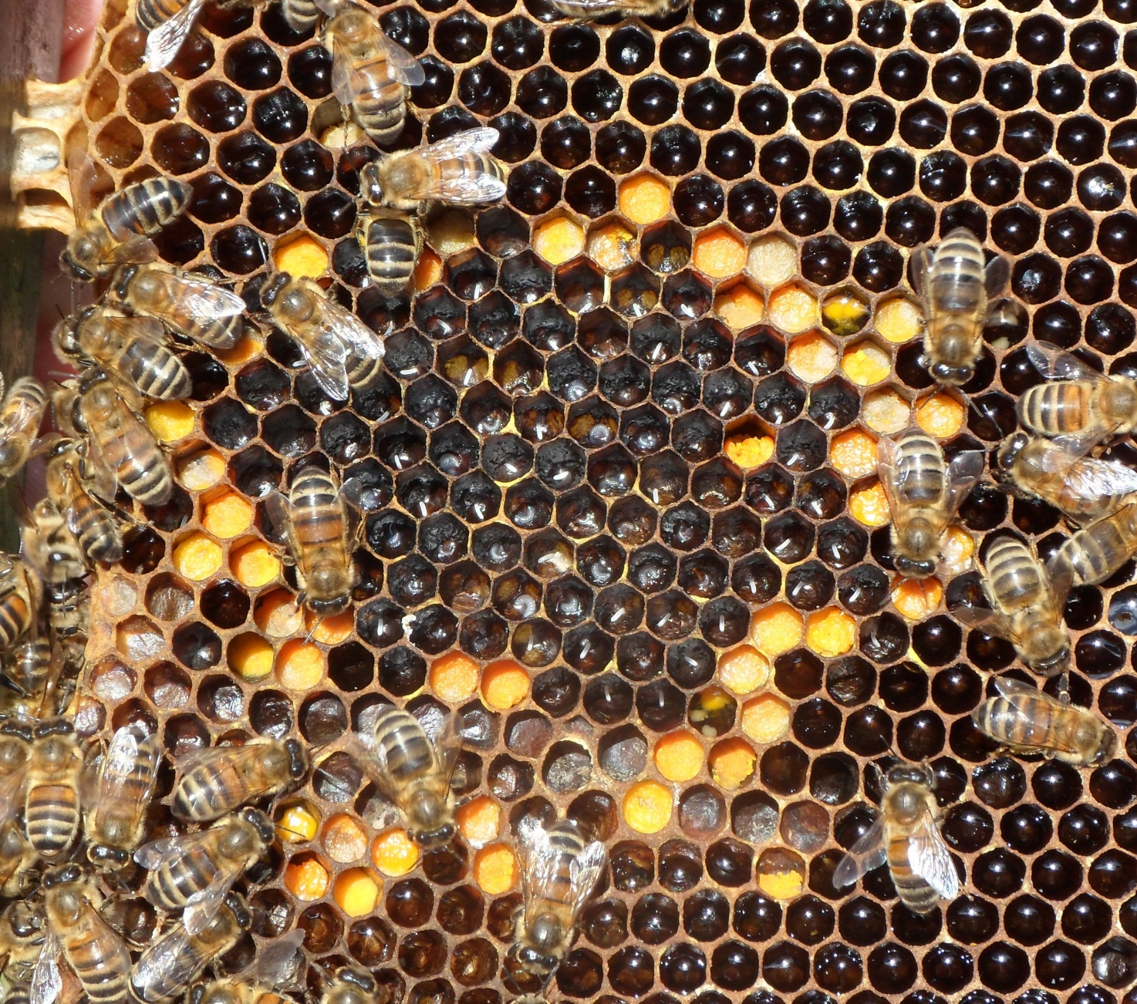
House Bees
Roland Prakel
Notes:
For the first three weeks of her adult life, a worker bee performs chores inside the hive.
These bees are called house bees by beekeepers.
These young adults clean the hive, feed larvae, build wax cells, and make honey.
Each bee, guided by an inner clock, does certain chores as she reaches a certain age.

Slide 27
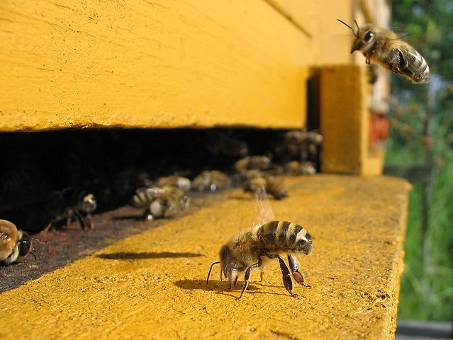
Roles Outside The Hive
Björn Appel,
Notes:
For the second half of the worker bee’s life, she works outside.
If the air is hot, her first task is to ventilate the hive by fanning her wings just outside the nest.
A honey bee’s wings flap over 183 times per second or 11,000 times per minute!
The worker’s next job is to stand guard outside the hive. Bees can recognize their hive mates by scent and will attack unfamiliar bees and other insects.
When a worker bee defends her colony against and stings an enemy, she gives off an alarm pheromone from a gland near her stinger to alert other bees.
The last role of the worker bee is that of forager, flying through fields, gardens, and orchards gathering food and supplies.

Slide 28
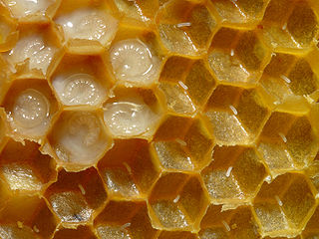
Life Cycle Of The Bee
Waugsberg
Notes:
All bees go thru 4 different stages to become an adult, egg, larvae, pupae and adult.
The queen lays an egg which hatches to become a larva.
Here you see the eggs on the right and the larva on the left.

Slide 29
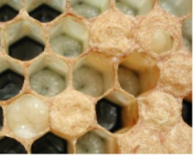
Pupa
Notes:
The pupa stage is also called the capped brood stage.
Nurse bees cover the larva with a wax capping.
The capped pupa is much like a butterfly, it spins a silk covering called a cocoon as it develops as a pupa. Think of this stage as similar to a chrysalis for a butterfly.
On the lower left is one about to pupate. On the upper right is one partially capped.

Slide 30
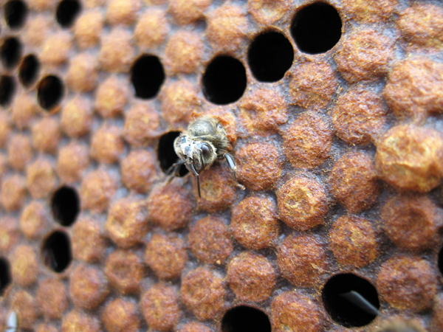
Young Bee
Notes:
The pupa becomes an adult which chews itself out of the cell. The first thing she does is to turn around and clean her cell.

Slide 31
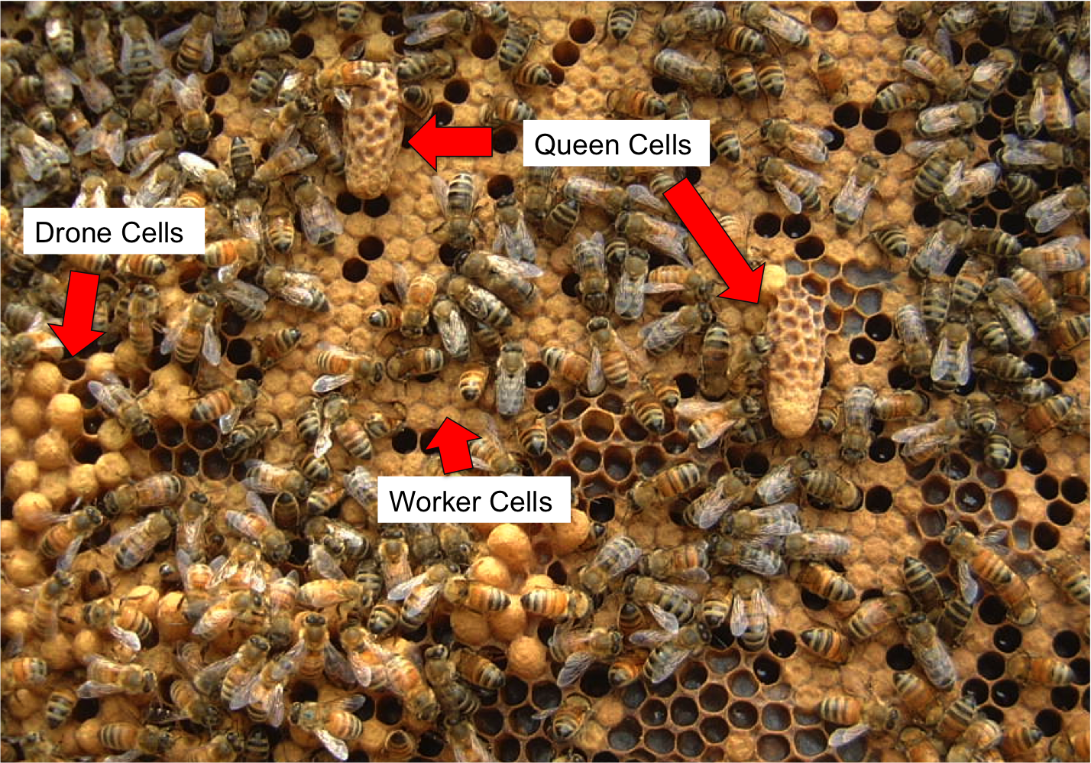
Types of Brood
Notes:
A queen is an adult in 16 days.
A worker is an adult in 21 days.
And a drone is an adult in 24 days.
The average life span of a bee born in the summer is 45 days.
On this slide you see 3 different types of brood or developing young. A beekeeper can tell what type of bee is developing by the shape of the brood cell.
The flat cells are worker cells, the domed cells are drones, and the long peanut looking cells are queen cells.
If you see queen cells in a hive it means one of two things.
The queen needs to be replaced because she is missing or becoming less productive, or the hive is way too crowded and some of the hive has to leave, or swarm.

Slide 32
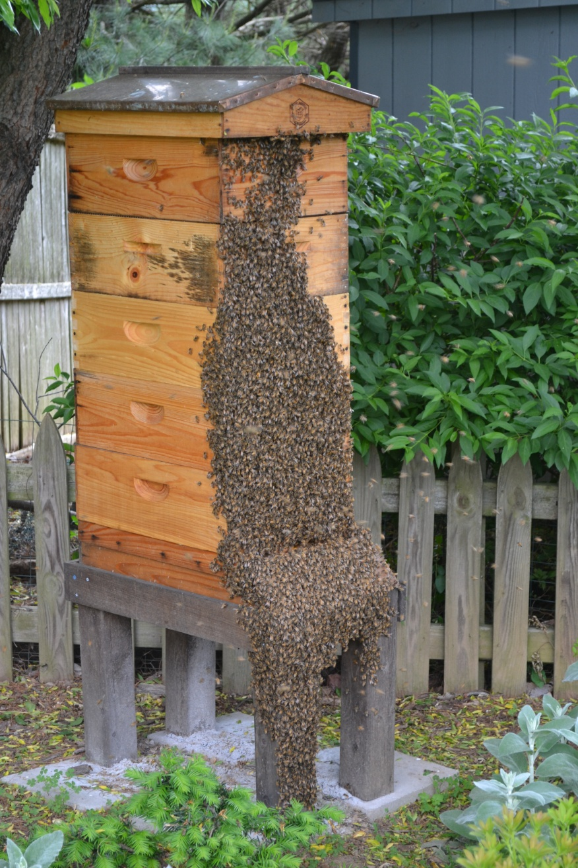
Swarms
McQueen
Notes:
A new honey bee colony is formed when the queen bee leaves the colony with a large group of worker bees a process called swarming.
The swarm can contain about 60% of the worker bees of the original hive and leave with the old queen.
This picture shows a hive just before it swarmed.

Slide 33
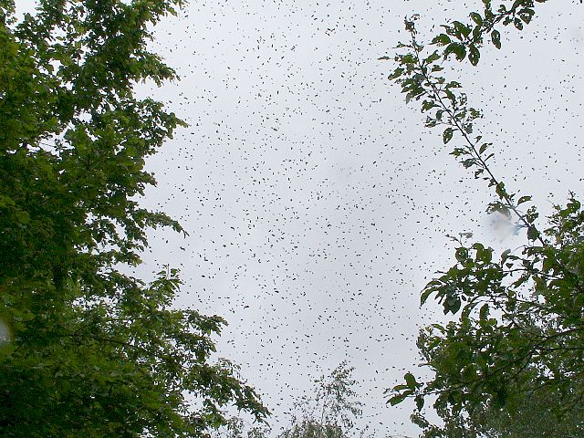
Swarming
Notes:
A swarm can contain thousands to tens of thousands of bees.
Swarming is mainly a spring phenomenon, but occasional swarms can happen throughout the producing season.
Swarming is the natural means of reproduction of honey bee colonies.

Slide 34
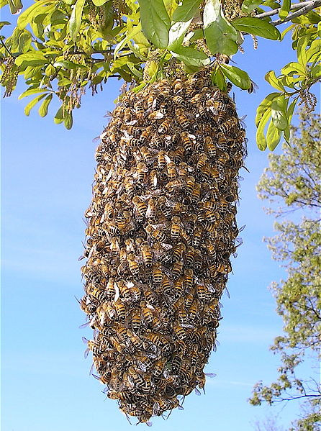
Swarm
Mark Osgatharp
Notes:
When a honey bee swarm emerges from a hive they do not fly far at first.
They may gather in a tree or on a branch only a few yards from the hive.
They form a cluster about the queen and send 20 - 50 scout bees out to find a suitable new nest locations.
The scout bees are the most experienced foragers in the cluster.
An individual scout returning to the cluster promotes a location she has found.
The beekeeper is left with a hive of diminished capability.
Beekeepers want to prevent swarming as it decreases their honey production.

Slide 35
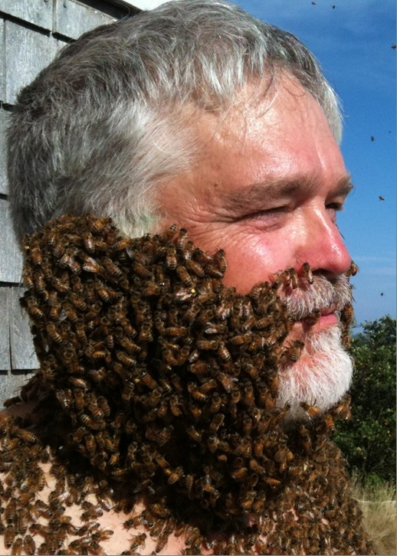
Stings
Visscher lab, UC Riverside
Notes:
A swarm of bees sometimes frightens people. This picture illustrates that bees do not sting unprovoked. Bees are usually not defensive at this stage of their life cycle when they are swarming.
This is principally due to the swarming bees' lack of brood (developing bees) to defend and their interest in finding a new nesting location for their queen.
This does not mean that bees from a swarm will not sting if they perceive a threat; however, most bees only sting in response to intrusions against their colony.
This trick to doing what is seen in this picture is done by creating an artificial swarm. The queen and bees are removed from the brood for a couple of days and fed a lot of sugar water. A small plastic vented vial with a queen inside is placed around a person’s neck.
The bees naturally cluster near and around the queen.

Slide 36
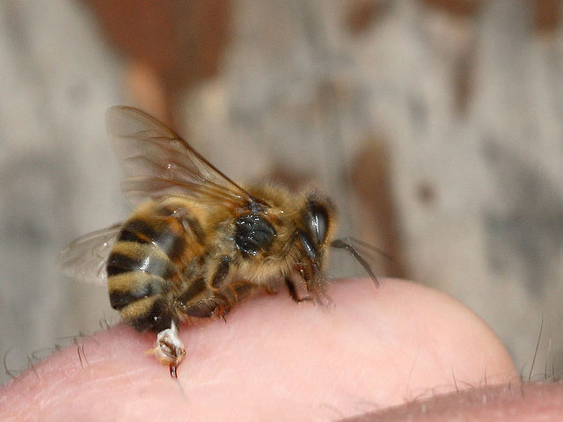
Bee Stinger
Waugsberg
Notes:
Workers have a stinger and a venom gland at the tip of their abdomen.
When a honey bee stings a person, it cannot pull the barbed stinger back out.
It leaves behind not only the stinger, but also part of its abdomen and digestive tract, plus muscles and nerves.
This massive abdominal rupture kills the honey bee.
Honey bees are the only species of bees to die after stinging.
A bee stings because she is defensive and is responding to a perceived threat.
The most aggressive stinging insect is a wasp. It can sting multiple times without loss of its life.

Slide 37
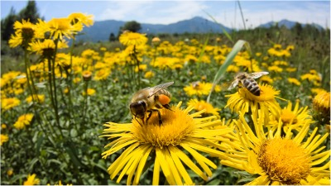
How Do Bees Make Honey?
Notes:
Worker bees visit over 2 million flowers to produce one pound of honey.
A honey bee makes 1/12 of a teaspoon of honey in her life time, or 36 bee life times to make one tablespoon of honey.
The field worker bee makes about ten trips a day, each one lasting about an hour.
She leaves the hive in the morning and returns from her last flight in the evening.
During these travels, the worker gathers not only nectar and pollen, but also water and propolis or bee glue.
.

Slide 38
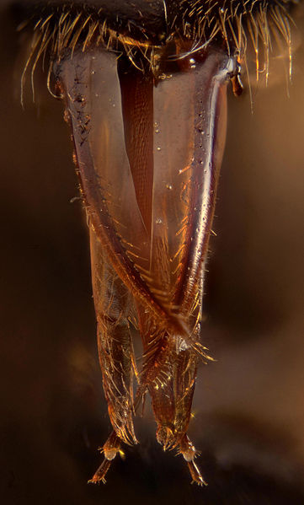
Proboscis
Notes:
Proboscis. The proboscis of the honey bee is simply a long, slender, hairy tongue that acts as a straw to bring liquid food that is nectar, honey and water to the mouth.
When in use, the tongue moves rapidly back and forth while the flexible tip performs a lapping motion.
After feeding, the proboscis folds into an area beneath the head so the mouthparts are not visible.
Bees can eat fine particles like pollen, which is used as a source of protein, but cannot handle big particles.

Slide 39
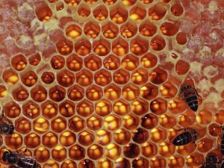
Honey Storage
Notes:
Worker bees get nectar from flowers. The nectar is transferred to their honey stomachs where enzymes cause it to thicken somewhat. The honey is transferred from the foraging bee to the house bee where this second bee adds enzymes to make the nectar more nutritious for the bees and us.
The honey is deposited into the honeycomb of the hive. Bees in the hive fan their wings making a breeze that flows over the nectar in the open cells. This causes the water to evaporate and it ripens into what we can eat. The bees know when there is less than 18.6 % water and the nectar has ripened into honey. Then and only then do bees cover it with a wax capping.
Notice the wax cells in the corner and nectar in the other cells.

Slide 40
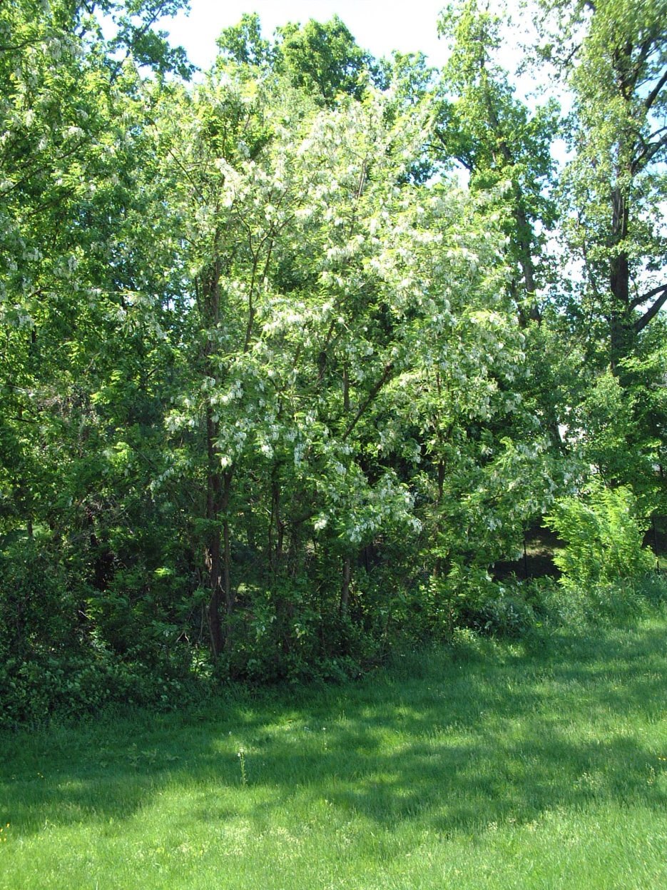
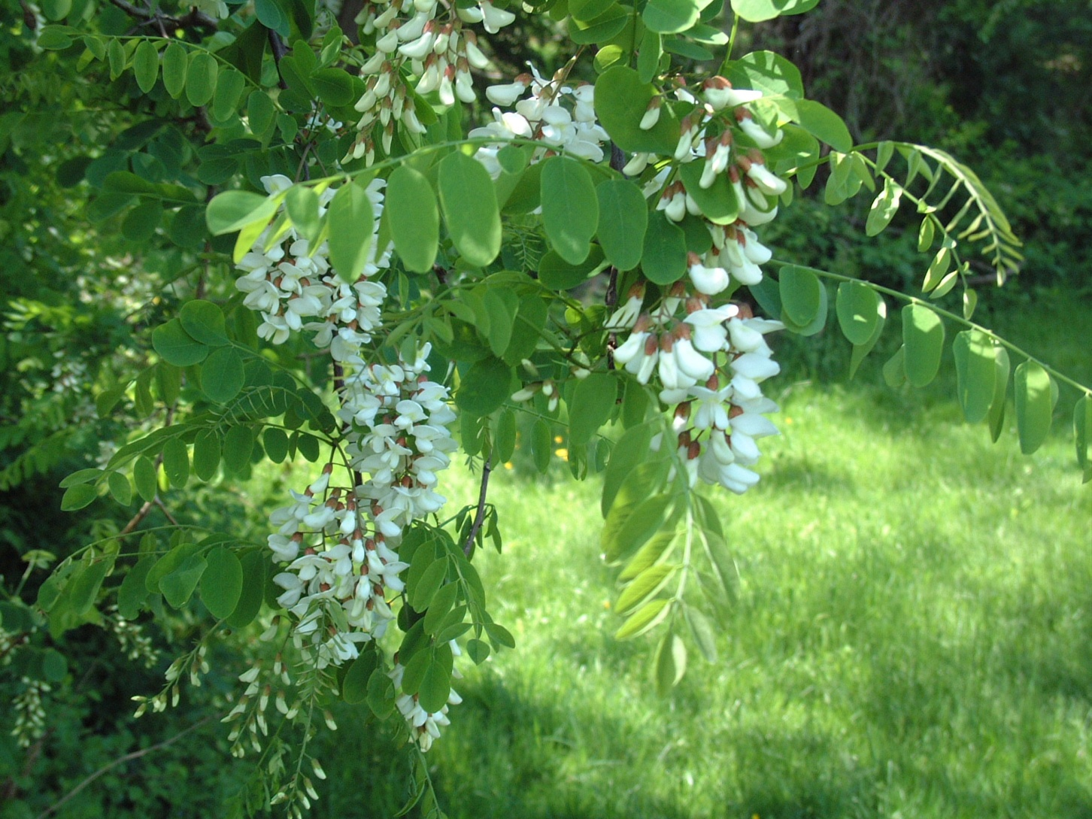
Nectar Sources
Richard Perry
Notes:
The color and the flavor of honey is determined by the flowers visited by the bees.
Common nectar sources for our area are trees.
These are pictures of a black locust blossom and tree.
This tree blooms for a short period in April or May.

Slide 41
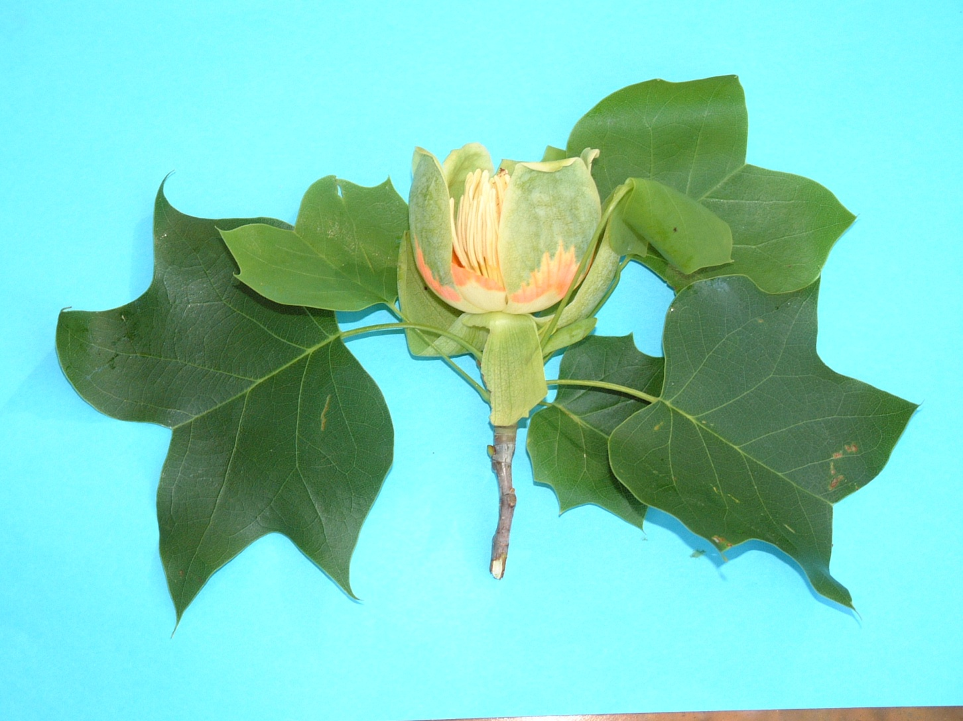
Tulip Tree
Richard Perry
Notes:
Tulip tree is another tree nectar source.
Wildflowers especially clover is another nectar source in Montgomery County.

Slide 42

Waggle Dance
Notes:
Here is a video that shows how bees communicate where new nectar sources are located.
( Click on Box , if sound system is not available here is the text to go with the video)
Honey bees have some fascinating abilities, among them being able to communicate by performing a unique dance. It informs hive mates where a newly discovered food source is located. Every cycle of this waggle dance roughly describes the shape of a figure 8. Let’s rewind and look in more detail. The bee only waggles on a part of its route the straight run indicated here by the waved line. The secret lies in the direction of the straight of the run or to be more precise in the angle between the straight run and the perpendicular which in this case is 90 degrees to the left. This tells the other bees that the food is available 90 degrees to the left of the sun. If the angle is 60 degrees to the right they will be flying 60 degrees to the right of the sun.

Slide 43
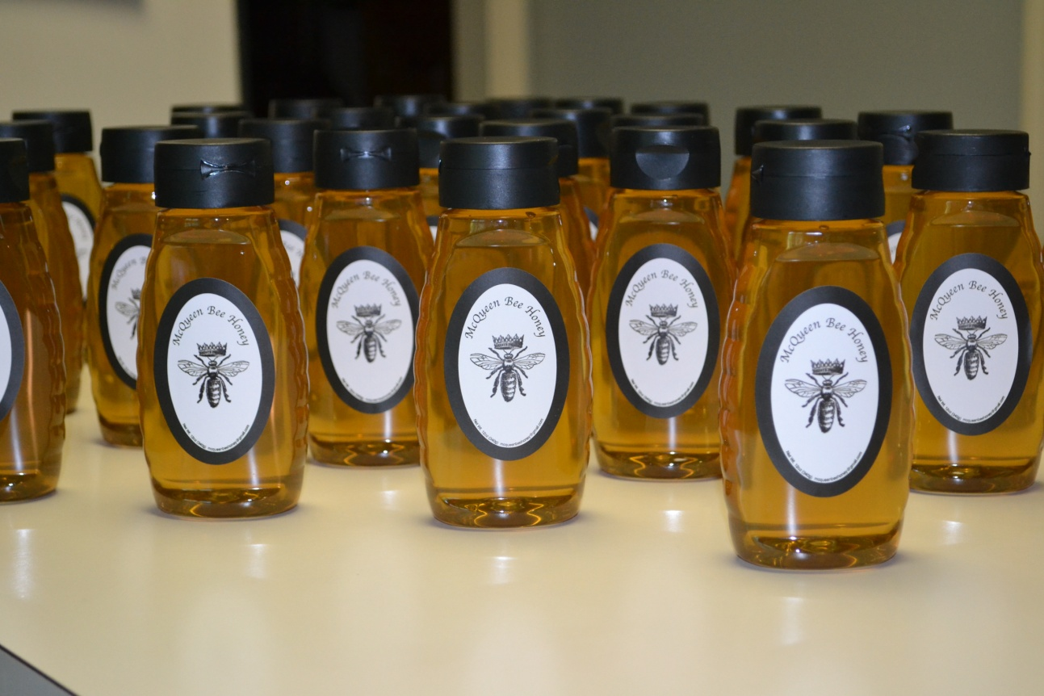
Extraction
How do we get the honey from hive to bottle?
McQueen
Notes:
Extraction is another word for harvesting honey. Today we will explain how a non commercial beekeeper, that is a hobbyist, extracts honey.

Slide 44
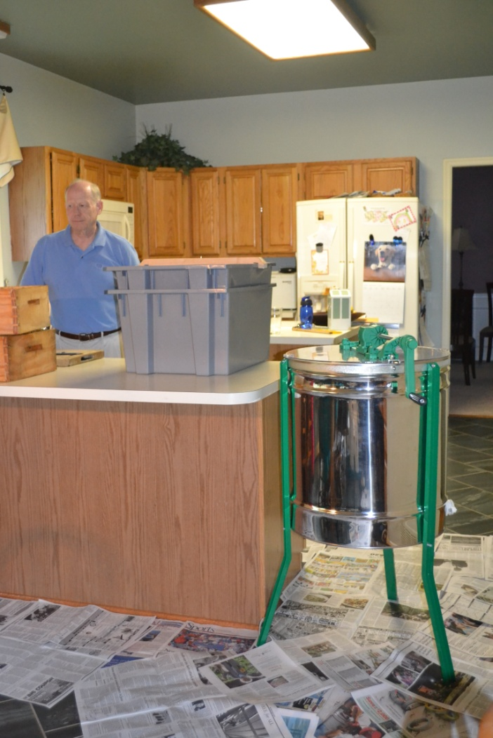
Extraction Equipment
McQueen
Notes:
Most backyard beekeepers extract the honey in their kitchens. All the equipment seen here is owned by the Montgomery Beekeepers Association and is loaned for the price of membership.
Because this is sticky business, newspaper on the floor is a good idea.
The Extractor is the shiny metal drum on legs.
The capping tray is the gray plastic bin on the counter, note that it has two levels.

Slide 45
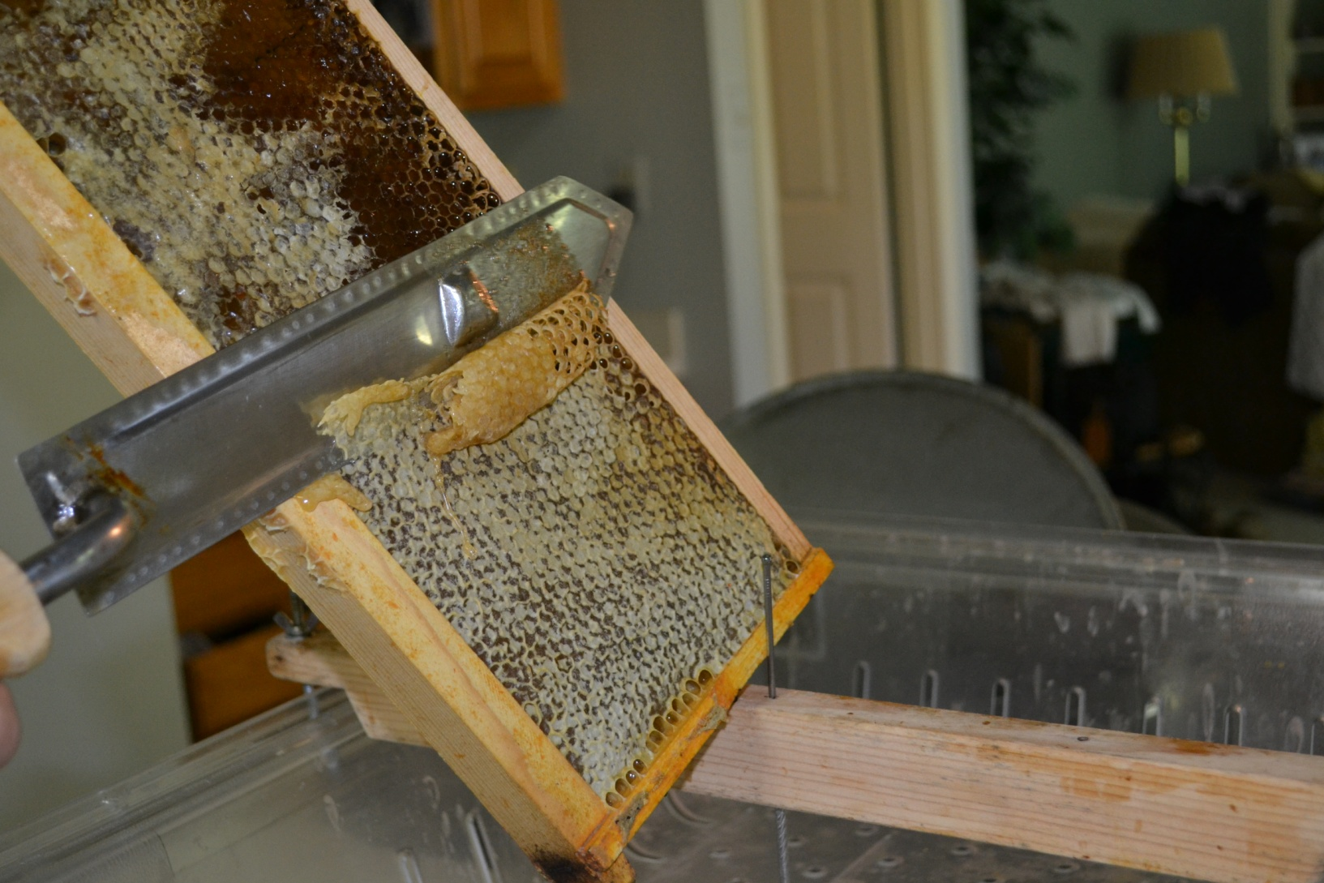
Wax Capping Removal
McQueen
Notes:
Beekeepers first remove the wax cappings to extract the honey.
Here a warm electric knife made for just this purpose is being used.
The wax cappings fall into the capping tray on the first level.
The honey connected to the wax drips through the slots and is collected in the lower level.
Nothing is wasted. The wax is kept for lip balm, soaps and candle making.

Slide 46
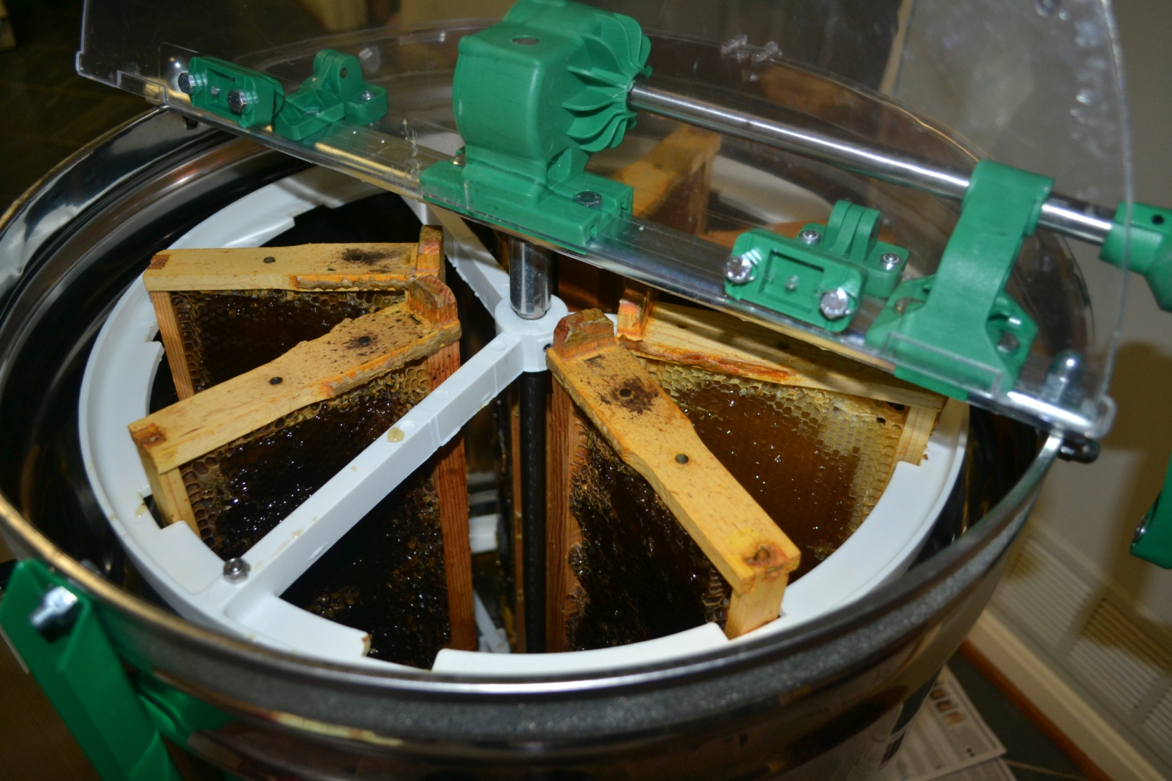
Extractor
McQueen
Notes:
The frames minus the wax coverings are then added to the extractor.

Slide 47
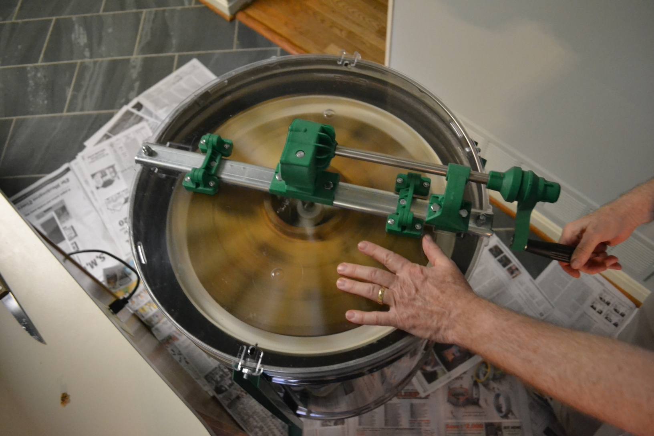
Centrifugal Force
McQueen
Notes:
Turning the hand crank spins the frames.
By centrifugal force the honey is released from the comb.

Slide 48
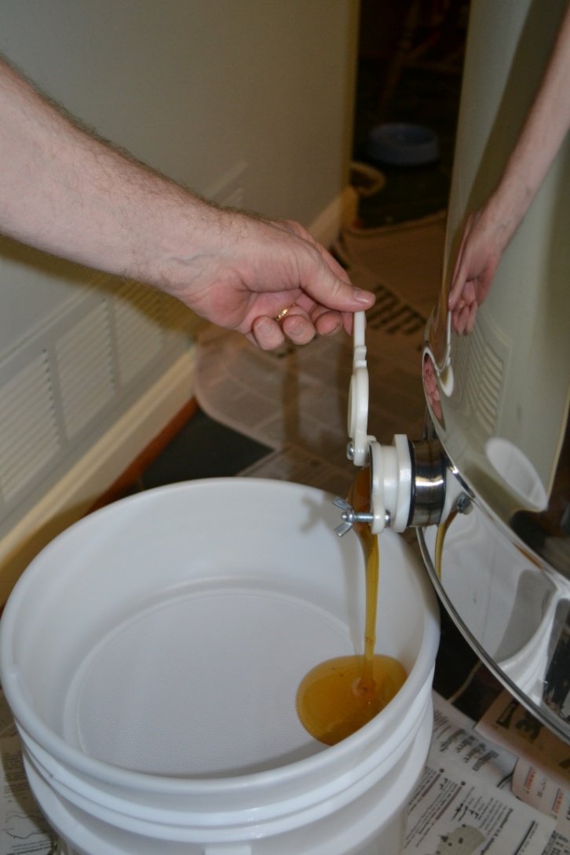
Filter
McQueen
Notes:
The honey is released through a valve at the bottom of the extractor called a honey gate.
It is then strained with a series of filters before it is bottled.

Slide 49
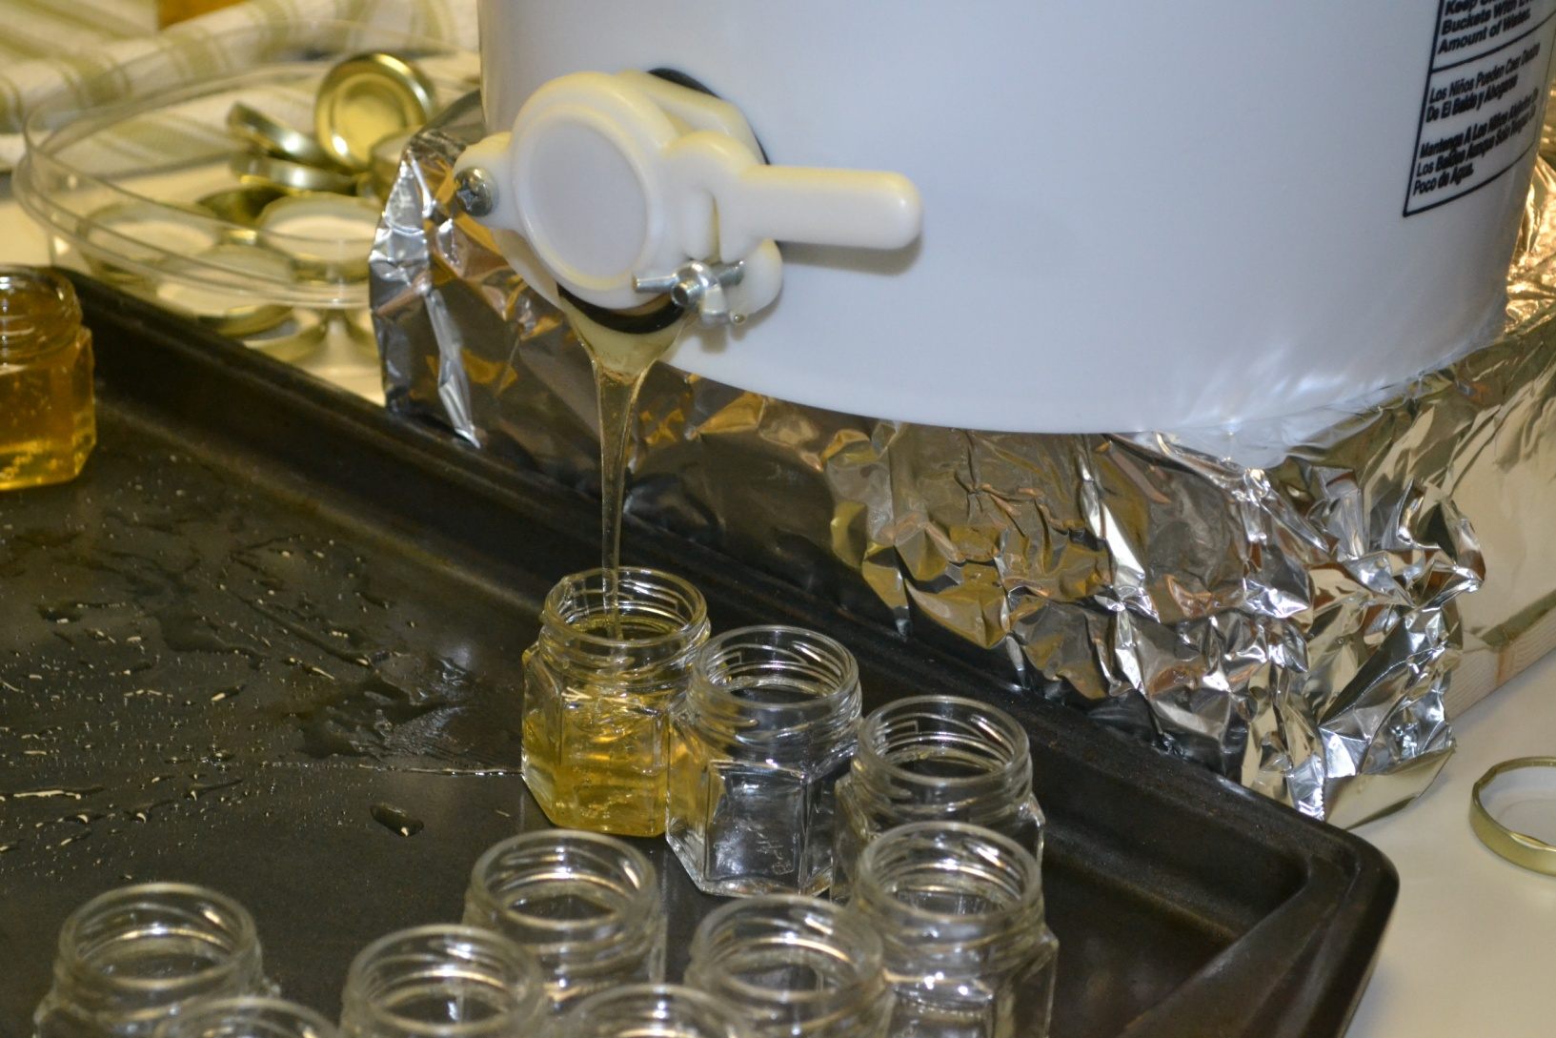
Bottling
McQueen
Notes:
Once the honey is strained it can then be bottled.

Slide 50
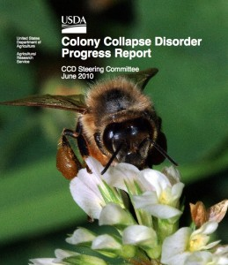
What is Happening To The Bees?
Notes:
According to the US Department of Agricultural Research in October 2006, some beekeepers began reporting losses of 30-90 percent of their hives. While colony losses are not unexpected, especially over the winter, this magnitude of losses was unusually high. Scientists named this phenomenon Colony Collapse Disorder, or CCD.
CCD is a mysterious phenomenon characterized by adult bees abandoning the hive, flying off and leaving behind the queen bee, brood and stored food.
Honey bees do not naturally abandon their young which make their disappearance all the more puzzling
Another mystery is that other insects appear to stay away from the hive for a few days before robbing the food stores. Usually other insects will rob unattended food stores quickly.

Slide 51
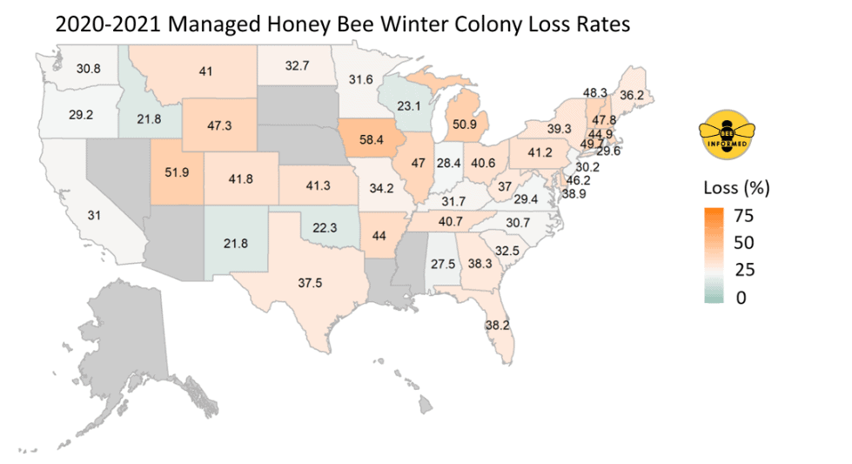
Bee Informed Partnership
Notes:
Honeybees are no longer disappearing suddenly and mysteriously. They’re dying persistently, in plain sight.
The Bee Informed Partnership works in collaboration with the Apiary Inspectors of America (AIA) ,the United States Department of Agriculture (USDA) and with beekeepers to collect and analyze colony loss across the United States.
Over the entire year (1 April 2020 – 1 April 2021), beekeepers in the United States lost an estimated 45.5% of their managed honey bee colonies. Over the last 10 years the average has been 39.4 % loss

Slide 52
Bee Informed Partnership
Notes:
Bee Informed Partnership has been collecting data since 2008.
On this graph the calendar years are shown on the X axis and the percentage of colony loss is on the Y axis. Initially in 2008 only the winter losses were recorded. I would like to focus only on the annual loss rate the red bars.
Colony losses of 15% are an acceptable range. Thirty years ago this was the average colony loss per year. What has happened since 2006 have been much greater.
Annual colony loss has fluctuated over the last 10 years, but the average is 39.4%. If losses continue at the 30 percent level or higher, it could threaten the economic viability of the bee pollination industry.
Honey bees would not disappear entirely, but the cost of honey bee pollination services would increase, and those increased costs would ultimately be passed on to consumers through higher food costs.

Slide 53
What Are Possible
Causes For CCD And Colony Loss?
Flowerless Landscapes
Pesticides
Parasites
Monoculture
Notes:
Not one single answer has been identified but there may be a combination of causes attributing to the loss of honey bee colonies.
Possible causes are environmental stresses, pesticides, parasites, and management stressors. It could be a perfect storm of a multiple of these factors decreasing the immunity of the honey bee and causing them to disappear.
Let’s look at these closer.

Slide 54

Flowerless Landscapes
David Stowell
Notes:
One cause for this loss may be our change in farming practices. After World War II we no longer used cover crops like clover and alfalfa crops as nitrogen fixing plants to amend the soil. We started using synthetic fertilizers to give our plants nitrogen. Clover and alfalfa are great nutritional sources for our bees. By managing our farms like this we have taken away nutritional resources for our bees.
Habitat loss through urban and rural development means areas once bloomed with a variety of nectar and pollen sources are now covered with flower free lawns. This will stress the bees with pollen and nectar scarcity and lack of diversity. This could lead to low nutritional value and have a negative effect on the bee’s overall health.
After 1945 we also started killing off weeds which created a feast for pests. We created even more pesticides to combat these pests. These chemicals kill the pests but created yet another concern for our honey bees.

Slide 55
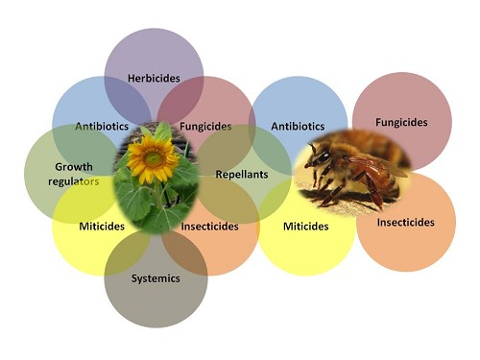
Pesticides
Ohio State University
Notes:
Accidental or intentional exposure to pesticides and other chemicals at lethal or sub-lethal levels affect our bees. One theory is that the toxins in the pesticides could act on the bee’s nervous system and may disorient them or even kill them.

Slide 56
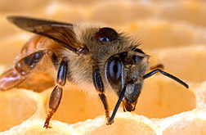
Parasites
Notes:
Varroa mites are a virus-transmitting parasite of honey bees and have frequently been found in hives hit by CCD.
A mite is seen on this bee in the picture on her back. In proportion to her body it would be like having a dinner plate stuck on your back.
The mite is a parasite that feeds on the fat bodies of the bee. Viruses are introduced by the mites and weakens the bee’s overall health.

Slide 57
Time Lapse of Bee Development
Notes:
Here is an amazing video showing a bee’s development from egg to maturity.
Notice the tiny mite growing on the bees body.

Slide 58
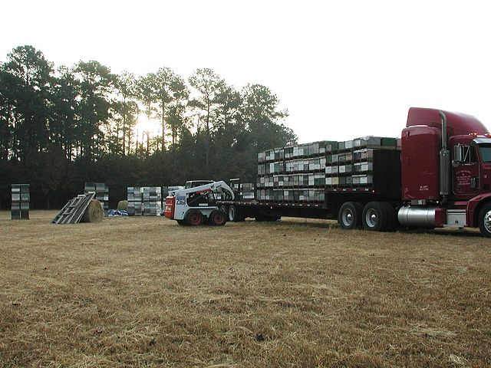
Monoculture
pollinator
Notes:
Farms are increasingly producing one crop. An example of this is almond groves.
1.5 million hives are transported each year to pollinate almond crops. This is over half of all hives (2.7 million) found in the United States.
Almond blossoms are a great source of protein for our bees, but when the almond crop is done flowering the hives must be transported as what remains is a dessert landscape for our bees.
This migration and apiary crowding necessary to transport the bees causes stress and may add to colony loss.

Slide 59
What Can You Do To Help ?
Plant habitat for pollinators
https://xerces.org/publications/plant-lists/pollinator-plants-mid-atlantic-region
Incorporate Integrated Pest Management in your
Home and Garden https://www.canr.msu.edu/ipm/ipm_for_homeowners
Buy local honey
www.mdbeekeepers.org/clubs.html
Keep bees!
https://montgomerycountybeekeepers.com/
Notes:
There is hope for our bees. It is not too late. Each of you can make a difference for our bees by doing two simple things, plant more flowers and use fewer pesticides. Plant habitat for pollinators. Information is readily available on line at the web site provided. Be sure to plant non invasive species
Follow the label carefully for pesticide application. Better yet avoid applying them altogether or use Integrated Pest Management. University of Michigan has a wonderful website that can answer a multitude of questions about pests in your home and garden
Purchase local honey to support local beekeepers. To see what farmers markets offer honey visit the web site provided. This website also lists beekeeping clubs in Maryland if you wish to become a beekeeper.
We welcome you to join the Montgomery County Beekeepers Association. We offer a short course every spring and offer meetings most 2nd Wed. of the month usually at the Agricultural History Farm Park in Derwood. Our web site is listed f under Keep Bees.

Slide 60

Questions?
Peggy Greb
Notes:
Thank you so much for having me here today.
I hope you have a greater understanding of the honey bee and how important it is in our environment today.
Some say the honey bee is our modern day canary in the mine.
It is our sentinel warning that something or things may be a hazard to us and our environment.
We just need to listen to the buzz a little more carefully.

